Slide 1
Sea Floor Bathymetry Trackline Surface Fitting Without Visible Artifacts Using ODETLAP
Tsz-Yam Lau, You Li, Zhongyi Xie, W. Randolph Franklin
Rensselaer Polytechnic Institute
Troy, NY, USA
ACM SIGSPATIAL GIS 2009, Seattle

Slide 2
Current methods inadequate
Ship Tracklines
Inverse Distance Weighting

Slide 3
Current methods inadequate
Ship Tracklines
Kriging

Slide 4
Current methods inadequate
Ship Tracklines
Voronoi

Slide 5
Current methods inadequate
Ship Tracklines
Linear SPLINE

Slide 6
Current methods inadequate
Ship Tracklines
QUADRATIC SPLINE

Slide 7
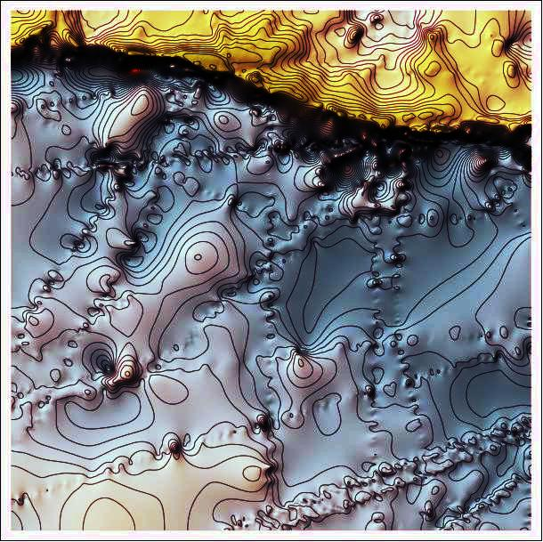
Solution: ODETLAP
Sparse overdetermined linear system.
R trades accuracy vs smoothness.
Limited precision data:
Too many resulting surface details not valid, but people like details.
R=1

Slide 8
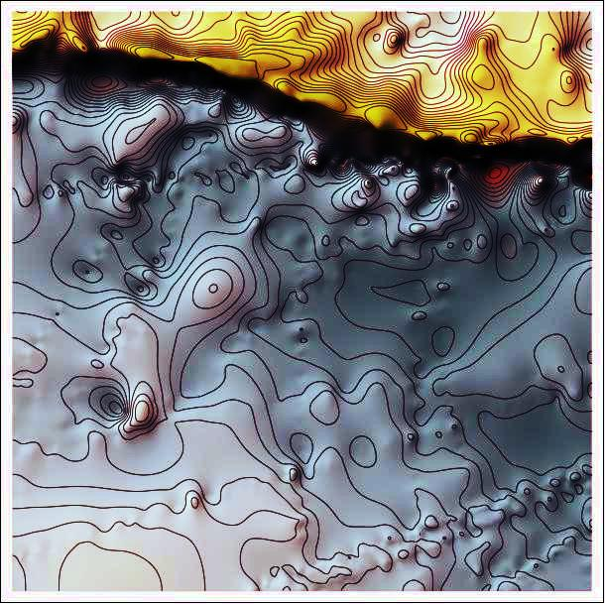
Solution: ODETLAP
Sparse overdetermined linear system.
R trades accuracy vs smoothness.
Limited precision data:
Too many resulting surface details not valid, but people like details.
R=5

Slide 9
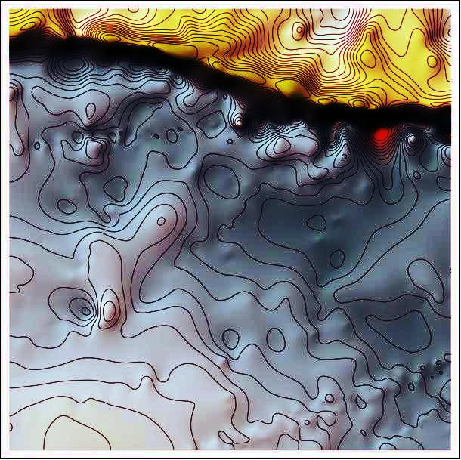
Solution: ODETLAP
Sparse overdetermined linear system.
R trades accuracy vs smoothness.
Limited precision data:
Too many resulting surface details not valid, but people like details.
R=10

Slide 10
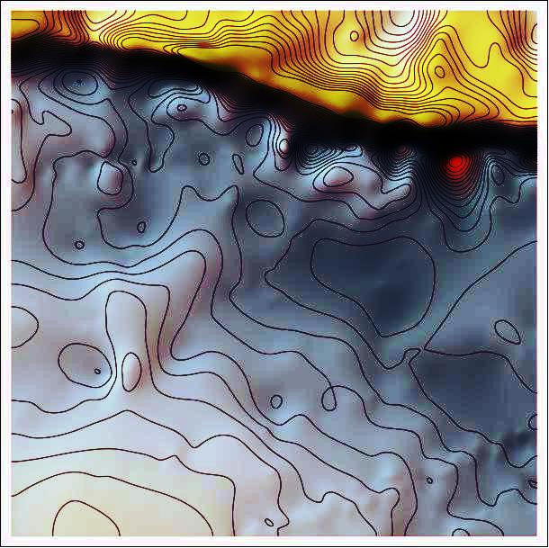
Solution: ODETLAP
Sparse overdetermined linear system.
R trades accuracy vs smoothness.
Limited precision data:
Too many resulting surface details not valid, but people like details.
R=20

Slide 11
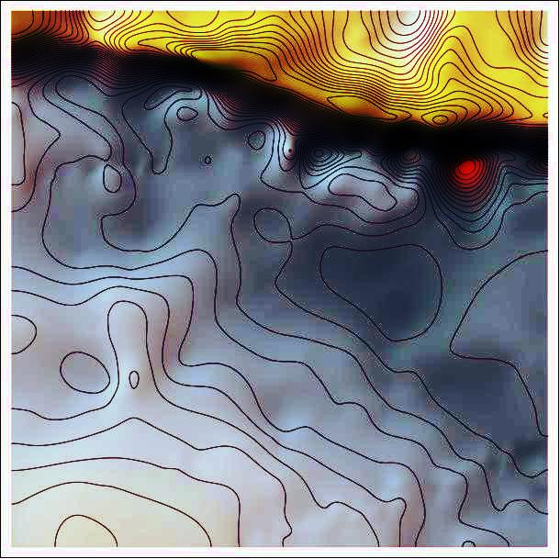
Solution: ODETLAP
Sparse overdetermined linear system.
R trades accuracy vs smoothness.
Limited precision data:
Too many resulting surface details not valid, but people like details.
R=30

Slide 12
ODETLAP with variable R
Problem of the closest known points being widely varying distance away
Solution: weight equations for different points differently
Surface shows details with fewer artifacts.

