Slide 1
Wildlife Conservation using Autonomous Drones
Paul Aarseth and Jeremy Bensley - Vulcan Inc.

Slide 2
Our Challenge
Game Reserves and National Parks are large
Poaching activities require little time
Manpower is sparse
Technology solutions are typically costly

Slide 3
Autonomy
The team at Vulcan Inc. is developing an autonomous UAV solution for wildlife conservation
  User assigns region of interest / search area
  UAV is capable of autonomously identifying objects on the ground
    Animals (Elephants, Cattle, Horses, etc)
    People
    Man-made structures (tents, fire)
    Vehicles (cars, canoes)
  Onboard intelligence determines how to respond to a positive classification
  Return to launch point and land

Slide 4
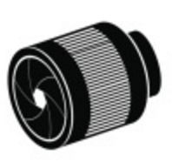
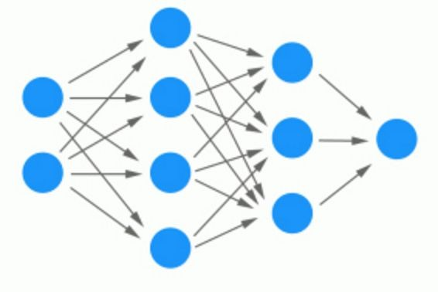

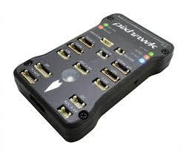
Autonomy
What sets our approach apart is having onboard intelligence
  GPU processors running a neural network computer vision model
  Flight Director (Intelligent system software) running on-board verifies the vision model classifications
  After a verified classification Flight Director decides next action
  Flight Director instructs the autopilot what to do next
Notes:
TX2-GPU

Slide 5
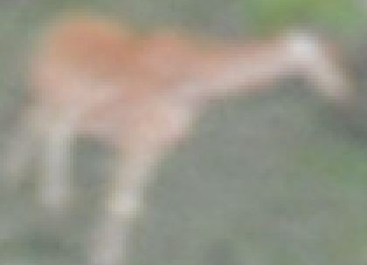
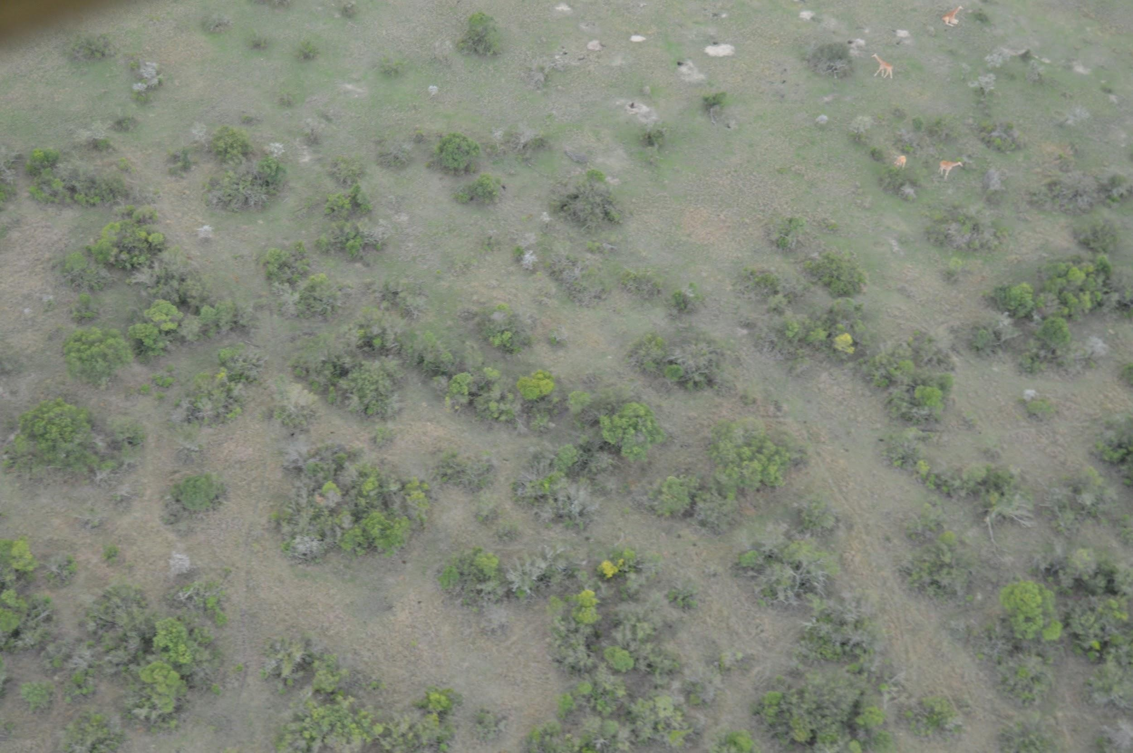
Small Object Detection
Our objects are very small and less defined
  .02% to .2% of the total image
75 px
1500 px
100 px
2000 px
Notes:
Standard object detection looks for large objects
PASCAL VOC1
Objects are 1.38% to 46.4% of the total image

Slide 6
Fully Convolutional Network
Based on NVIDIA Detectnet
  Detection and Classification concurrently
Resulting Heatmap

Slide 7
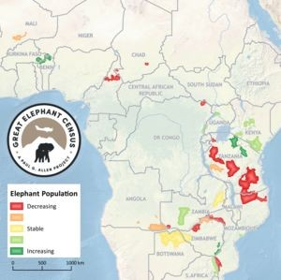
Training Data
11 different object classes
Training Data Sources
  Started with what we had
    Great Elephant Census
    Vulcan Productions
  Started adding our own images
    Quadcopter flights over Eastern Washington
    Test flights in Texas at an approved UAV facility
  Partnered with wildlife survey photographers
Annotate all target objects in the images

Slide 8
Data Challenges
More training data is always better
  NOT ALWAYS!
Significant performance boost when we restricted the images and annotations to locations of interest
  Image Recall went from 75% to 90%
  Image False Positive Rate went from 20% to 8%
Notes:
Removed the images from Washington because it was creating a ton of errors in detection. This was due to the terrains not being the same.

Slide 9
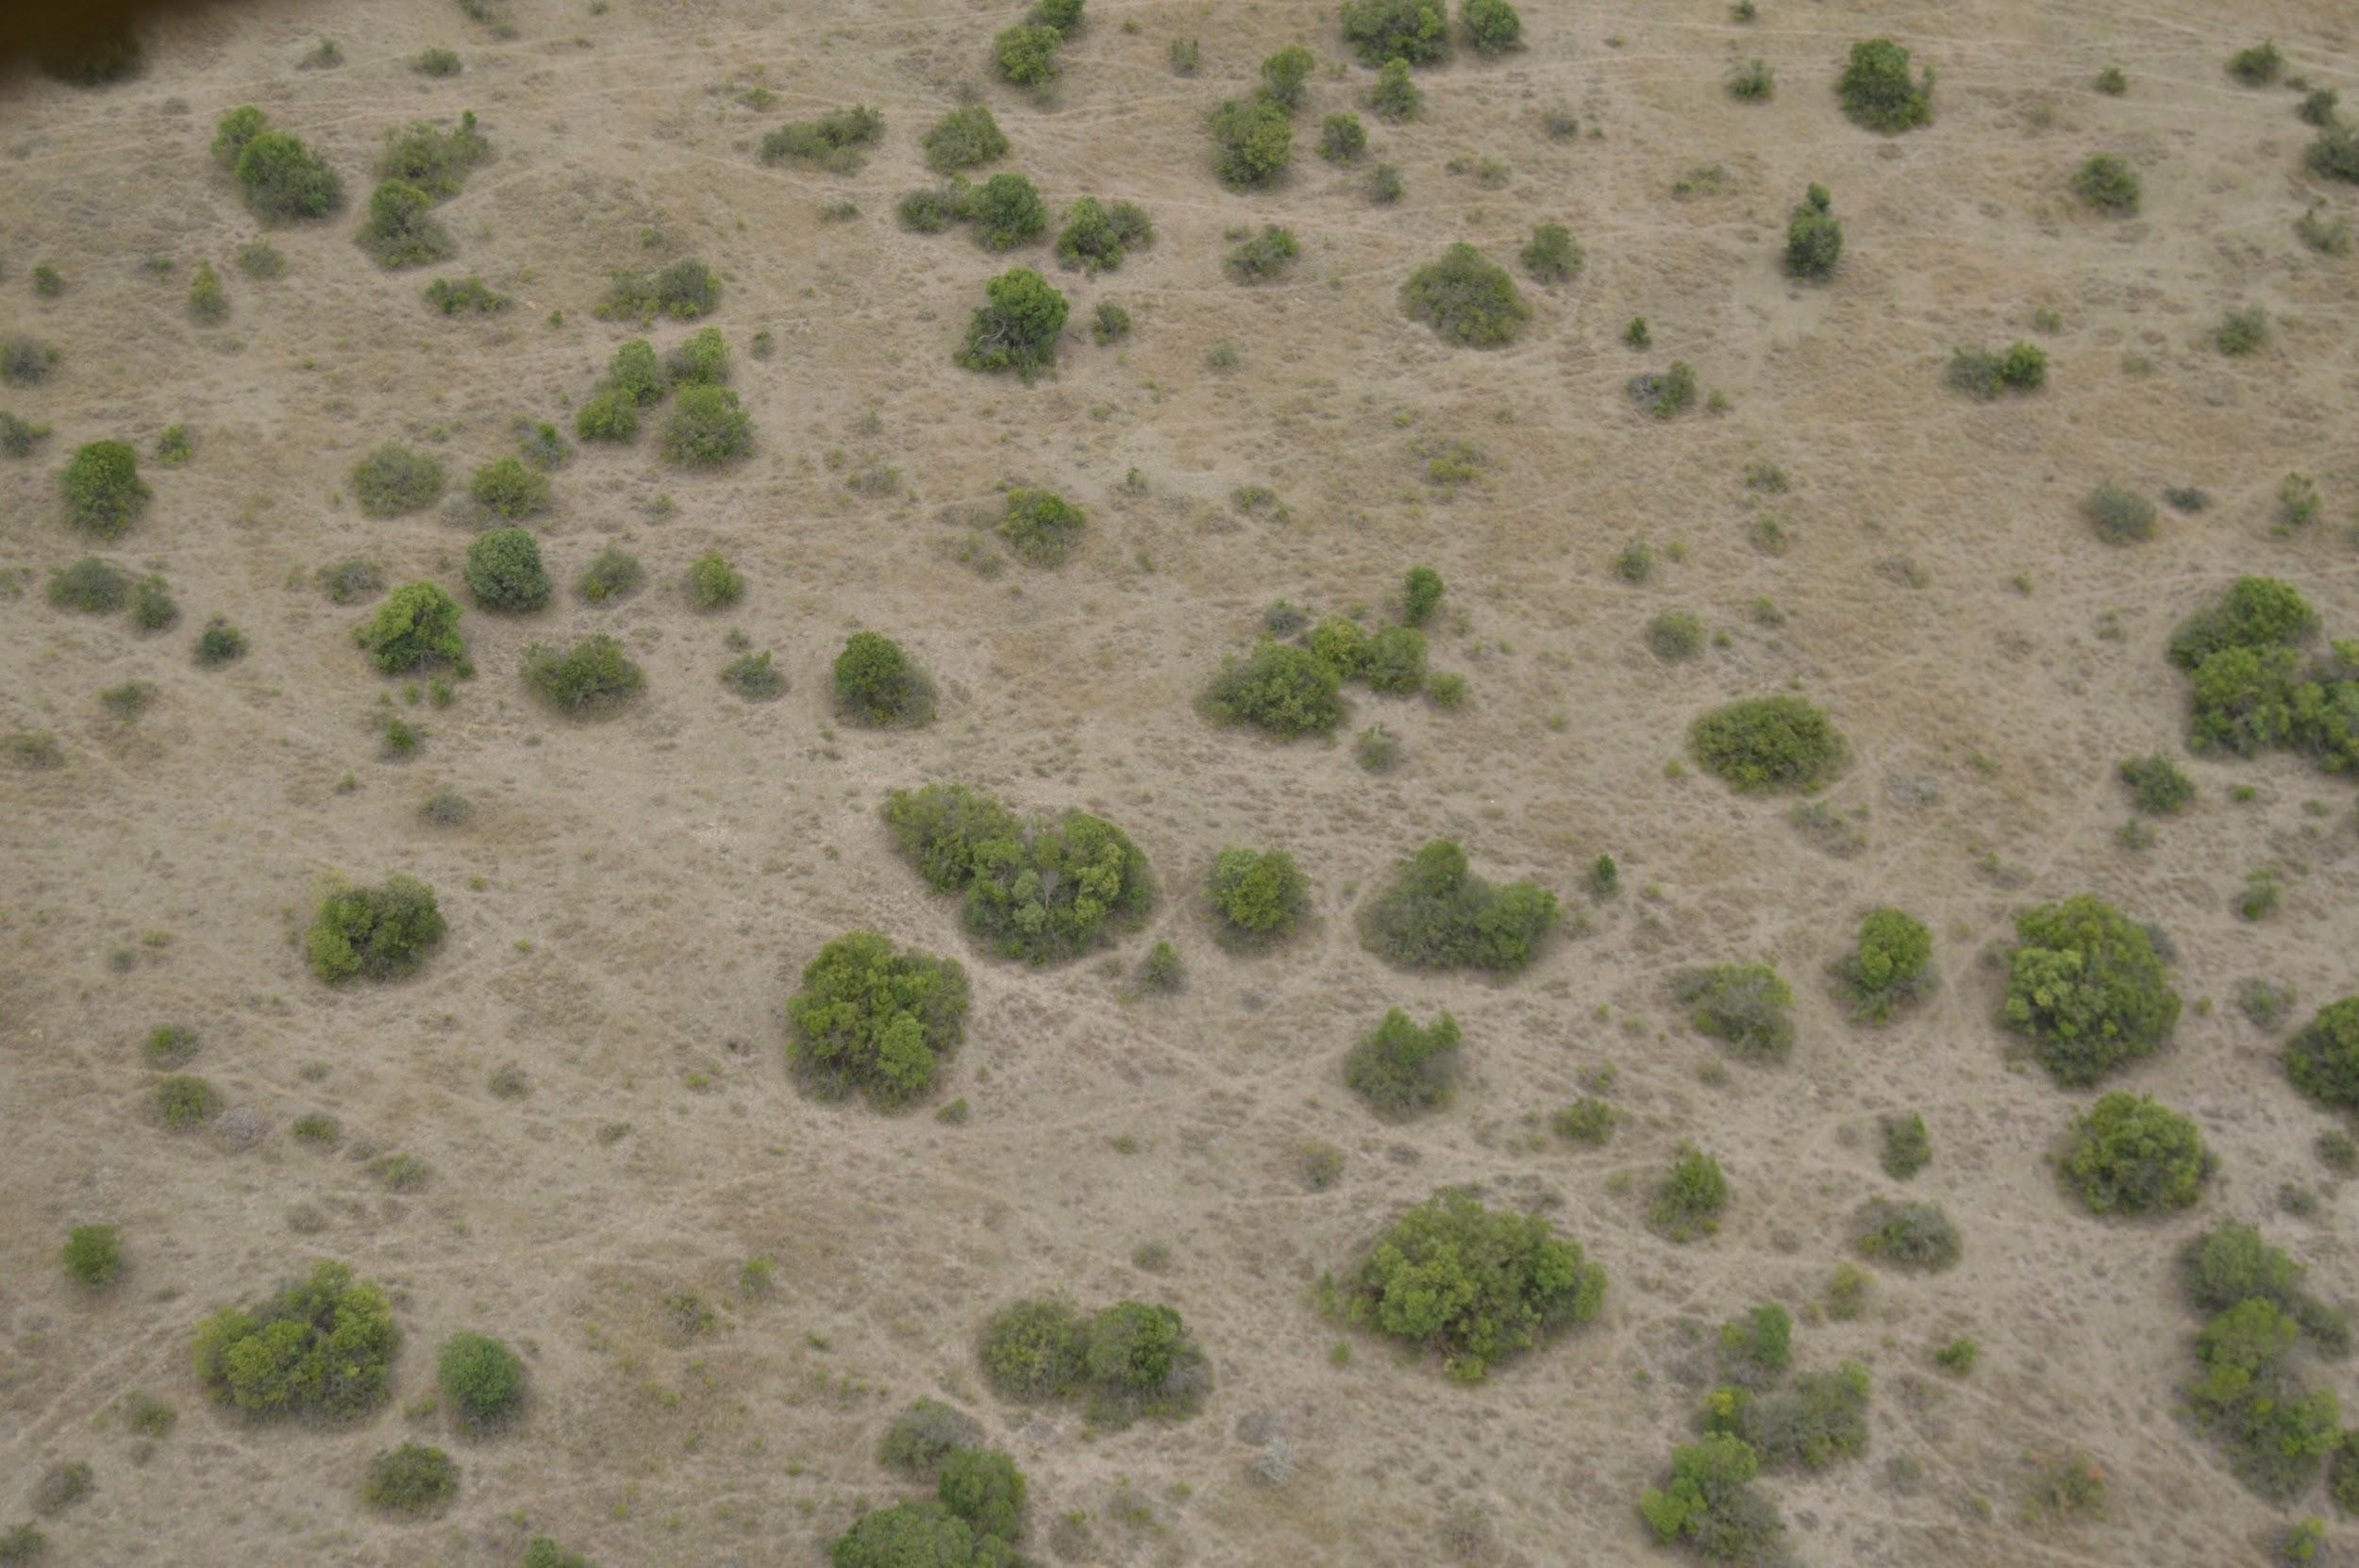
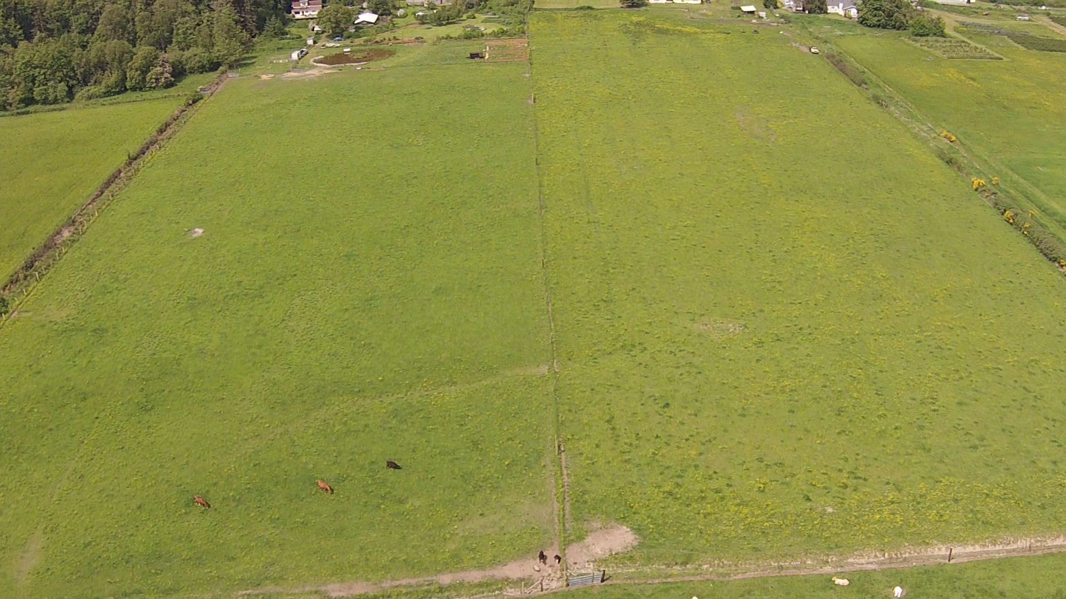
Data Challenges

Slide 10
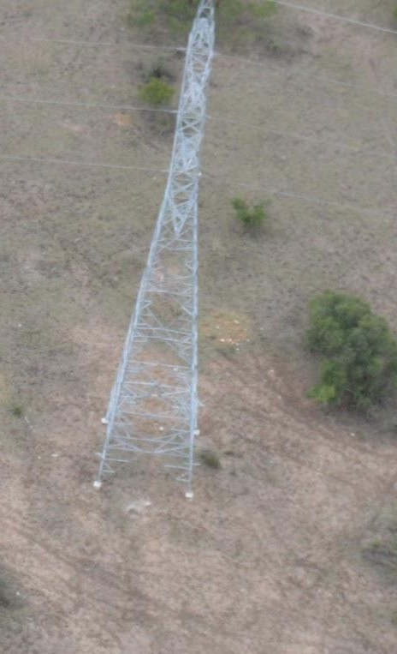
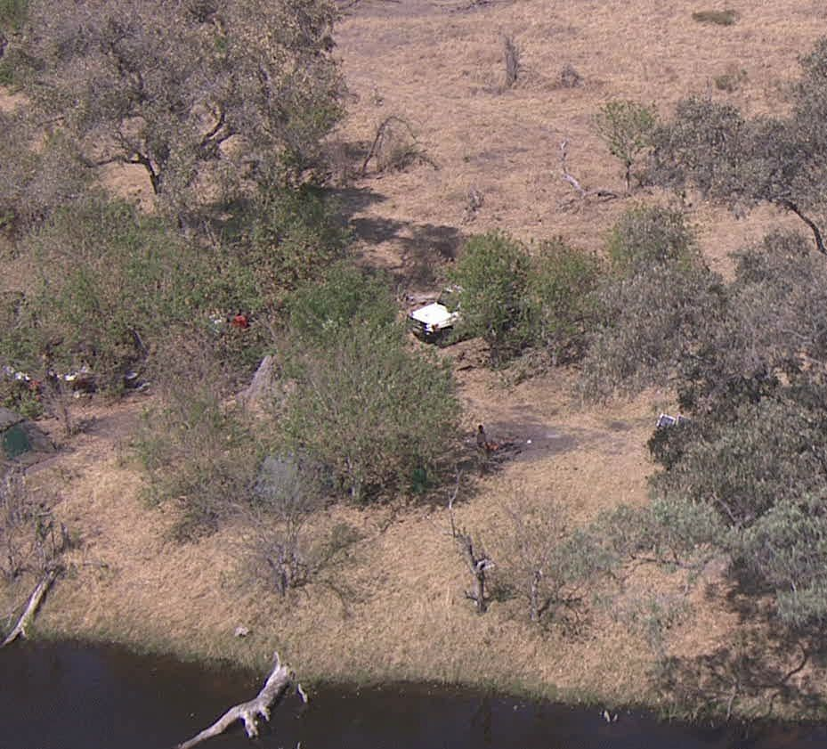
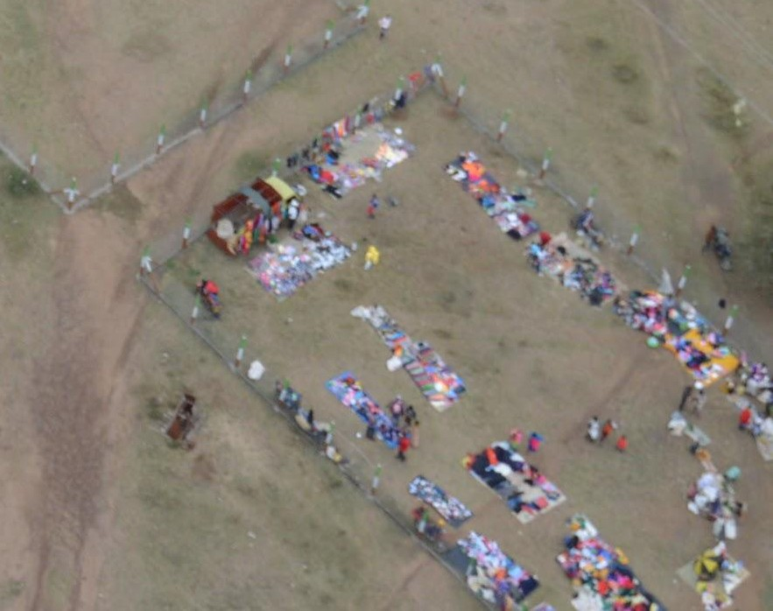
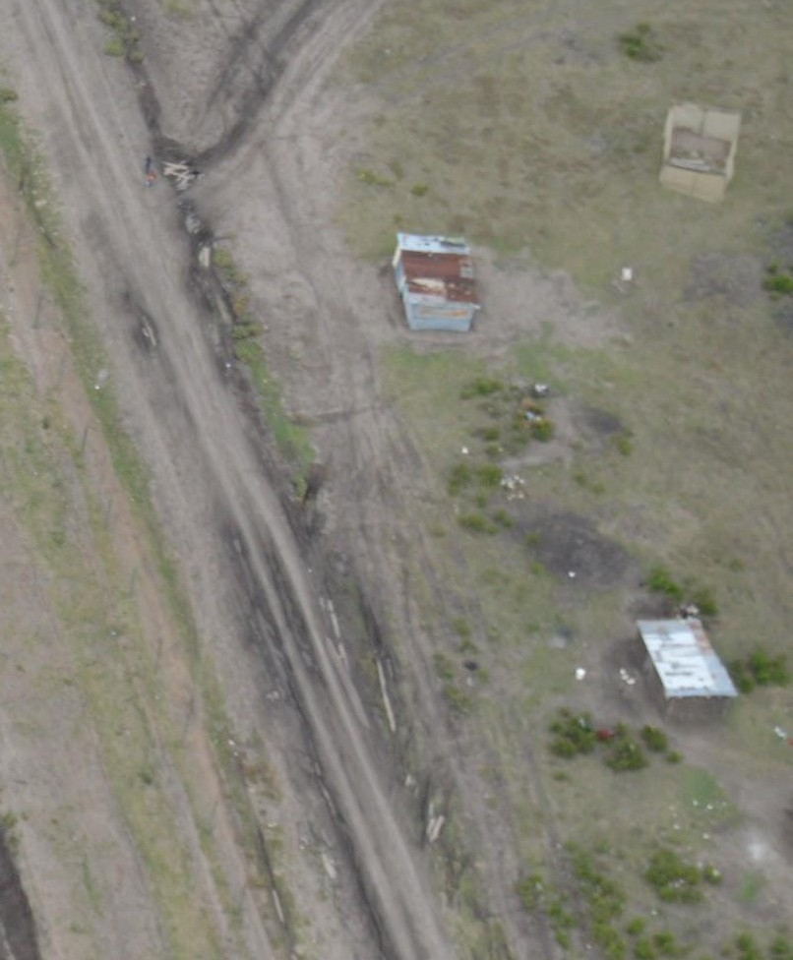
Data Challenges
Anomaly
  Something out of the ordinary
  Low inter-annotator agreement on what an anomaly was
  Models got confused when the objects were very different

Slide 11
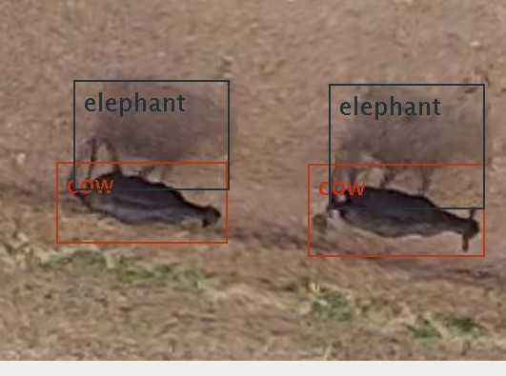
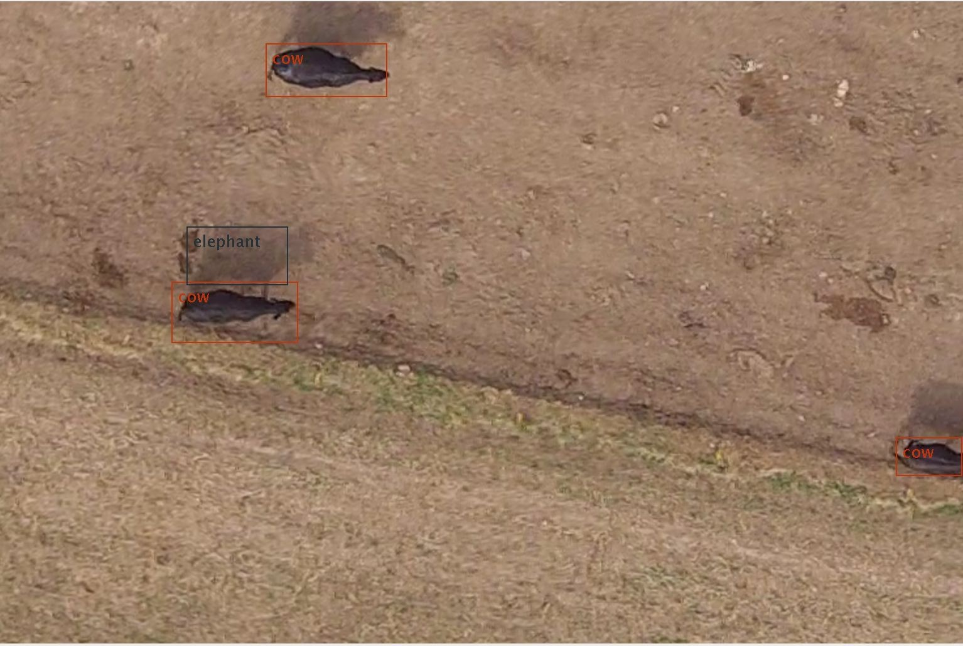
Data Challenges

Slide 12
Image Acquisition
Image quality important
DSLR image quality would be great
  Too big, heavy, and too much power
Smaller cameras fit the size, weight, and power constraints but also
have lower image quality
Target objects are small so minor differences how the image is captured can have a large impact on the CNN performance
Notes:
CNN - Convolutional Neural Networks

Slide 13
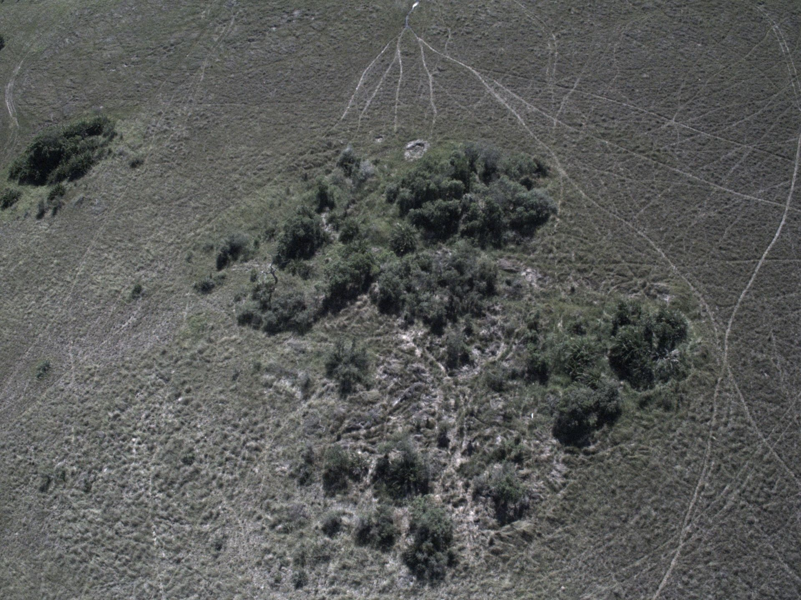
Image Acquisition
Camera Difficulties
  Gray world assumption
Color fidelity
Bayer to RGB transform
Notes:
Grey World Assumption – all pixels combined will be white, however when most of the colors in the picture are brown and white, it violates this assumption
Color Dynamic range
Bayer – to RGB transform: pixelation

Slide 14
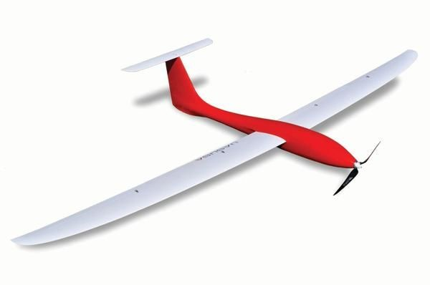
Flight Director ^{(™)}
Verification of positive classifications
  Flight Director determines GPS coordinates of all potential object sightings
  Verification requires the object be positively classified in successive images at the same GPS coordinate (within an error measure)
33.02°, 96.61°

Slide 15
Flight Director ^{(™)}
Verification of positive classifications
  Flight Director determines GPS coordinates of all potential object sightings
  Verification requires the object be positively classified in successive images at the same GPS coordinate (within an error measure)
33.02°, 96.61°

Slide 16
Flight Director ^{(™)}
Flight Director intelligence
  Assess significance of detected object
    Animal or break in perimeter fencing
      log coordinates and continue on current mission
    Person or Vehicle
      determine if the location of the person is an immediate threat
      abort current mission and return to data link range to relay image back to an operator for verification

Slide 17
Performance
Assist scouts on the ground with actionable information
Image Recall
  How many images that contain target objects did our system correctly identify
  Maximize
  90%
Image False Positive Rate
  How many images with no target objects were identified by the system
  Minimize
  8%

Slide 18
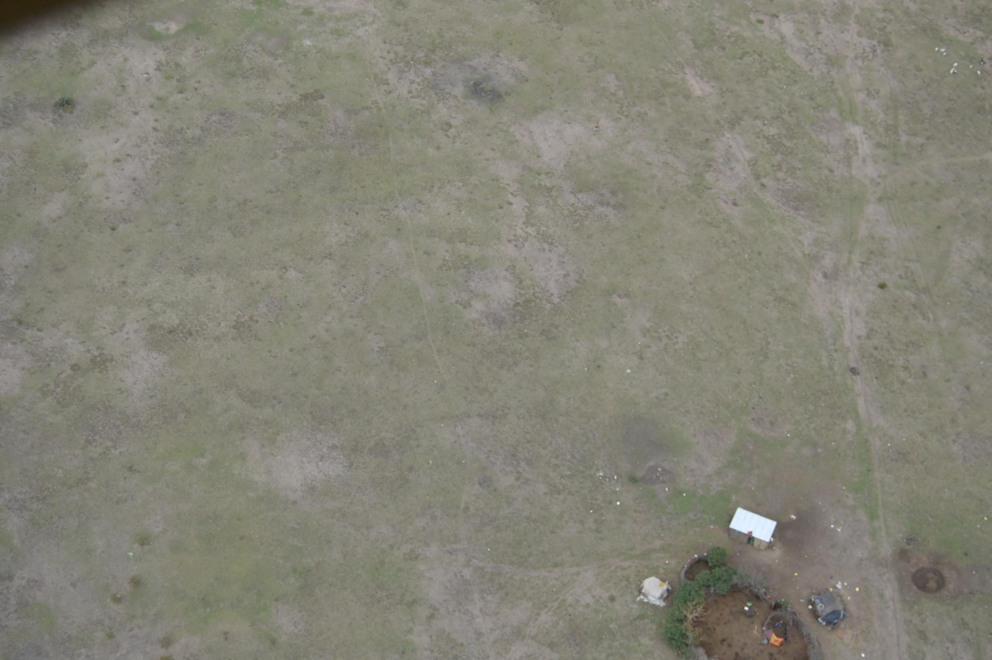

Slide 19
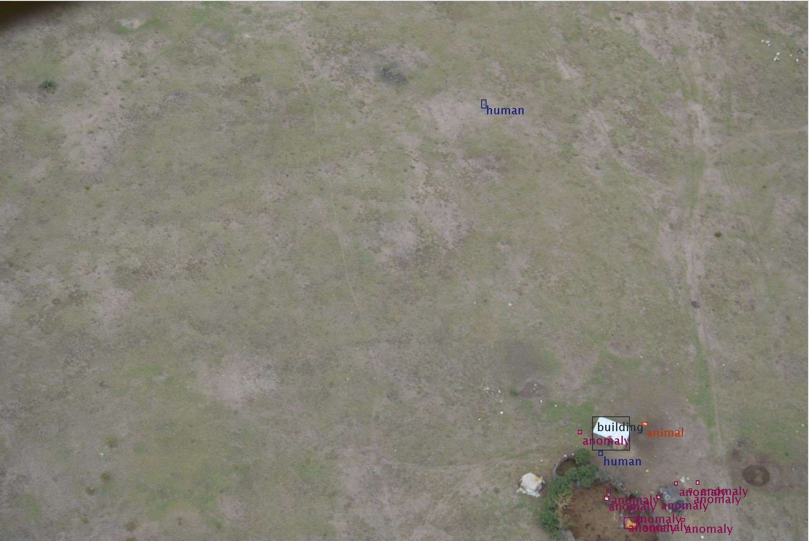

Slide 20
Optimization
TX2 running FCN can process a 4000 x 3000 pixel image in 2000 x 1500 pixel chunks in 3.5 s
875 ms per 2000 x 1500 pixel image
TensorRT improved running time but gave a serious degradation in detection and classification performance
Notes:
FCN - Fully Convolutional Networks

Slide 21
Conclusion
Our system for wildlife conservation allows the enables us to better use our resources on the ground by providing time critical and strategic information

