Slide 1
How To Use GPUs For Faster, Better and Cheaper Drug Development
Presented by Gaurav Tripathi, Co-founder and CTO of Innoplexus AG

Slide 2
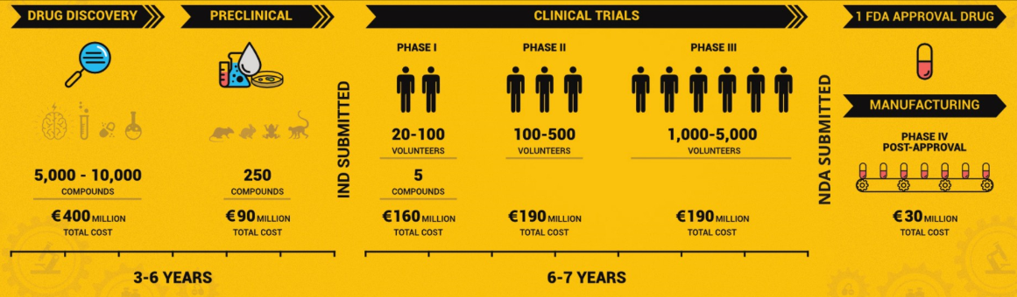
Drug Development is Complex
Current cost is ~$1.2 billion dollars over 9-13 years before a company can begin manufacturing a new drug
These companies start with a few thousand possible candidates before slowly whittling down to 1 or 2 marketable drugs which have been approved
Throughout this process an enormous amount of data is created, all of which needs to be analyzed
Notes:
A key challenge they have run into is how to make this acquired data useable

Slide 3
Possible Data Types
Deep – One useable piece of data in a hundred-page document
Dense – A statement which took years of research to be able to conclude
Diverse – Different file formats, semantics and syntax differences within these files

Slide 4
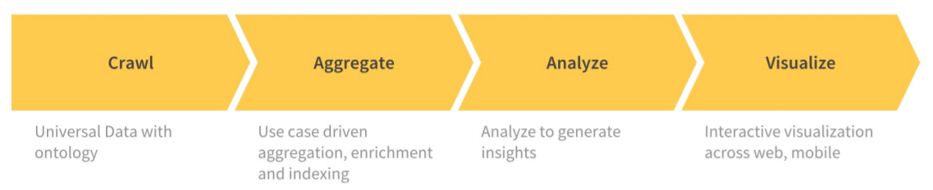
Data Collection and Presentation
This company acquires data by scanning over 300 million websites to determine which are relevant
They are currently working on how to teach a machine how to understand unstructured data, including contexts and tables
A challenge they face is how to connect 100s of terabytes of data

Slide 5
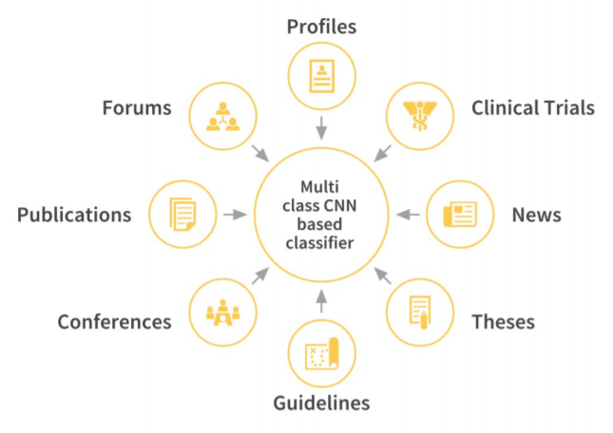
Data Processing
Innoplexus plans on being able to process multiple data types
The first step would be determining what category a piece resides in and then relevant information
For example, a forum post would have the author’s username, date of posting, the post’s content, and comments regarding it

Slide 6
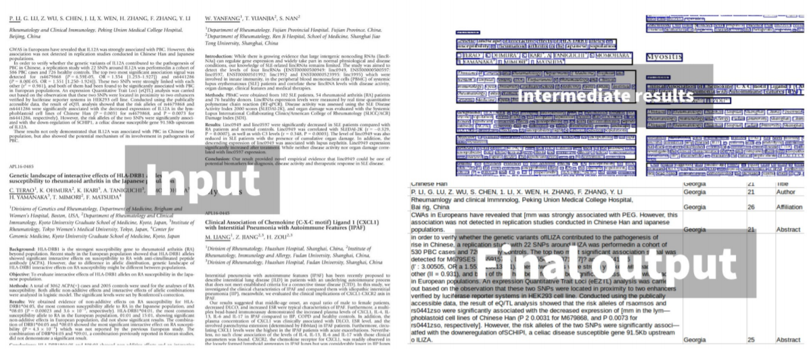
Data Processing
Notes:
The input is usually from academic journals, long and full of information.
They segment this data into different categories and output a neat list of titles, authors, the abstract, and so on

Slide 7
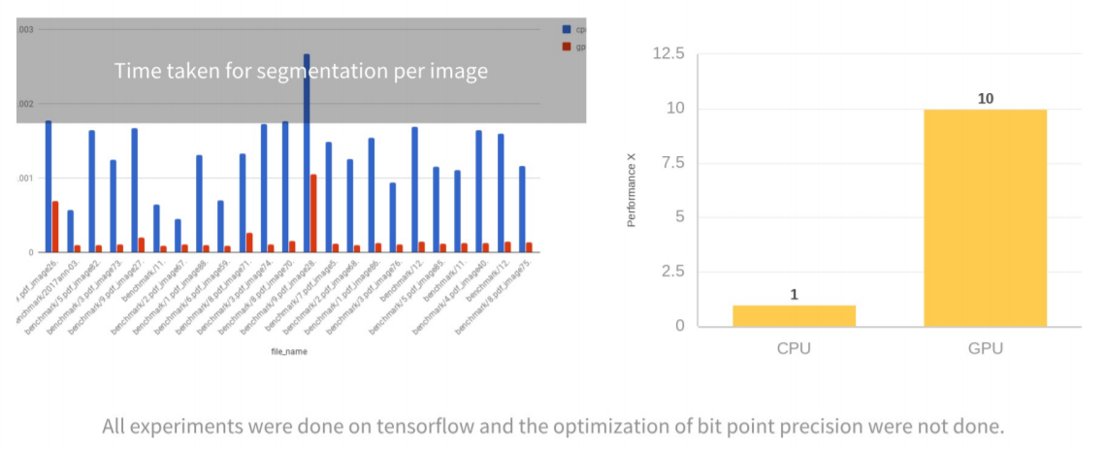
Performance
Notes:
They began the company using CPUs but eventually switched to GPUs. This resulted in a 10x increase in performance
For calculations regarding the shortest distance between millions of pairs it took 2 NVIDIA TESLA V100 GPUs 4.5 days to finish while it was estimated to take 50 quad-core CPUs over a year. Keep in mind these are estimations but the choice is pretty obvious in this case. Should they wish to perform these calculations in real time they would need to use clusters of GPUs.
GPUs make AI such as this make it possible to scale.

Slide 8
Reference
https://on-demand-gtc.gputechconf.com/gtcnew/sessionview.php?sessionName=s9614-how+to+use+gpus+for+faster%2c+better+and+cheaper+drug+development

