Slide 1
Texture and Texture Mapping
ECSE 4750: Computer Graphics
Rensselaer Polytechnic Institute
Nov 5, 2012

Slide 2
The Quest for Visual Realism
Notes:
hippos

Slide 3
Another Example of Textual Mapping
The left hand image is flat shaded, the right hand image has been textured.
Notes:
Left, some cubics, boxes; left, grass, windows, floors, yellow line, side walk, and light.

Slide 4
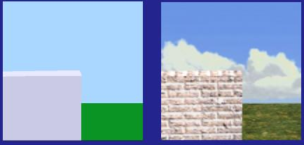
Motivation
Adding per-pixel surface details without raising the geometric complexity of a scene.
E.g. Details can be any object or light properties etc.
Modeling and rendering time is saved by keeping the geometrical complexity low.
Colors can be stored in a texture (represented as an image) and applied to a rendered scene.
Scene without texture
Scene with color texture

Slide 5
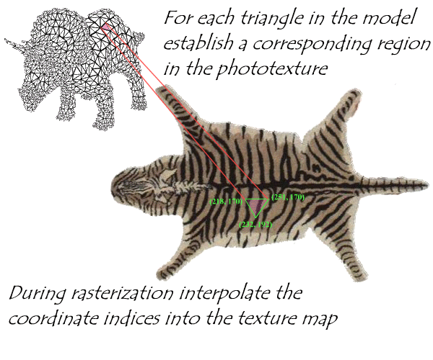
Photo - textures
Increased scene detail without increasing geometric complexity

Slide 6
Basic Concept
“Slap an image on a model.”
How do we map a two-dimensional image to a surface in three dimensions?
Texture coordinates
2D coordinate (s, t) which maps to a location on the image (typically s and t are over [0,1])
Assign a texture coordinate to each vertex
Coordinates are determined by some function which maps a texture location to a vertex on the model in three dimensions

Slide 7
Basic Concept
Once a point on the surface of the model has been mapped to a value in the texture, change its RGB value (or something else!) accordingly
This is called parametric texture mapping
A single point in the texture is called a texel

Slide 8
Something else?
The first known use of texture in graphics was the modulation of surface color values, (diffuse coefficients) by Catmull in 1974.
A texture does not have to indicate color!
Bump mapping was developed in 1978 by Blinn
Transparency maps in 1985 by Gardner

Slide 9
What is a textural map?
Practical: “A way to slap an image on a model.”
Better: “A mapping from any function onto a surface in three dimensions.”
Most general: “The mapping of any image into multidimensional space.”

Slide 10
Overview
Notes:
Parameterization & Projection

Slide 11
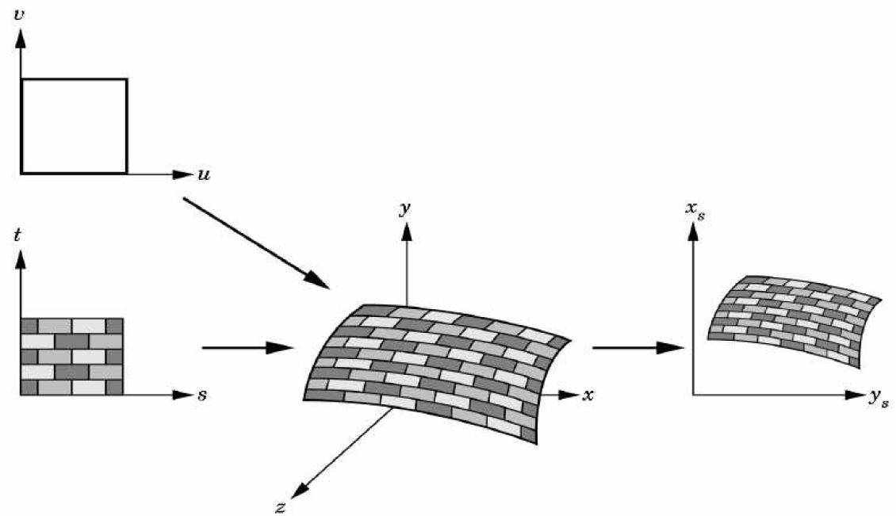
Visual Overview

Slide 12
Notes on Hardware
Texture-mapping is supported in all modern graphics hardware since the introduction of the Voodoo 3Dfx—it’s therefore cheap and easy.
Though the mapping is conceptualized in the order texture -> object -> screen, it is determined in reverse order in hardware, during scan conversion (“To which texel does this pixel map?”)

Slide 13
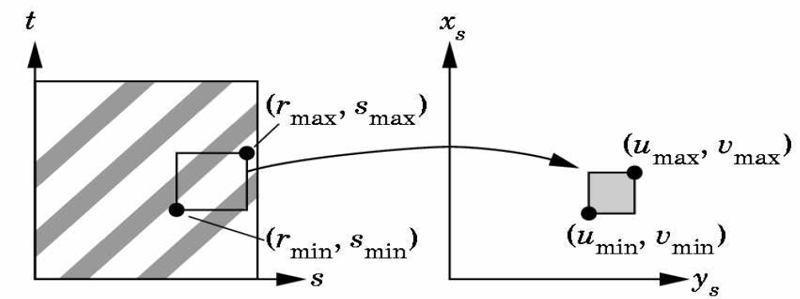
What is the map shape?
"Where do I have to look in the texture map to find the color?" To answer this question, we consider two things: map shape and map entity.
For map shape, most intuitively, Planar Linear Mapping.
Do a direct mapping of a block of texture to a surface patch
Notes:
In two-dimensional texture mapping, we have to decide how to paste the image on to an object. In other words, for each pixel in an object, we encounter the question, "Where do I have to look in the texture map to find the color?" To answer this question, we consider two things: map shape and map entity.
We’ll discuss map shapes first. For a map shape that’s planar, we take an ( x,y,z ) value from the object and throw away (project) one of the components, which leaves us with a two-dimensional (planar) coordinate. We use the planar coordinate to look up the color in the texture map.

Slide 14
Example of Planar Mapping
Notes:
This slide shows several textured-mapped objects that have a planar map shape. None of the objects have been rotated. In this case, the component that was thrown away was the z-coordinate. You can determine which component was projected by looking for color changes in coordinate directions. When moving parallel to the x-axis, an object’s color changes. When moving up and down along the y-axis, the object’s color also changes. However, movement along the z-axis does not produce a change in color. This is how you can tell that the z-component was eliminated.

Slide 15
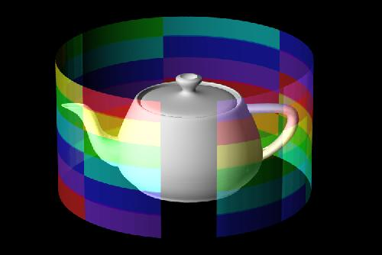
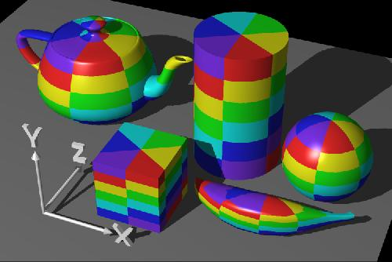
Other Map Shapes
Cylinder Map Shape
Notes:
A second shape used in texture mapping is a cylinder. An ( x,y,z ) value is converted to cylindrical coordinates of ( r, theta, height ). For texture mapping, we are only interested in theta and the height. To find the color in two-dimensional texture map, theta is converted into an x-coordinate and height is converted into a y-coordinate. This wraps the two-dimensional texture map around the object.
The texture-mapped objects in this image have a cylindrical map shape, and the cylinder’s axis is parallel to the z-axis. At the smallest z-position on each object, note that the squares of the texture pattern become squeezed into "pie slices". This phenomenon occurs at the greatest z position as well. When the cylinder’s axis is parallel to the z-axis, you’ll see "pie slices" radiating out along the x- and y- axes.

Slide 16
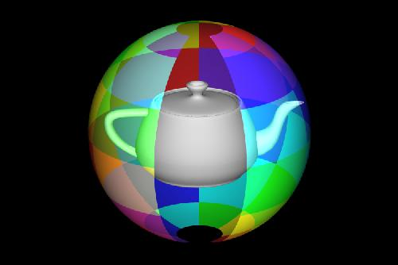
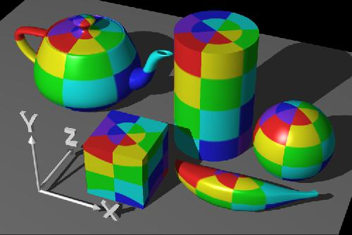
Other Map Shapes
Sphere Map Shape
Notes:
When using a sphere as the map shape, the ( x,y,z ) value of a point is converted into spherical coordinates. For purposes of texture mapping, we keep just the latitude and the longitude information. To find the color in the texture map, the latitude is converted into an x-coordinate and the longitude is converted into a y-coordinate.
The objects have a map shape of a sphere, and the poles of the sphere are parallel to the y-axis. At the object’s "North Pole" and "South Pole", the squares of the texture map become squeezed into pie-wedge shapes. Compare this to a map shape of a cylinder. Both map shapes have the pie-wedge shapes at the poles, but there is a subtle difference at the object’s "equator". The spherical mapping stretches the squares in the texture map near the equator, and squeezes the squares as the longitude reaches a pole.

Slide 17
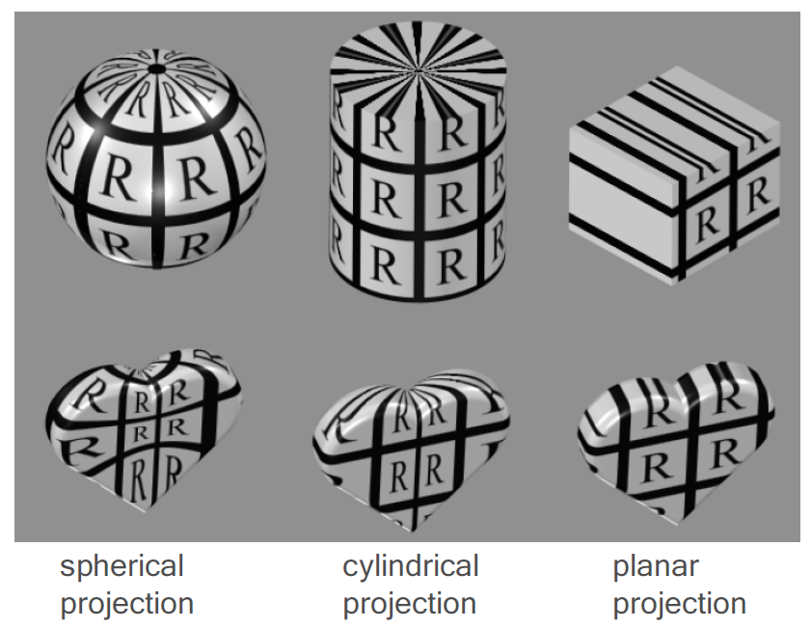
Mapping Functions
Planar mapping
(s,t) -> (x,y) -> (xs,ys)
Cylindrical mapping
(s,t) -> (θ, h) -> (xs,ys)
Spherical mapping
(s,t) ->(latitude, longtitude)
->(xs, ys)

Slide 18
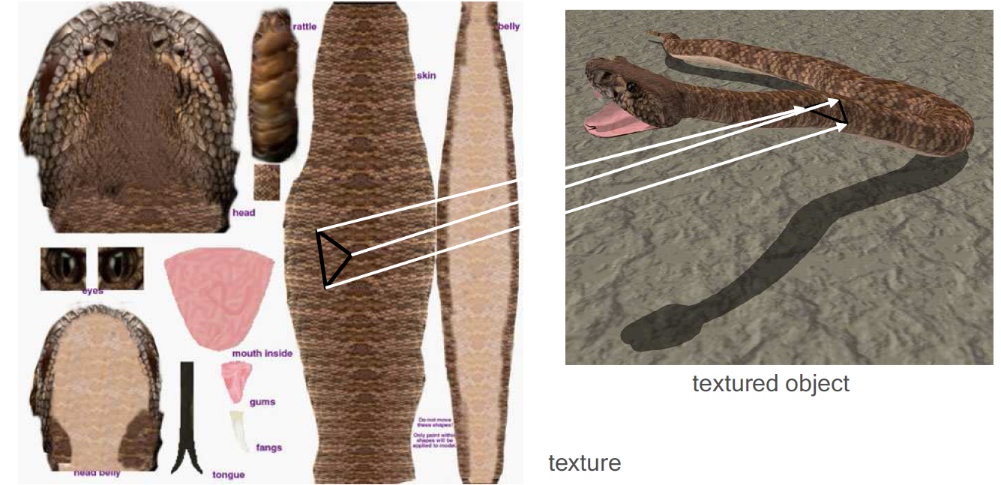
Mapping Functions
Use of different mapping for surface patches
Minimize distortions, avoid artifacts at seams
Several texture coordinates can be assigned to a single vertex

Slide 19
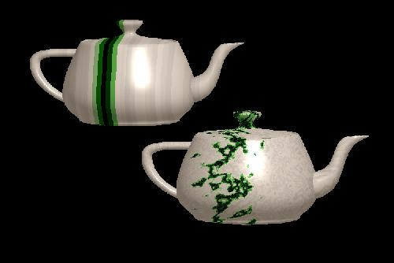
What about map entity?
Wood, metal, marble… is not only a picture, it is a material which can be modeled.
Regular Function + Perturbations
Perturbing stripes can result in a texture with a marbled appearance.

Slide 20
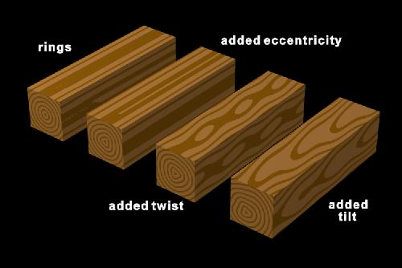
Wood material:
From mathematical rings to eccentric, twisted tilted wood

Slide 21
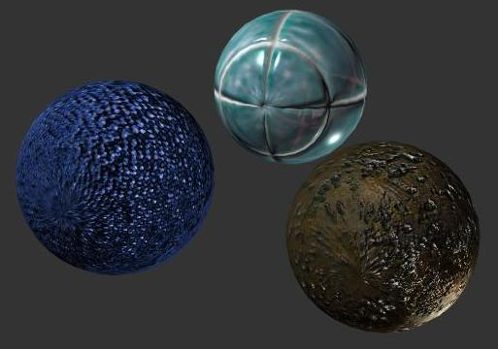
Bump mapping: normal variation
James Blinn invented the method of perturbing the surface normal n. This changes the light interaction but not the actual size of the objects, so that bump mapped objects appear smooth at the silhouette.

Slide 22
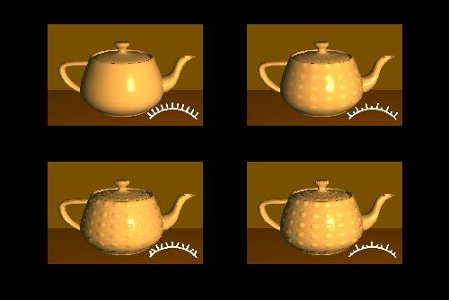
Another example of bump mapping
Bump mapping affects object surfaces, making them appear rough, wrinkled, or dented. Bump mapping alters the surface normals before the shading calculation takes place.

Slide 23
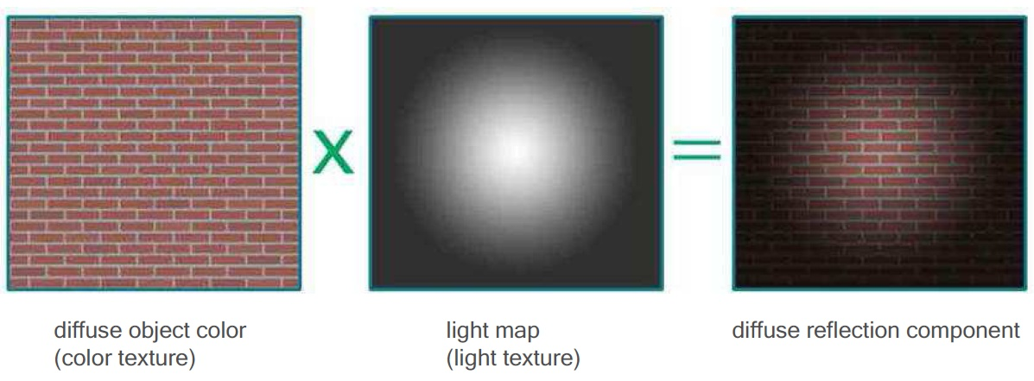
Light Mapping
Notes:
Different from adding light sources and projections, and compute the lights at real time, this is a light map where light is added directly as light texture.

Slide 24
Light Mapping – Another example

Slide 25
Textural Mapping in OpenGL
Chapt. 12 of the textbook gives a good reference.
Let me mention several important functions:

Slide 27
Textural Mapping in OpenGL
More Functions

Slide 28
Homework on this chapter
Exercise 12.1
Exercise 12.2
Exercise 12.3
We will release detailed information on the course website.

