Slide 1
UFV
RPI
PinMesh – Fast and exact 3D point location queries using a uniform grid
Salles V. G. Magalhães (UFV/RPI)
Marcus V. A. Andrade (UFV)
W. Randolph Franklin (RPI)
Wenli Li (RPI)

Slide 2
Introduction
Point location is a basic problem in many areas such as:
Computer Graphics
CAD/CAM
Geographic Information Science
Computer Games
Given a 2D or 3D subdivision and a query point, the point location problem consists in determining:
if the point is inside (or not) a polygon (2D) or a polyhedron (3D)
which polygon (2D) or polyhedron (3D) contains the point

Slide 3
Introduction
For example, given the Deutschland map, we want to know where we are

Slide 4
Introduction
For example, given the Deutschland map, we want to know where we are
Here

Slide 5
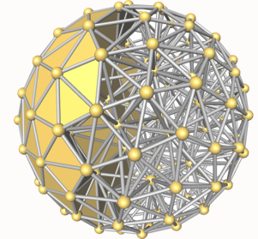
Introduction
In 3D, we want to know which tetrahedron contains a given point
Which tetrahedron
contains a point
here?
http://doc.cgal.org/latest/Triangulation_3

Slide 6
Introduction
A common strategy ray casting
The idea is:
cast a semi-infinite ray from the query point
compute the intersections between the ray and the subdivision boundaries
counting intersections decide if the point is inside or not (a region)
closest intersection determine which polygon (polyhedron) contains the point
Works well for a small number of queries

Slide 7
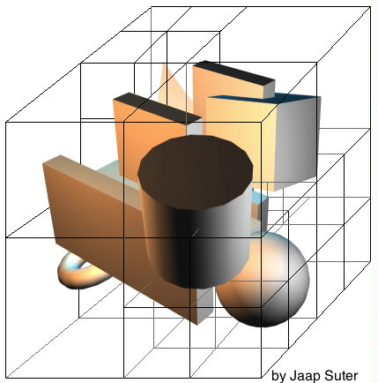
Introduction
For many queries: a spatial data structure is used as an index for example, an Octree

Slide 8
Introduction
For many queries: a spatial data structure is used as an index for example, an Octree
RCT (Relative Closest Triangle) proposed by Liu at al. is an efficient 3D point location method:
uses an Octree
for all we know, it was the fastest algorithm available

Slide 9
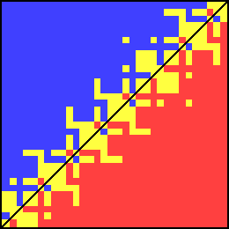
Introduction
Challenge: robustness
finite floating-point approximate representation
the difference round-off errors
Example: 3 points orientation
Blue: left turn
Red: right turn
Yellow: collinear
Source: Kettner et al., Robustness problems in geometric computations

Slide 10
Introduction
Common “solutions”:
epsilon tweaking
snap rounding
Large datasets & 3D increased chance of failure
Chance of failure prevents the use of the code in the solution of other problems
Avoiding (or circumventing) round-off errors is a big challenge mainly in geometric algorithms
No guarantee

Slide 11
Introduction
We propose PinMesh (Point in Mesh), to locate a cloud of points in triangular meshes which is:
exact (round-off errors free)
fast (faster than RCT)
It is based on ray casting and uses:
a two-level uniform grid: to accelerate queries
rational numbers: to avoid round-off errors
Simulation of Simplicity (SoS): to handle intersection special cases
parallelism: to better use the current hardware capability

Slide 12
Introduction
PinMesh ideas are simple
Our main contribution:
carefully combine and implement these ideas to obtain an exact and efficient method
In a 16-core Xeon, on a mesh with 50 million triangles:
preprocess 14 sec
query (one million points) 0.6 sec
about 27 times faster than RCT

Slide 13
PinMesh Implementation
PinMesh can be divided into two steps:
preprocessing
querying
Preprocessing step
to speed up the computation of intersections between the ray and the mesh
Create a 3D two level uniform grid:
superimpose a regular grid over the data
insert into each cell the triangles intersecting it
for uneven data, a second level grid is created inside those cells having “many” elements

Slide 14
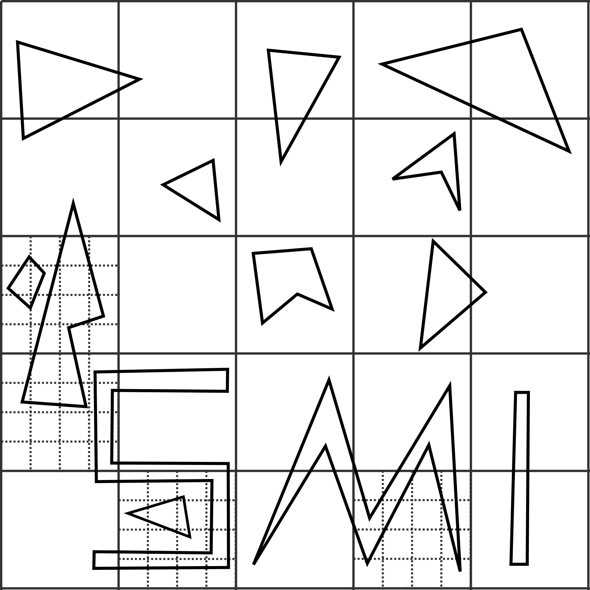
Two level uniform grid
A 2D example – cells with more than 5 elements were refined

Slide 15
PinMesh Implementation
Optimization steps:
Label empty cells with the region identifier containing it scanline floodfill process
Grid cells’ contents (references to the triangles) stored in a ragged array
Why not a three (or more) level grid or a general trees?
experiments showed they are slower
uniform grid is easily parallelizable and quickly constructed and traversed

Slide 16
PinMesh Implementation
Query step:
Cast a vertical ray from the query point
Determine the “lowest” triangle intersecting the ray
To illustrate this process, let´s consider a 2D example

Slide 17
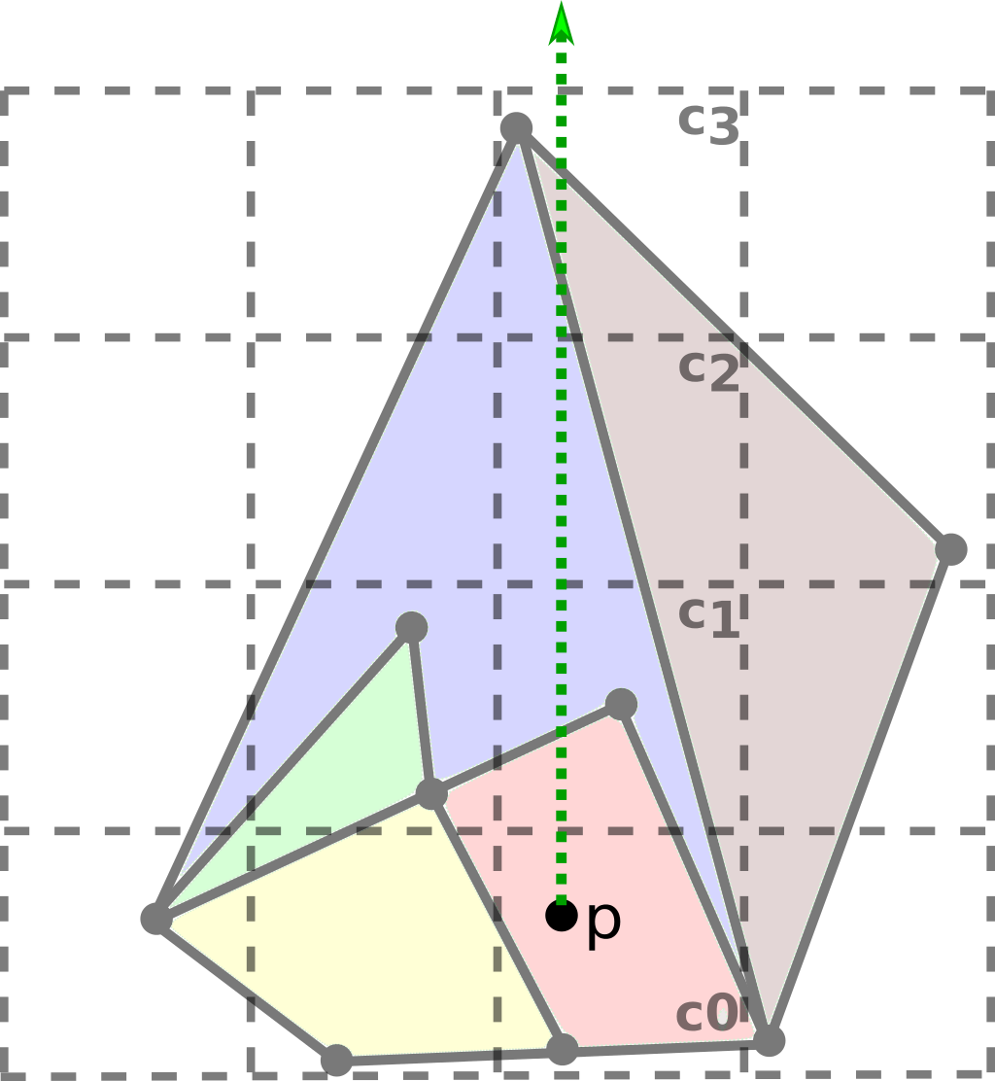
PinMesh Implementation
Given a 2D mesh and the grid indexing it
p is a query point and C₀ is the cell containing it
C₀ is not empty
cast a vertical ray from p

Slide 18
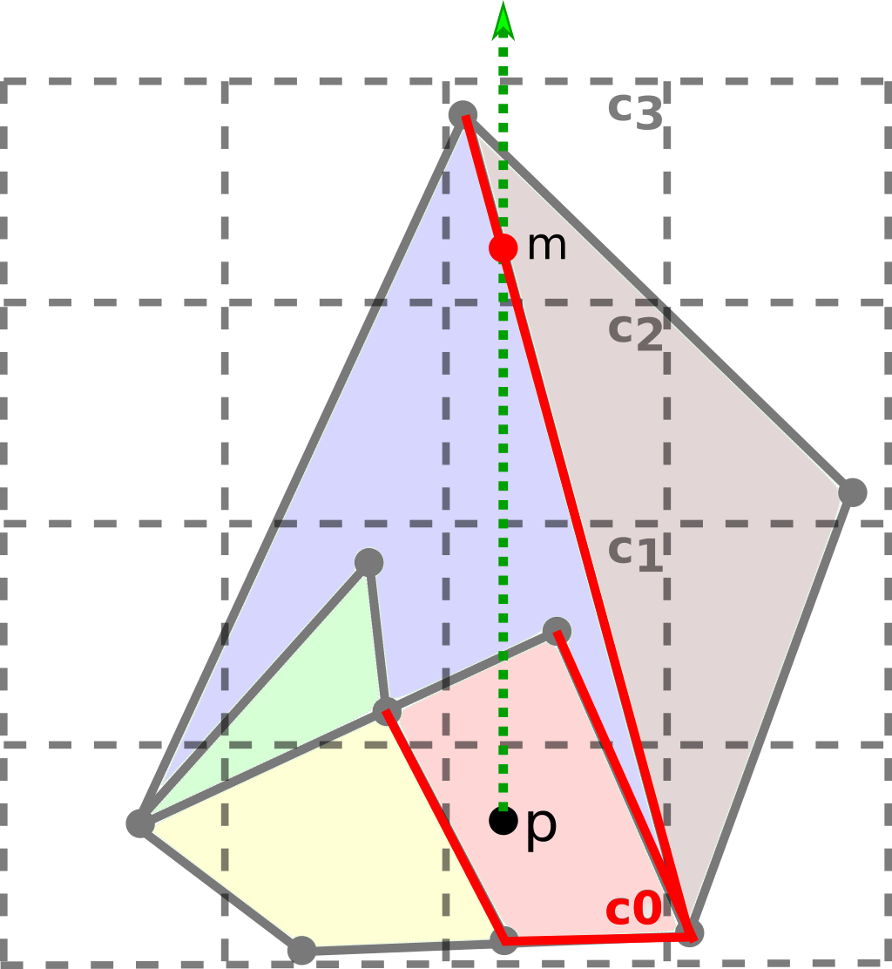
PinMesh Implementation
Determine the intersection between the ray and all edges in C₀
Set m as the closest one

Slide 19
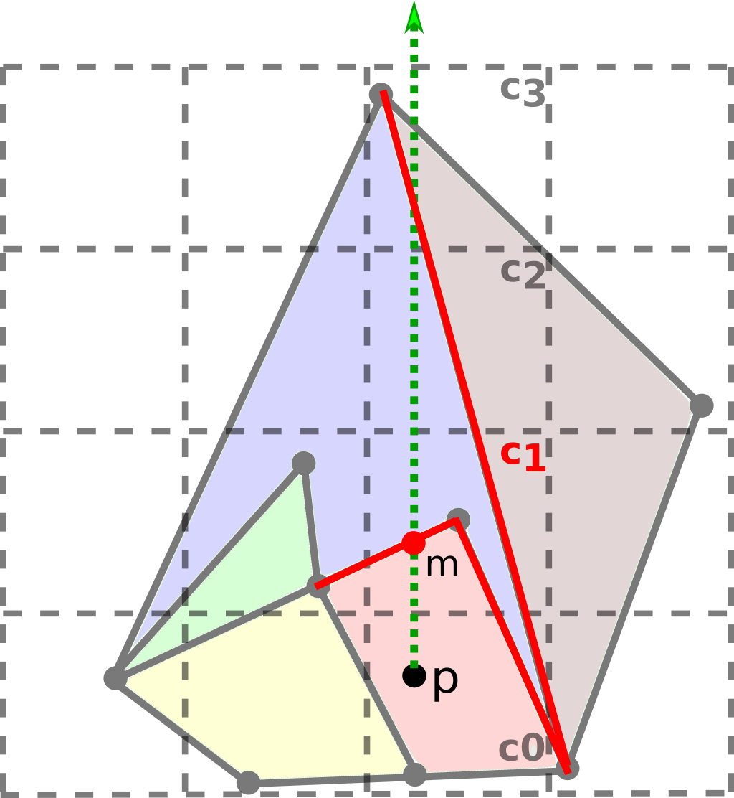
PinMesh Implementation
Since m is not in C₀, moves up to C₁
Determine the intersection between the ray and all edges in C₁
Update m with the “lowest” intersection

Slide 20
PinMesh Implementation
Since m is in the current cell C₁, done!
m is the closest intersection
the edge orientation allows to get the polygon containing p

Slide 21
PinMesh Implementation
An exact and correct implementation is a challenge
Exactness (no round-off errors) using rational number (by GMP library)
Correctness treating all special cases in ray casting:
ray intersecting an edge or vertex two or more triangles sharing the intersection point

Slide 22
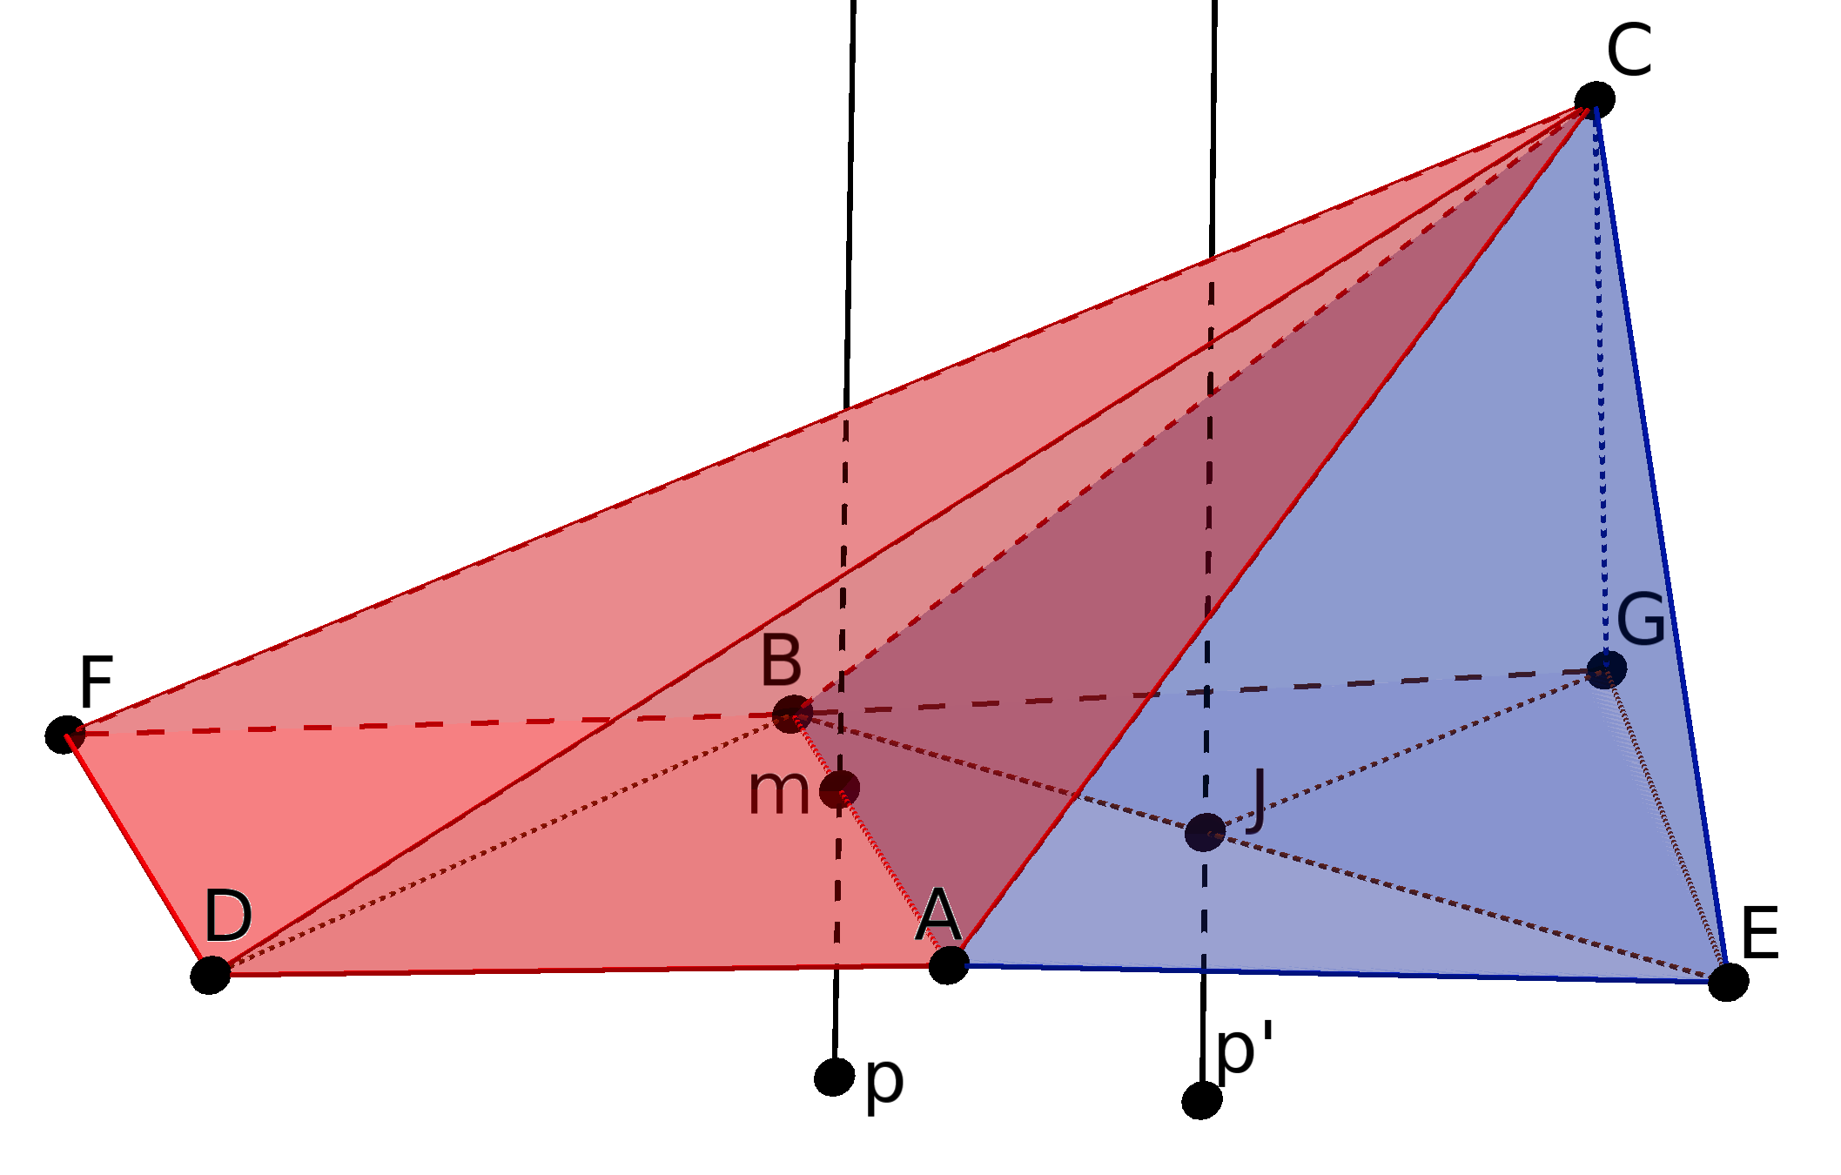
PinMesh Implementation
For example,
Ray from p intersects the edge AB
Ray from p’ intersects the vertex J

Slide 23
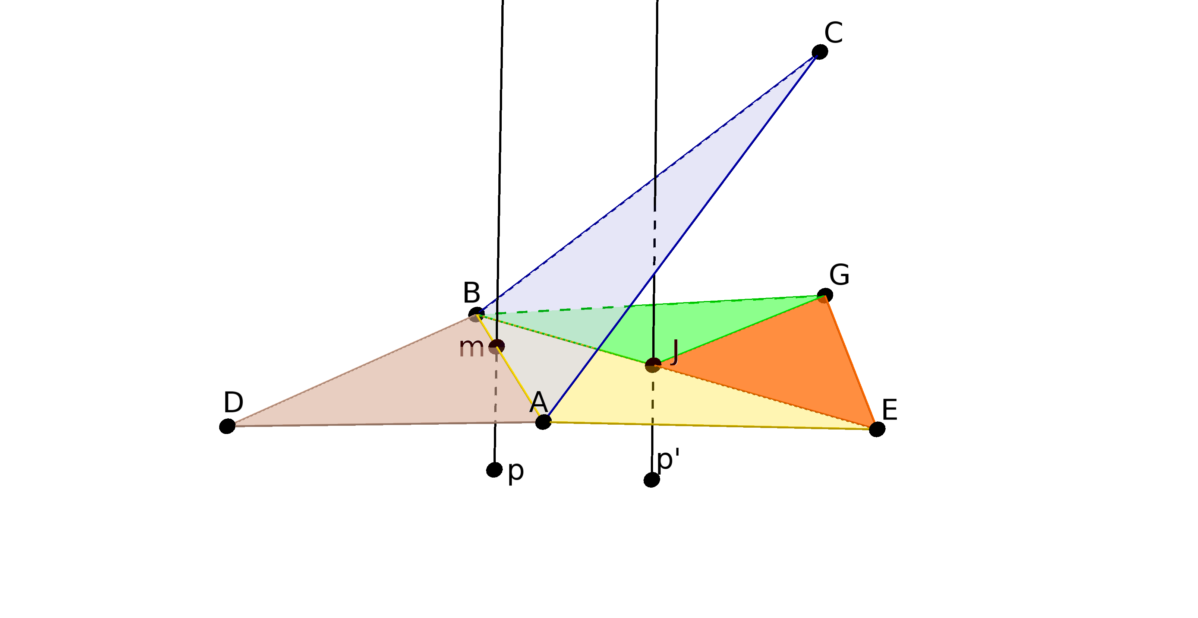
PinMesh Implementation
For example,
Edge AB is shared by three triangles:
triangle ABC does not bound the region containing p

Slide 24
PinMesh Implementation
Special cases Simulation of Simplicity (SoS)
SoS “solve” special cases in a globally consistent way
Special cases are “conceptually avoided”:
doing a symbolic perturbation by a formal indeterminate infinitesimal value ε
ε is not a concrete value
ε is used only to simulate the effect it would cause for the algorithm

Slide 25
PinMesh Implementation
Rules used in the evaluation process:
for any positive value a,
ε < a
a + ε is equivalent to a
ε^{i} < ε for any natural i
A query point p=(p_{x}, p_{y}, p_{z}) is conceptually translated to p_{ε}=(p_{x}+ε, p_{y}+ε², p_{z}+ε³)
Then, no vertical ray from p_{ε} will intersect an edge or a vertex

Slide 26
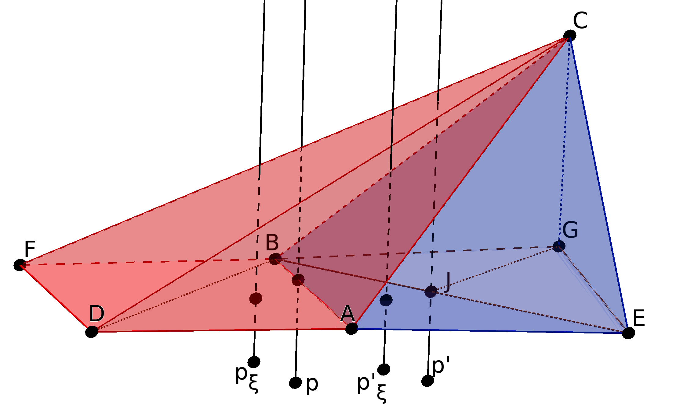
PinMesh Implementation
For example,

Slide 27
PinMesh Implementation
In PinMesh the special cases are:
the vertical ray intersecting an edge or a vertex
Given a point p=(p_{x}, p_{y}, p_{z}) and a triangle t with vertices t_{i} = (t_{ix}, t_{iy}, t_{iz}) for i=0,1,2
Let p’ and t’ be the projection of p and t onto the horizontal plane z=0:
p’=(p_{x}, p_{y}, 0)
t’ vertices are t’_{i} = (t_{ix},t_{iy},0)
A vertical ray (from p) intersects the interior of t if and only if p’ is inside t’

Slide 28
PinMesh Implementation
Given the barycentric coordinates λ₀, λ₁ and λ₂ of p’ with respect to t’
p’ is inside t’ if and only if 0 < λ_{i} < 1 for i=1,2,3
And λ₀, λ₁ and λ₂ can be computed by

Slide 29
PinMesh Implementation
The special cases are:
if det = 0 t is a vertical triangle
if some λ_{i} is 1 means p’ coincides with the vertex t’_{i}
if some λ_{i} is 0 and all other are not 1 means p’ is on an edge of t’.
Using SoS:
p’ coordinates (p’_{x}, p’_{y}, 0) are replaced with p’_{ε} =(p’_{x}+ε, p’_{y}+ε², 0)
special cases can be identified using ε rules

Slide 30
PinMesh Implementation
For example,
Some extra clauses are included in the functions
There is no execution overhead unless an extra clause is executed (and then it is small)

Slide 31
Parallel implementation
PinMesh was designed to work in parallel
Preprocessing step is executed in parallel:
cells intersected by each mesh triangle
cell containing each query point
Query step is also executed in parallel

Slide 32
Experimental results
PinMesh was implemented in:
C++
GMP for multiple precision rational numbers
OpenMP for parallel programming
Experimental results were executed:
using g++ 4.9.3 (with the -O3 optimization flag)
on a workstation with a dual 8-core Xeon 3.1GHz E5-2687 hyperthreading processors, 128 GiB of RAM
with Linux Mint 17 operating system
PinMesh was configured to use 16 threads

Slide 33
Experimental results
PinMesh was compared with RCT which:
uses floating-point numbers
does not handle special cases
can give incorrect results
is sequential
As far as we know, RCT was the most efficient point location algorithm available
It is faster than other algorithms such as the method in CGAL

Slide 34
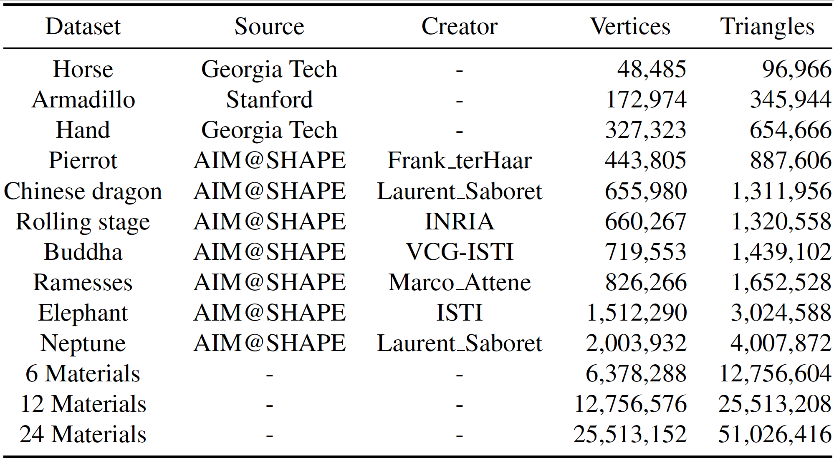
Experimental results
The 13 datasets used in the tests

Slide 35
Experimental results
The 13 datasets used in the tests
These meshes are single-material containing only one large polyhedron.

Slide 36
Experimental results
The 13 datasets used in the tests
These are multi-material, containing many polyhedra:
6 Materials are the combination of the six largest single-material
12 and 24 materials are 2 and 4 translated copies of 6 Materials

Slide 37
Experimental results
The 13 datasets used in the tests
This dataset is uneven distributed:
only 0.01% of the grid cells contain triangles
0.08% are empty and completely inside the mesh
the remaining 99.92% are empty and outside the mesh

Slide 38
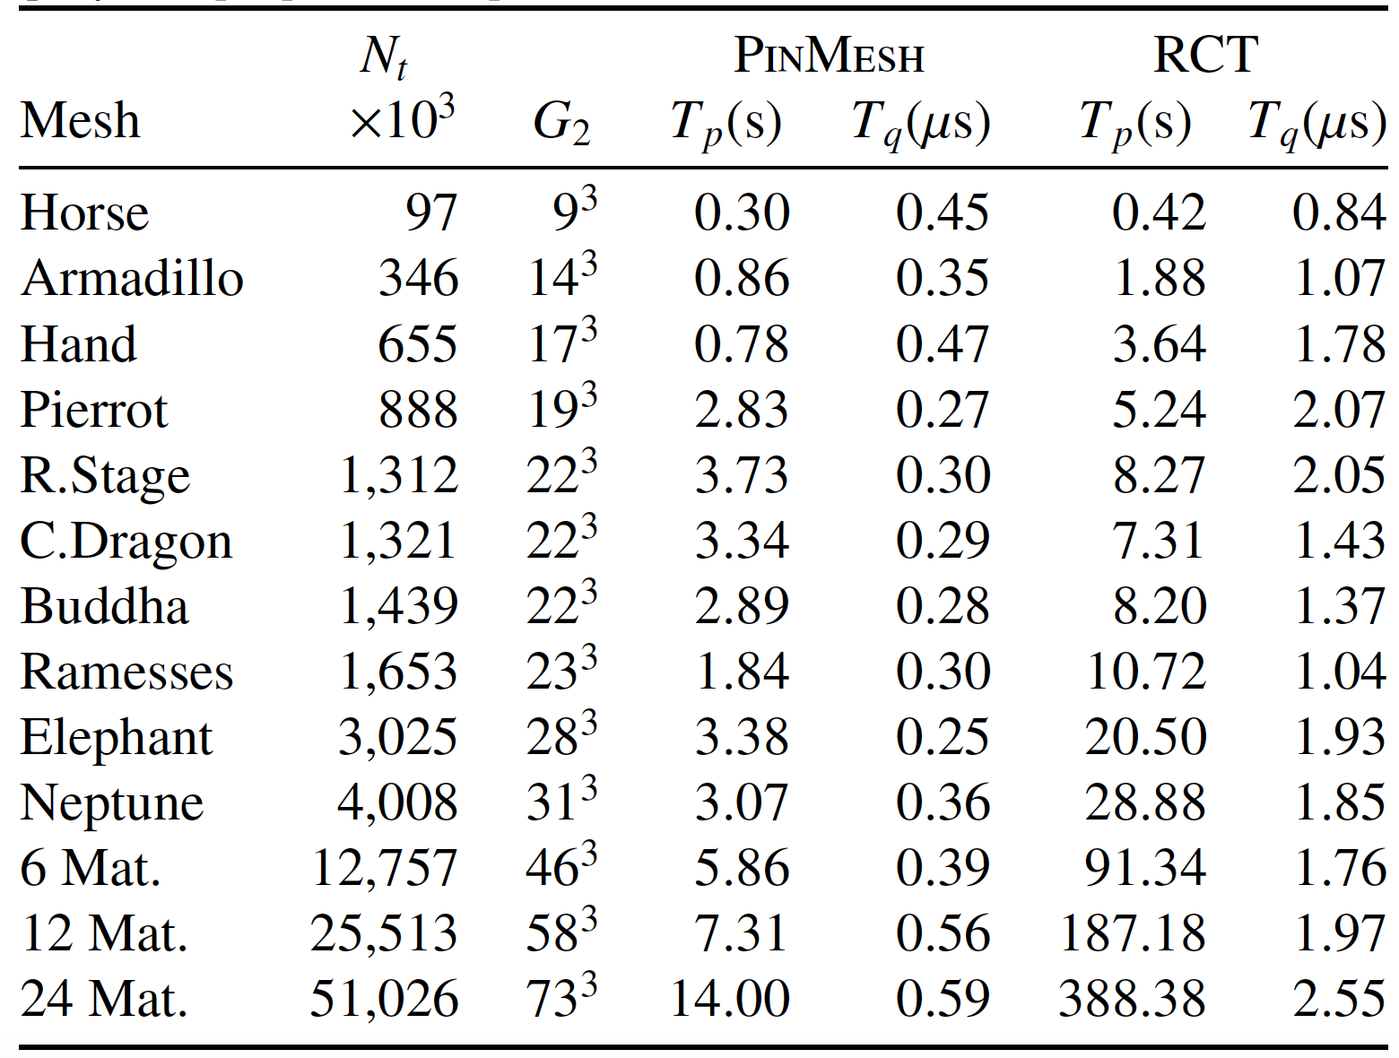
Experimental results
Runtime to preprocess and locate one million of points in meshes. T_{q} is the mean time per point

Slide 39
Experimental results
Runtime to preprocess and locate one million of points in meshes. T_{q} is the mean time per point
PinMesh was up to 27 times faster than RCT:
PinMesh 15s
RCT 401s

Slide 40
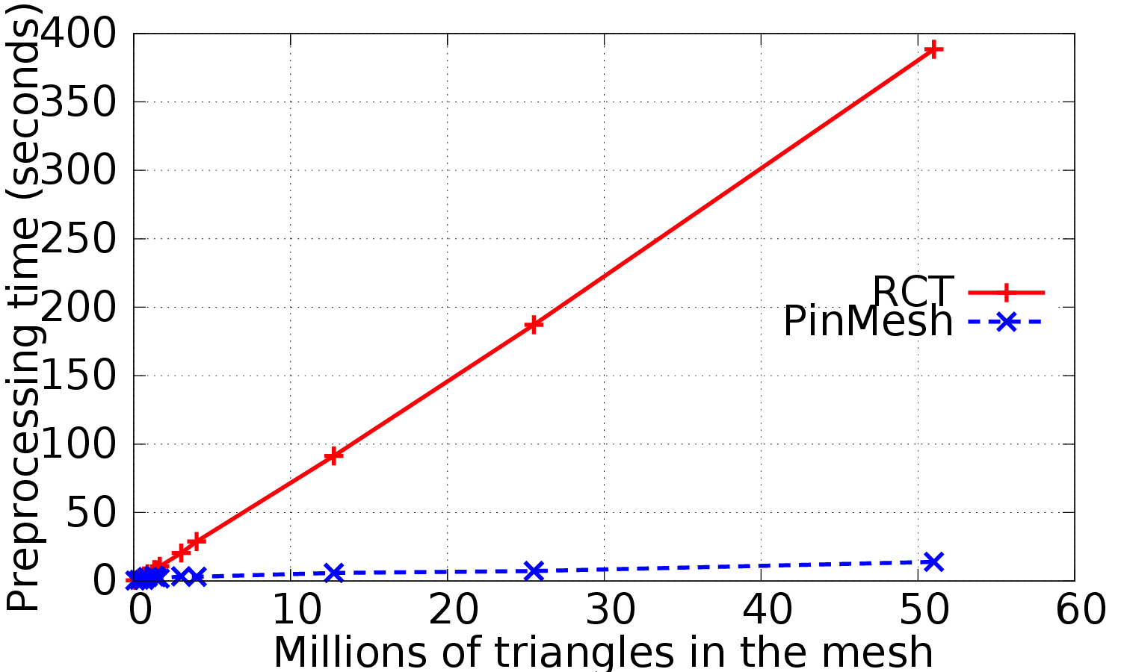
Experimental results
Comparing preprocessing time

Slide 41
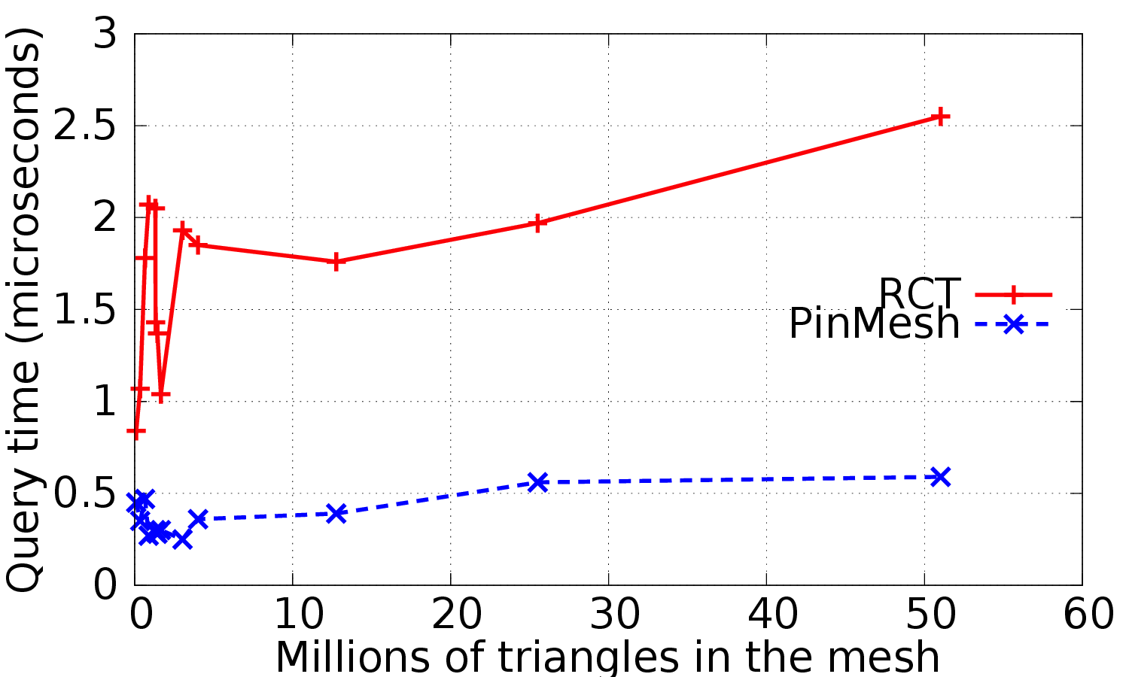
Experimental results
Comparing querying time

Slide 42
Experimental results
PinMesh’s parallel performance was evaluated running it with different numbers of threads
Processing time to perform one million of queries in the largest mesh (the 24 materials)

Slide 43
Experimental results
PinMesh’s parallel performance was evaluated running it with different numbers of threads
Processing time to perform one million of queries in the largest mesh (the 24 materials)
Even with 1 thread PinMesh was faster than RCT:
PinMesh spent 70s while RCT 401s

Slide 44
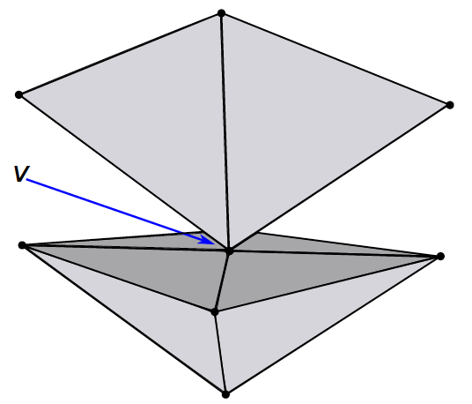
Experimental results
Besides being faster than RCT and preventing round-off errors, PinMesh has another important advantage.
PinMesh can treat some special cases that RCT can not do
Suppose a query point vertically below vertex v (inside the pyramid)
The ray will intersect the mesh in v and there are 8 triangles sharing it

Slide 45
Conclusions
We presented PinMesh a very fast, parallel- izable, and exact algorithm for locating a cloud of points in a 3D mesh
PinMesh always determines point location queries correctly, even with inputs having many special cases
The code is freely available to be used in other applications

Slide 46
Conclusions
The code was submitted and approved to the SMI 2016 reproducibility stamp
PinMesh code is freely available in
https://github.com/reproducibilitystamp/PinMesh
Congratulations to the organizers for this excellent initiative:
can stimulate authors to provide a complete open-source implementation

Slide 47
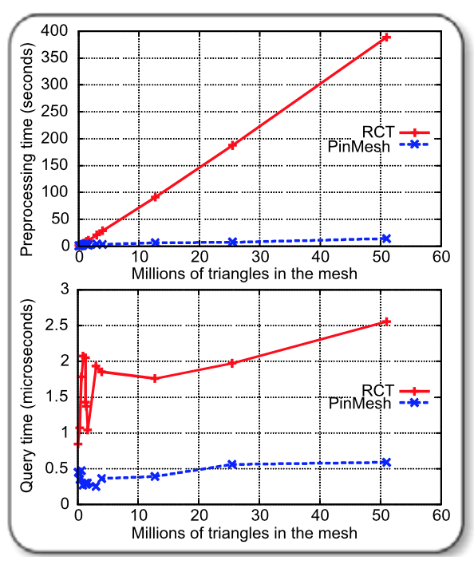
Questions
Acknowledgements Contacts:
marcus@ufv.br
salles@ufv.br
mail@wrfranklin.org
Grant IIS-1117277
UFV

Slide 48
Additional slides

Slide 49
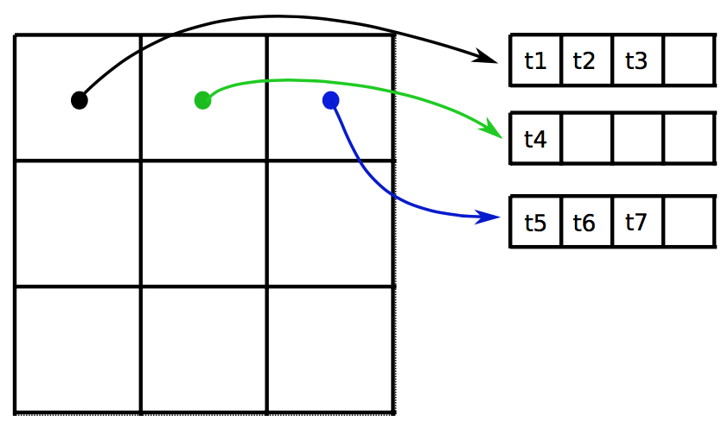
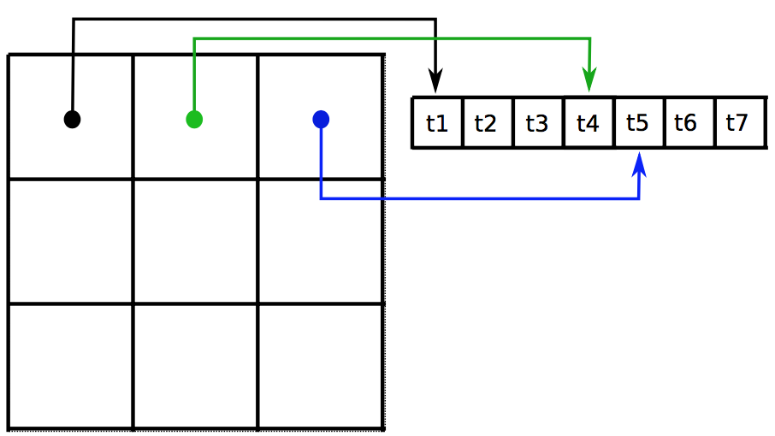
PinMesh Implementation
Grid cells’ contents (references to the triangles) are stored in a ragged array
For example
Conventional arrays Ragged array
The mesh is scanned twice, but only a big array is allocated instead of many small arrays

Slide 50
PinMesh Implementation
The cases that need to be analyzed using SoS are when a λ_{i} is either 0 or 1
The perturbed projected point p’_{ε} is (p’_{x}+ε, p’_{y}+ε², 0)
Replacing p’ with p’_{ε} in barycentric equations:

Slide 51
PinMesh Implementation
Then, analyze these expression to verify when λ_{εi} = 0 or λ_{εi} = 1
Consider λ_{ε0} :
if λ₀ ≠ 0 and λ₀ ≠ 1 0 < λ_{ε0} < 1
If λ₀ = 0 λ_{ε0} < 1. Lacks to show that λ_{ε0} > 0
Suppose det > 0. Then, λ_{ε0} > 0 if and only if (t’_{1y}- t’_{2y})×ε + (t’_{2x}- t’_{1x})×ε² > 0
Which is true:
if (t’_{1y} - t’_{2y}) > 0 or
If (t’_{1y} - t’_{2y}) = 0 and (t’_{2x}- t’_{1x}) > 0
A similar analysis can be done for det < 0

Slide 52
PinMesh Implementation
If λ₀ = 1 λ_{ε0} > 0. Lacks to show that λ_{ε0} < 1
Suppose det > 0. Then λ_{ε0} < 1 if and only if (t’_{1y}-t’_{2y})×ε + (t’_{2x}- t’_{1x})×ε² < 0
Which is true:
if (t’_{1y} - t’_{2y}) < 0 or
If (t’_{1y} - t’_{2y}) = 0 and (t’_{2x}- t’_{1x}) < 0
The other two functions used in PinMesh can be analyzed in a same way
The implementation of these functions includes some extra clauses to check these special cases
There is no significant overhead

Slide 53
Experimental results
In all tests the PinMesh’s uniform grid was configured as:
first level with 64³ cells.
all cells containing one or more triangles were refined (to increase the number of empty cells)
second level resolution was chosen to have a expected number of triangles per cell equal to 0.0005

