Slide 1
Resources for Learning LabVIEW Software Development
March 2010

Slide 2
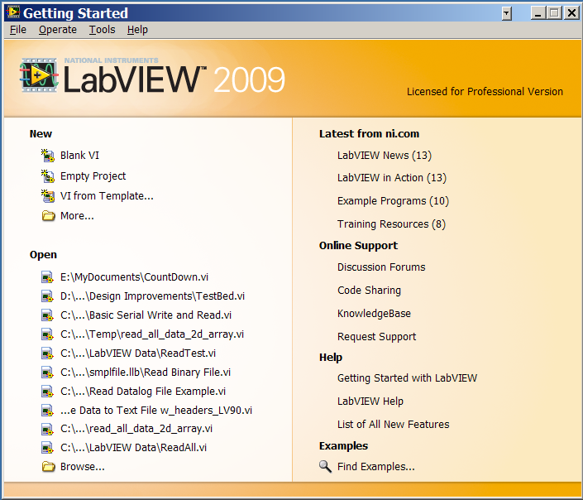
Getting Started with LabVIEW

Slide 3
Introductory Tutorial Courses
NI (Academic) Tutorials
http://www.ni.com/academic/learn_labview/
LabVIEW Introduction – Three-Hour Courseware
LabVIEW Introduction – Six-Hour Courseware

Slide 4
Computer Based Training
NI LabVIEW Core Software (Yellow DVD 1 of 2)
LabVIEW Basic 1
LabVIEW Basic 2

Slide 5
Software Engineering with LabVIEW
http://zone.ni.com/devzone/cda/tut/p/id/7117
NI Developer Zone
Configuration Management Tools and Guidelines
Requirements Gathering and Mapping
Application Architecture
Code Re-Use and Interoperability
Developing, Debugging and Reviewing Code
Testing and Validation of LabVIEW Application
Development Process

Slide 6
Books (1 of 3)
A list of LabVIEW Books
http://zone.ni.com/devzone/cda/pub/p/id/409
RPI Library Web Resource
LabVIEW digital signal processing and digital communications [electronic resource] Clark, Cory L. New York : McGraw-Hill, c2005.
LabVIEW advanced programming techniques [electronic resource] Bitter, Rick. Boca Raton, Fla. : CRC Press, c2001.

Slide 7
Books (2 of 3)
RPI Folsom Book Stacks
LabVIEW for everyone : graphical programming made easy and fun. Travis, Jeffrey. , Upper Saddle River, NJ : Prentice Hall, c2007. Q183.A1 T73 2007
LabVIEW graphical programming Johnson, Gary W., 1958- , New York : McGraw-Hill, c2006. Q185 .J64 2006
Virtual bio-instrumentation : biomedical, clinical, and healthcare applications in LabVIEW Olansen, Jon B., Upper Saddle River, NJ : Prentice Hall PTR, c2002. R856 .O434 2002
LabVIEW advanced programming techniques Bitter, Rick. , Boca Raton : CRC Press, c2001. QA76.6 .B5735 2001
Internet applications in LabVIEW Travis, Jeffrey. Upper Saddle River, NJ : Prentice Hall, c2000. Q185 .T83 2000

Slide 8
Books (3 of 3)
Design Lab References
LabVIEW & Data Acquisition
Robert H. King, Introduction to Data Acquisition with LabVIEW, McGraw-Hill Co., Inc. 2009
National Instruments, LabVIEW Measurement Manual, April 2003 Edition.
DIAdem Manuals
National Instruments, DIAdem Basics Course Manual, April 2007 Edition
National Instruments, DIAdem Advanced Course Manual, April 2007 Edition

