Slide 1

Materials Selection in 30 Minutes
Prof. Dan Lewis
Materials Science and Eng. lewisd2, X2297, MRC 110

Slide 2
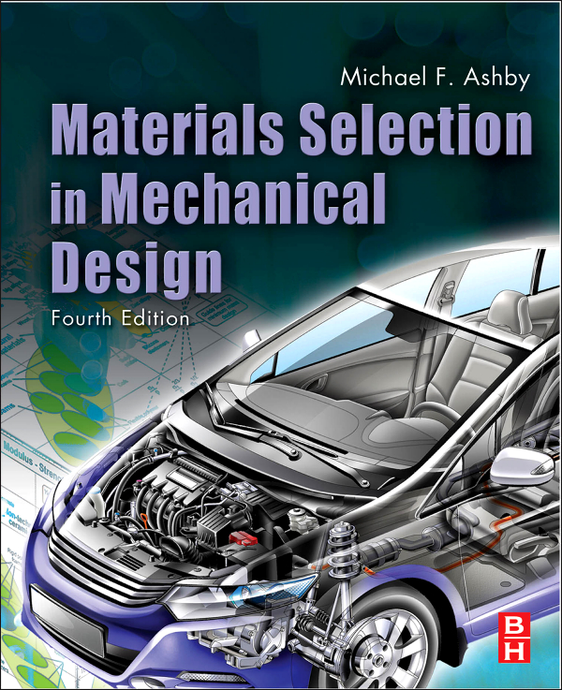
Materials Selection in Mechanical Design, 4th Edition © 2010 Michael Ashby

Slide 3
Materials Selection Requires:
Identification of objectives, constraints, and free variables.
Development of a performance equation.
Inspection of materials properties (through materials indices).
Seeking documentation on specific materials.
All of the above.

Slide 4
Materials Selection Requires:
Identification of objectives, constraints, and free variables.
Development of a performance equation.
Inspection of materials properties (through materials indices).
Seeking documentation on specific materials.
All of the above.

Slide 5

Early cameras were made of wood and constructed with the care and finish of a cabinetmaker; they had well-ground glass lenses manufactured by techniques developed for watch and clock making
Figure 1.5
High-end cameras are now manufactured with the precision and electronic sophistication of scientific instruments; lower-end models are made with molded polypropylene or ABS bodies

Slide 6
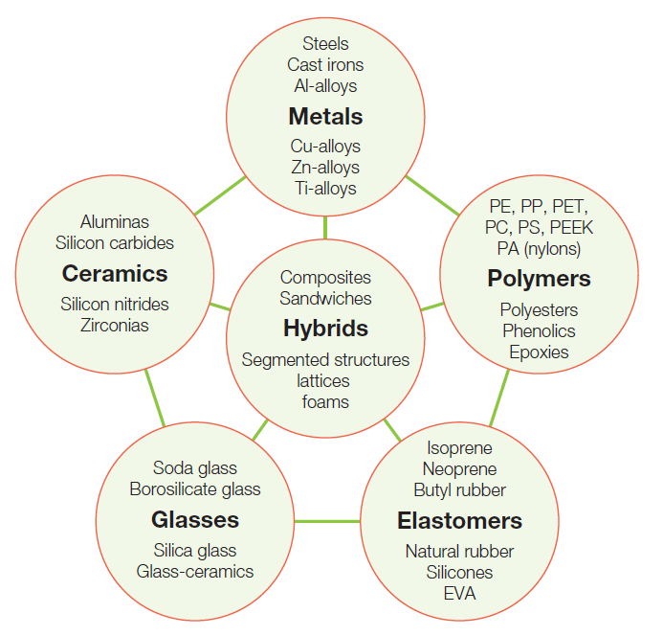
Menu of Engineering Materials
The members of a material family have certain features in common: similar properties, similar processing routes, and, often, similar applications
Figure 3.1

Slide 7
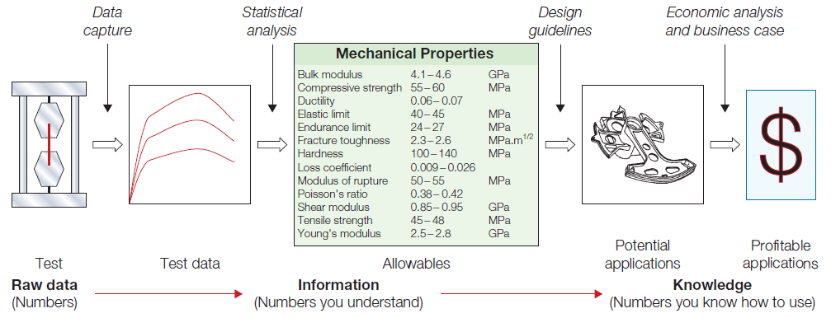
What type of materials information do
you need for design?
Figure 3.2
We are interested in the data in the center of the schematic; structured data for design allowables and information concerning the materials ability to be formed, joined, and finished

Slide 8
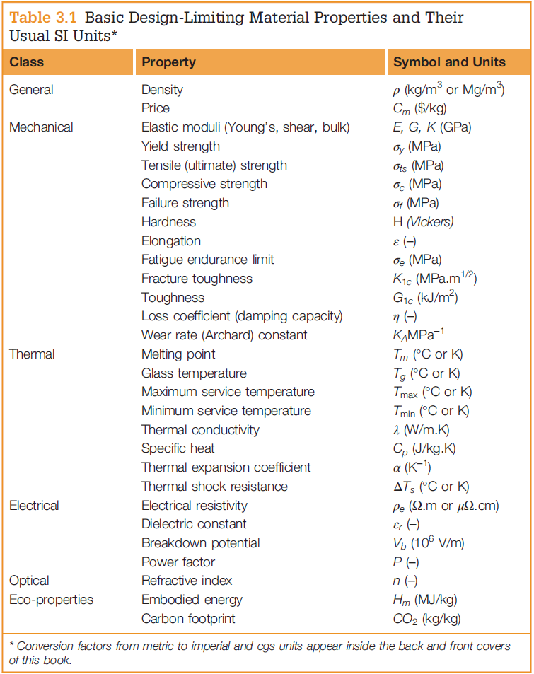
Material Properties and Their Units
Each material can be thought of as having a set of attributes or properties
The combination that characterizes a given material is its property profile
Figure 3.3

Slide 9
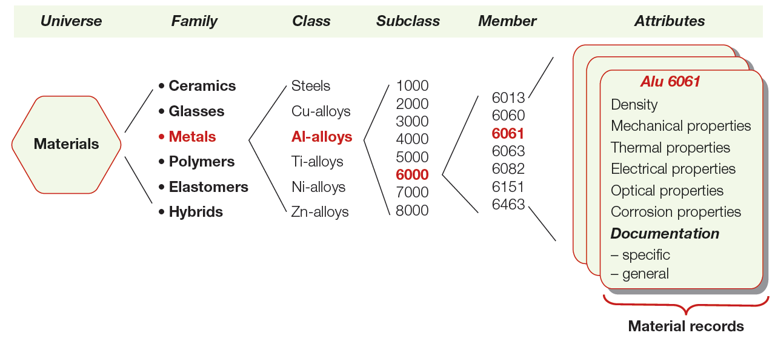
Figure 5.2
The universe of materials is divided into families, classes, subclasses, and members; each member is characterized by a set of attributes: its properties

Slide 10
Objectives
Consider what is meant when you think of the definition of “objective”. Get your iClickers ready…

Slide 11
Identify the objectives among “A”, “B” and “C” below.
My summer job must pay in excess of $10/hour.
If I walk to work, I would like my commute to last no more than 10 minutes.
Today, the recipe requires 454 g of flour to bake bread.
“A” and “B” are objectives, “C” is not.
“A”, “B”, and “C” are NOT objectives.

Slide 12
Identify the objectives among “A”, “B” and “C” below.
My summer job must pay in excess of $10/hour.
If I walk to work, I would like my commute to last no more than 10 minutes.
Today, the recipe requires 454 g of flour to bake bread.
“A” and “B” are objectives, “C” is not.
“A”, “B”, and “C” are NOT objectives.

Slide 13
Identify the objectives among “A”, “B” and “C” below.
Pay > $10/hour (I want to maximize my pay.)
T_{walk} < 10 minutes (I want the shortest commute possible.)
M_{flour} = 454 grams (not seeking a maximum or minimum, just a statement of property needs.)
“A” and “B” are objectives, “C” is not.
“A”, “B”, and “C” are NOT objectives.

Slide 14
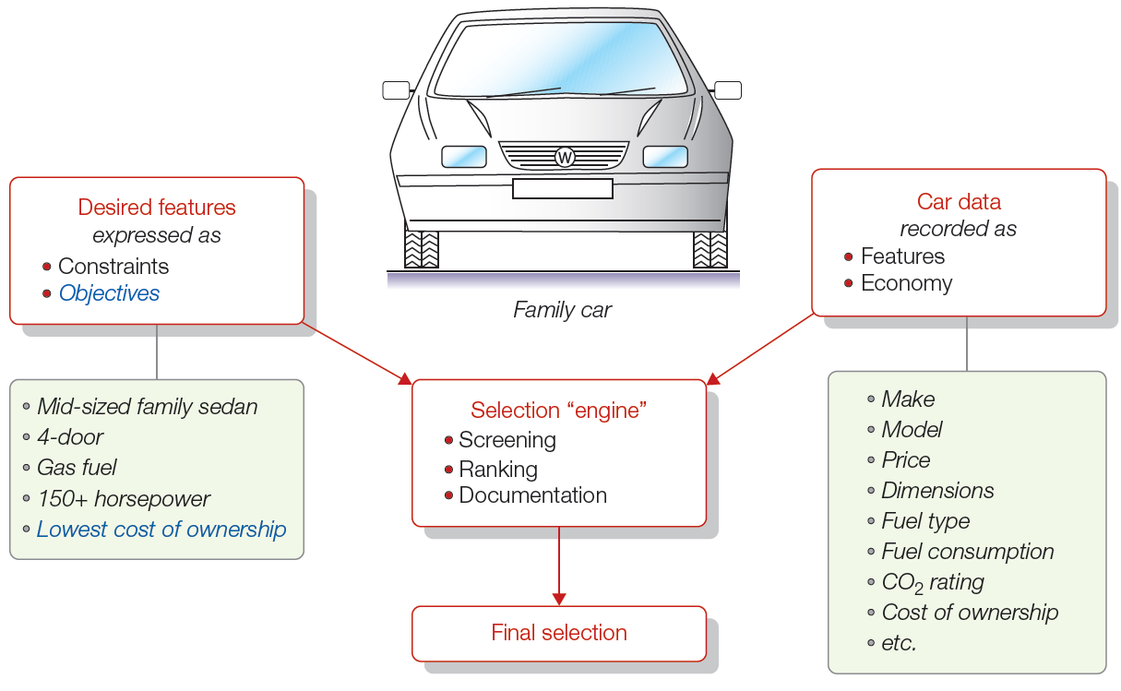
Selection Strategies
Figure 5.3
Required features are constraints; they are used to screen out unsuitable cars. The survivors are ranked by cost of ownership

Slide 15
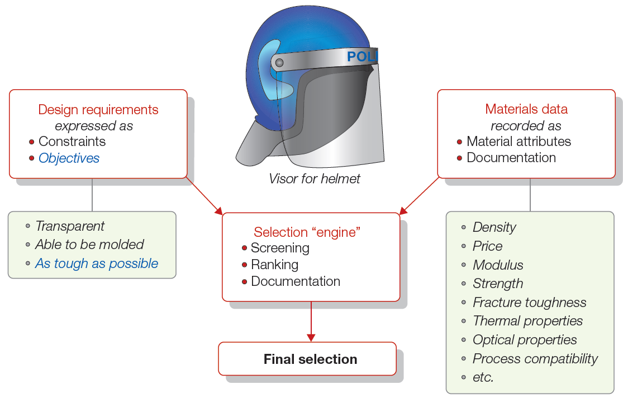
Choosing a Material
Figure 5.14
Design requirements are first expressed as constraints and objectives. The constraints are used for screening. The survivors are ranked by the objective, expressed as a material index.

Slide 16
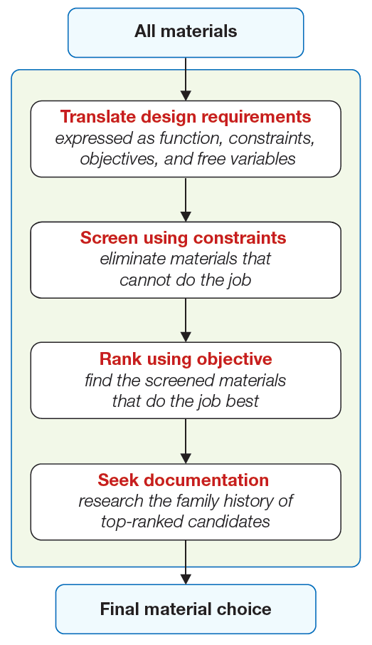
Strategy for Materials Selection
The four main steps:
Translation
Screening
Ranking
Documentation
Figure 5.5

Slide 17
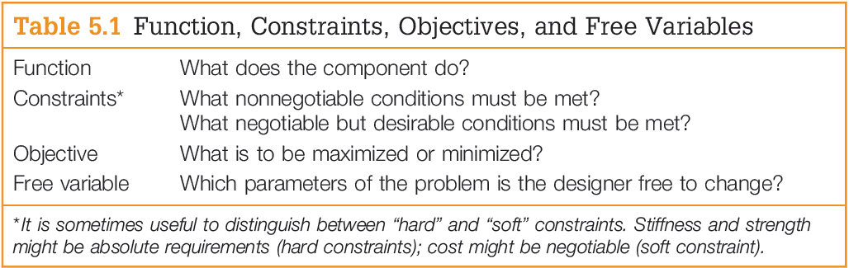
Translating Design Requirements

Slide 18
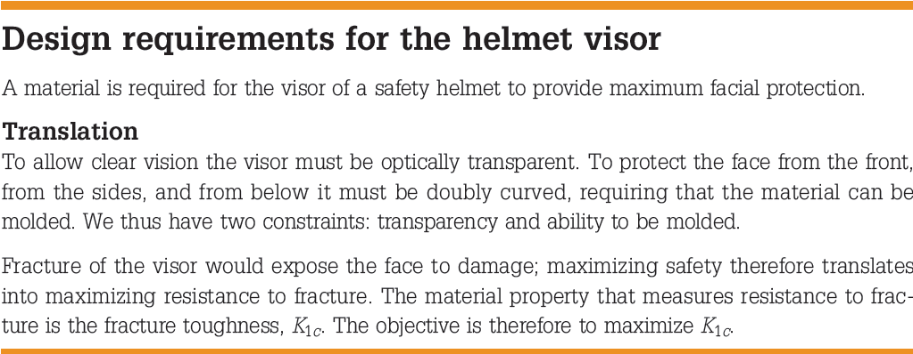
Figure 5.14

Slide 19
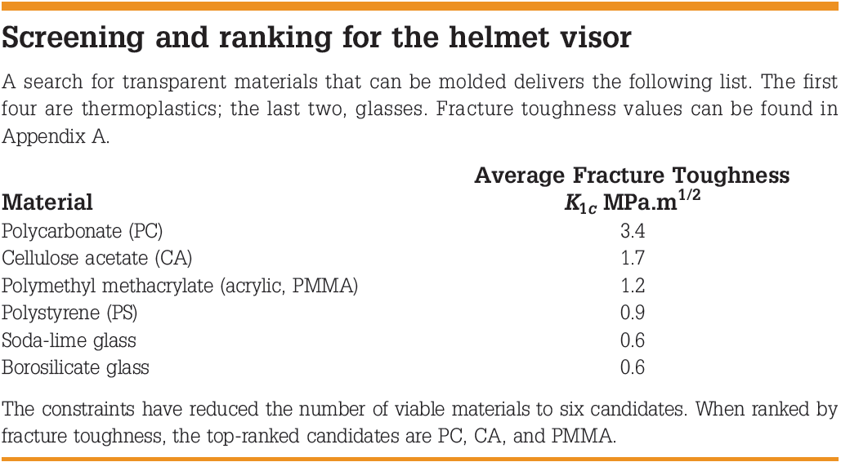
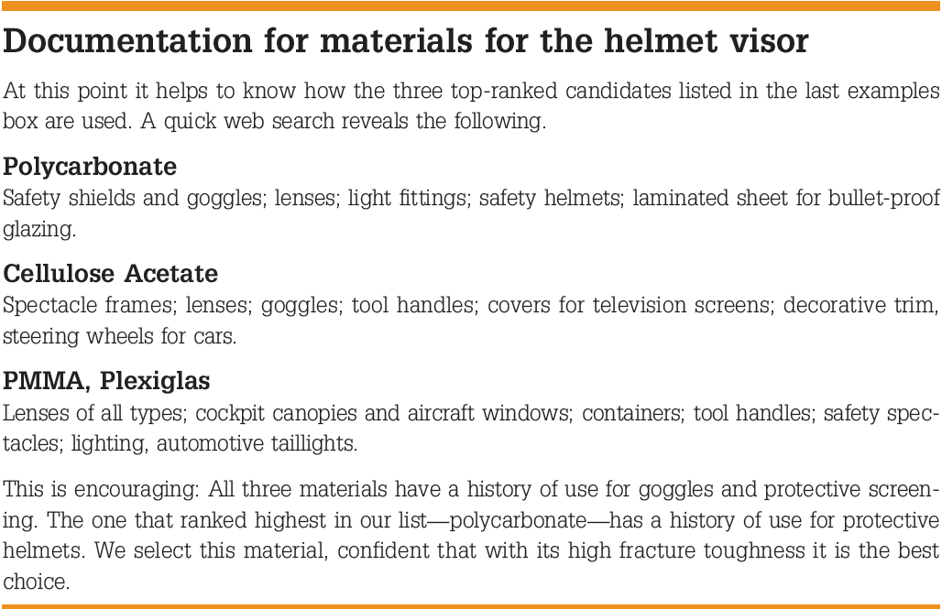

Slide 20
Material Indices
Constraints set property limits.
Objectives define material indices, for which we seek extreme values.

Slide 21
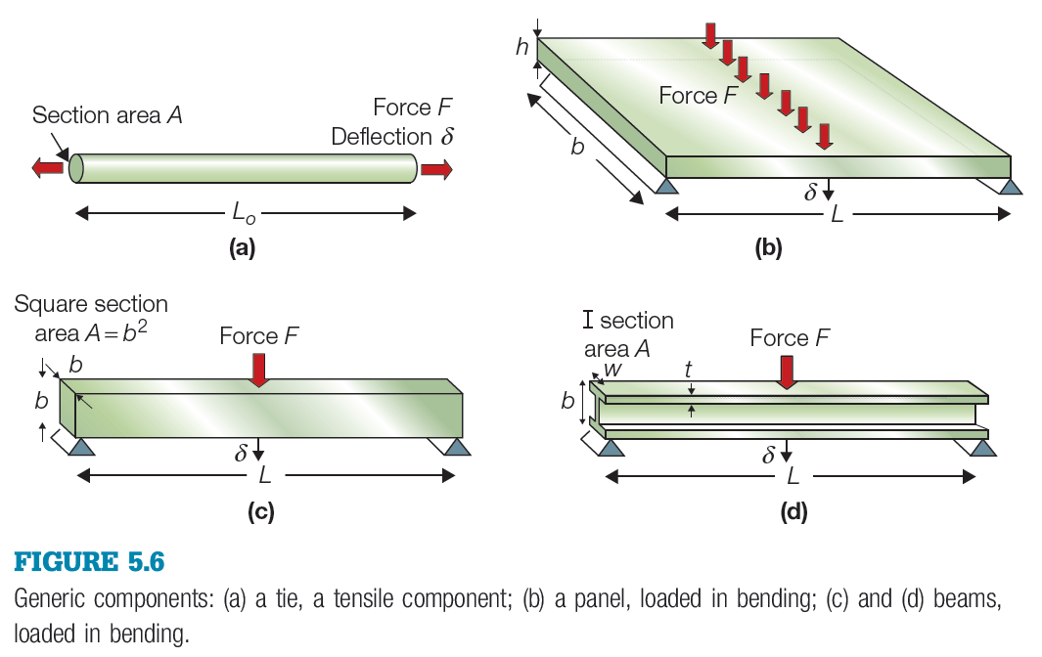

Slide 22
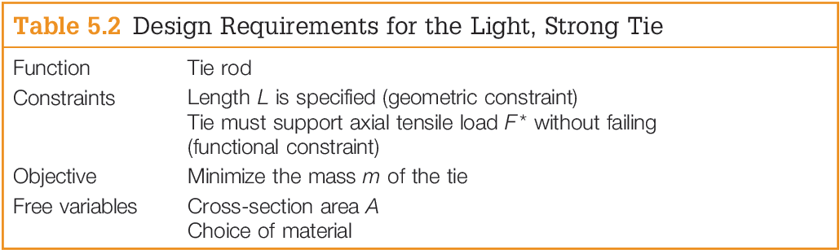

Minimizing Mass: A light, strong tie
Objective Function: equation describing the quantity to be maximized or minimized.

Slide 23

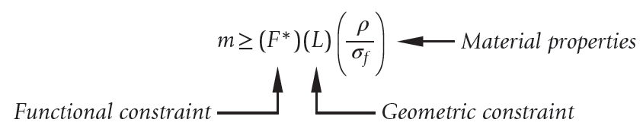

We can reduce the mass by reducing the cross-section, but there is a constraint: A must be sufficient to carry F*, requiring that:
Eliminating A between these two equations gives:
Material indices are generally expressed so that a
maximum value is sought, so the material index
for a light, strong tie is:

Slide 24
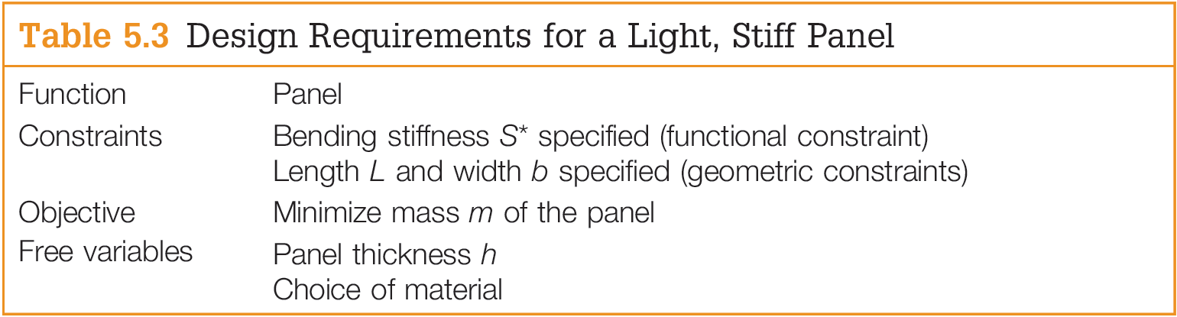



Minimizing Mass A light, stiff panel
Objective Function
Constraint on Stiffness
Second Moment of Area

Slide 25
Break Into Groups and Develop the Performance Equation for the Light, Stiff Panel
Objective Function
Constraint on Stiffness
Second Moment of Area

Slide 26
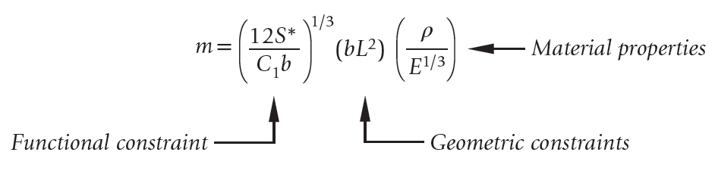

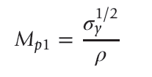
Material index for a light, stiff panel
Material index with a constraint of strength rather than stiffness

Slide 27
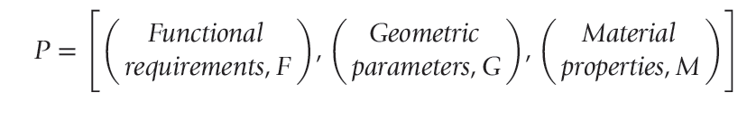
Performance Equation
The performance of a structural element is determined by three things: the functional requirements, the geometry, and the properties of the material of which it is made.

Slide 28
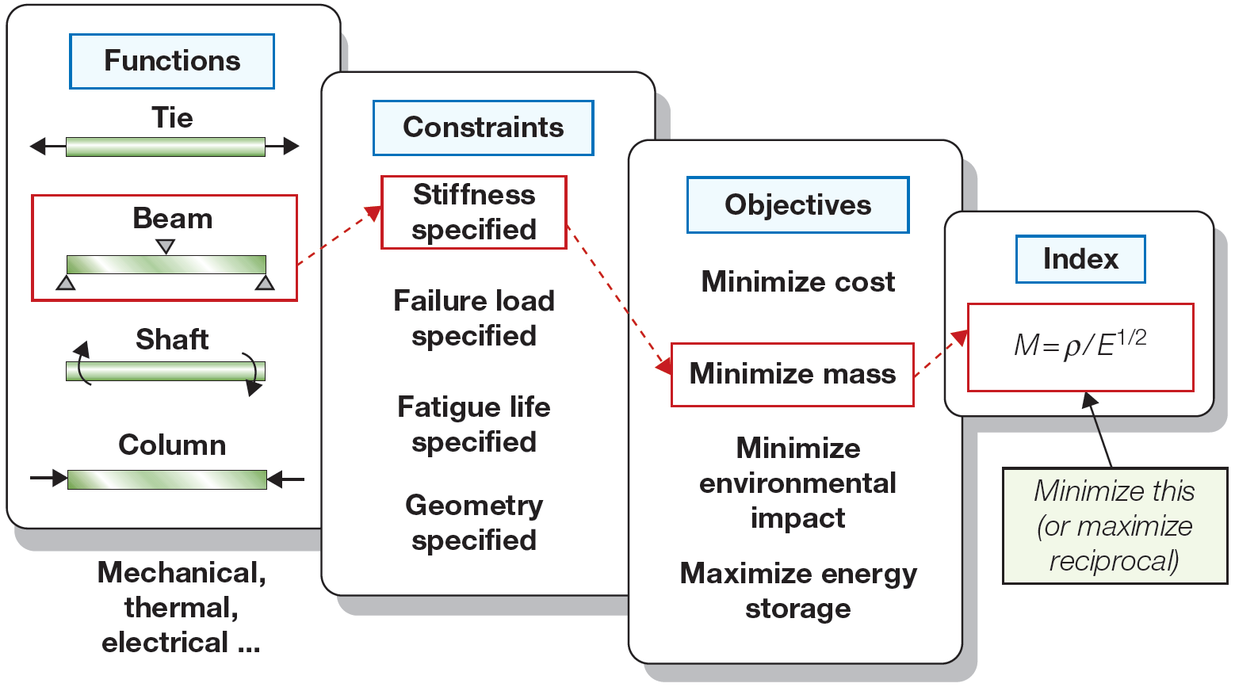
Figure 5.7
The specification of function, objective, and constraint leads to a materials index. The combination in the highlighted boxes leads to the index E^{1/2}/ρ.

Slide 29
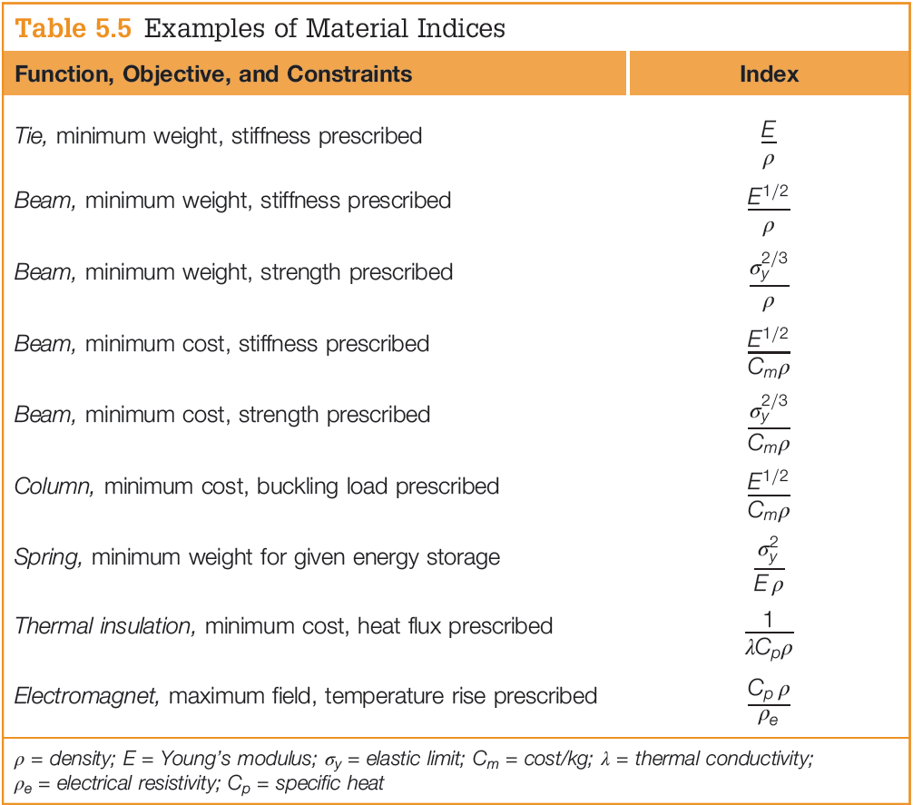

Slide 30
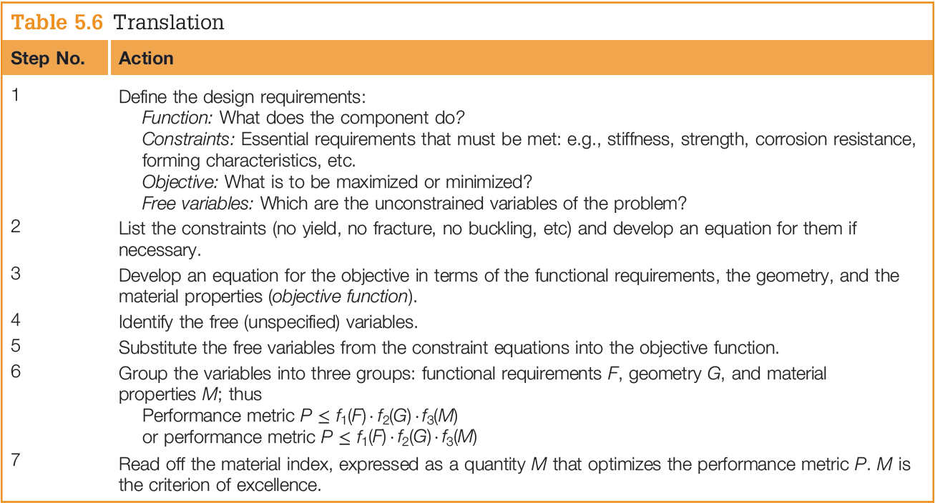

Slide 31
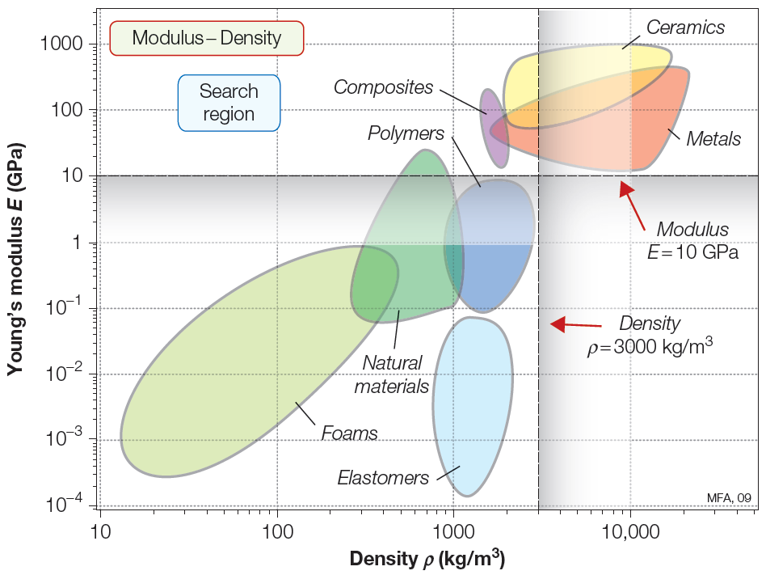
Figure 5.8
A schematic E-ρ chart showing a lower limit for E and an upper limit for ρ.

Slide 32
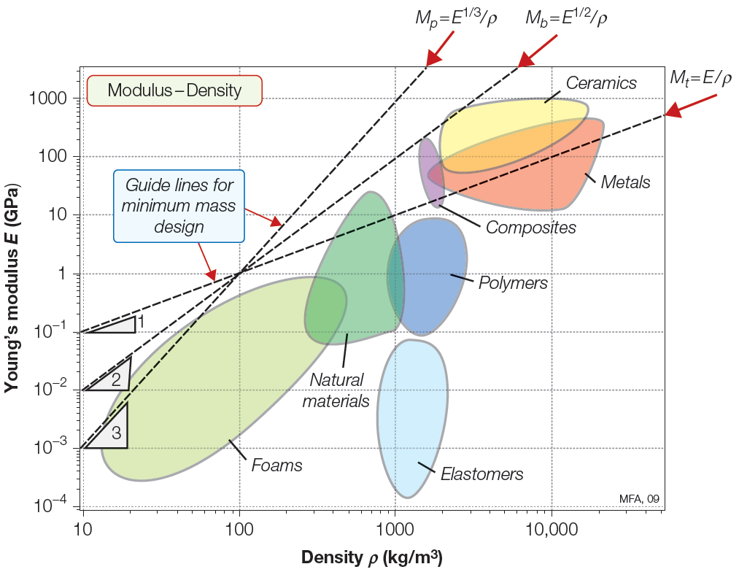
Ranking: Indices on Charts
Figure 5.9
A schematic E-ρ chart showing guide lines for the three material indices for stiff, lightweight design.

Slide 33
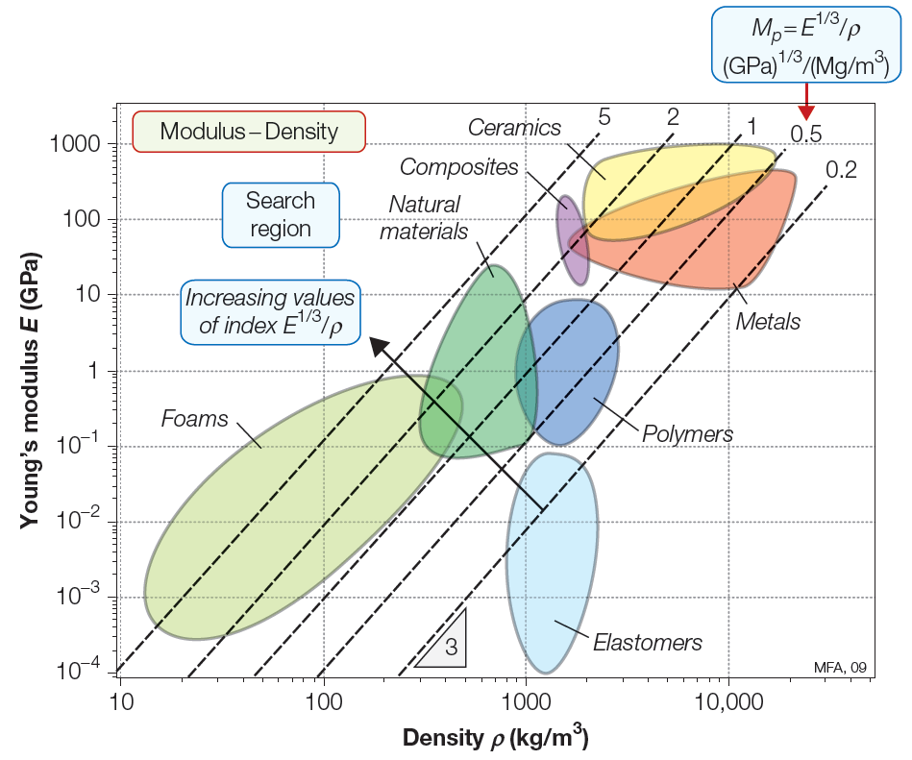
Figure 5.10
A schematic E-ρ chart showing a grid of lines for the material index M=E^{1/3}/ρ.

Slide 34
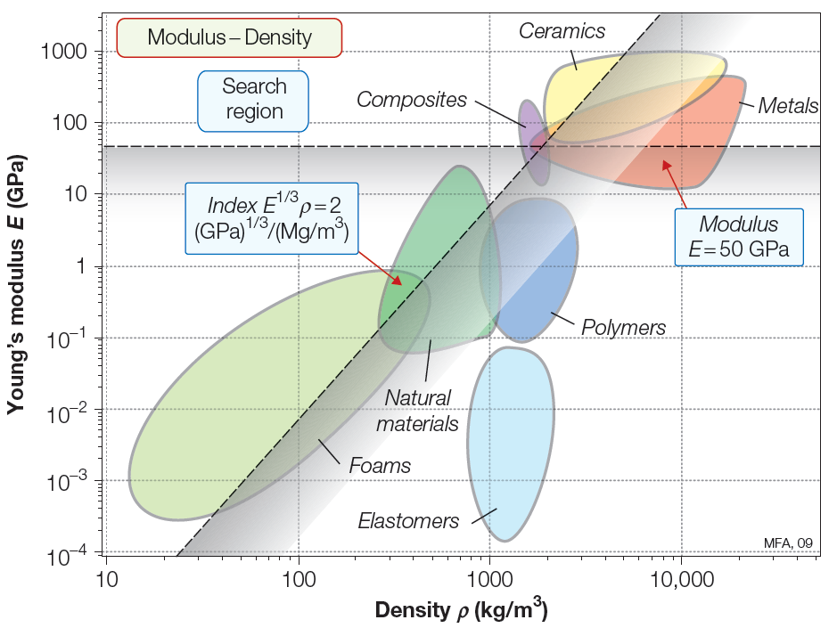
Figure 5.11
A selection based on the index M=E^{1/3}/ρ > 2(GPa)^{1/3} (Mg/m³) together with the property limit E > 50 GPa. The materials contained in the search region become the candidates for the next stage of the selection process

Slide 35
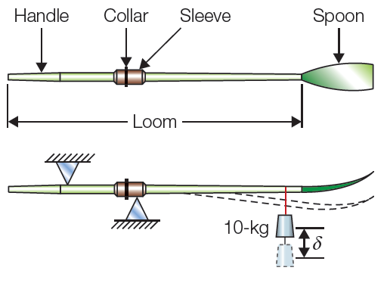
Materials for Oars
Credit for inventing the rowed boat seems to belong to the Egyptians. The real stimulus for development of boats and oars came in 1900 with the establishment of rowing as an Olympic sport. Since then both have drawn the fullest craftsmanship and materials of their day.
Figure 6.11

Slide 36
Materials for Oars: Translation
An oar is essentially a beam loaded in bending
Oars must be strong enough not to break, but they are designed on stiffness – to give a specified elastic deflection under a given load
Must also be light – extra weight increases the drag on the hull
Oars must also be tough enough to withstand being dropped or clashing together

Slide 37
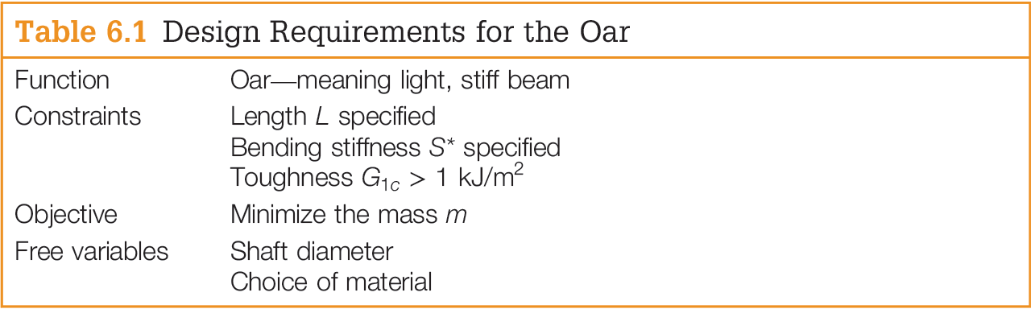

The material index for the oar is that
for a light, stiff beam:

Slide 38
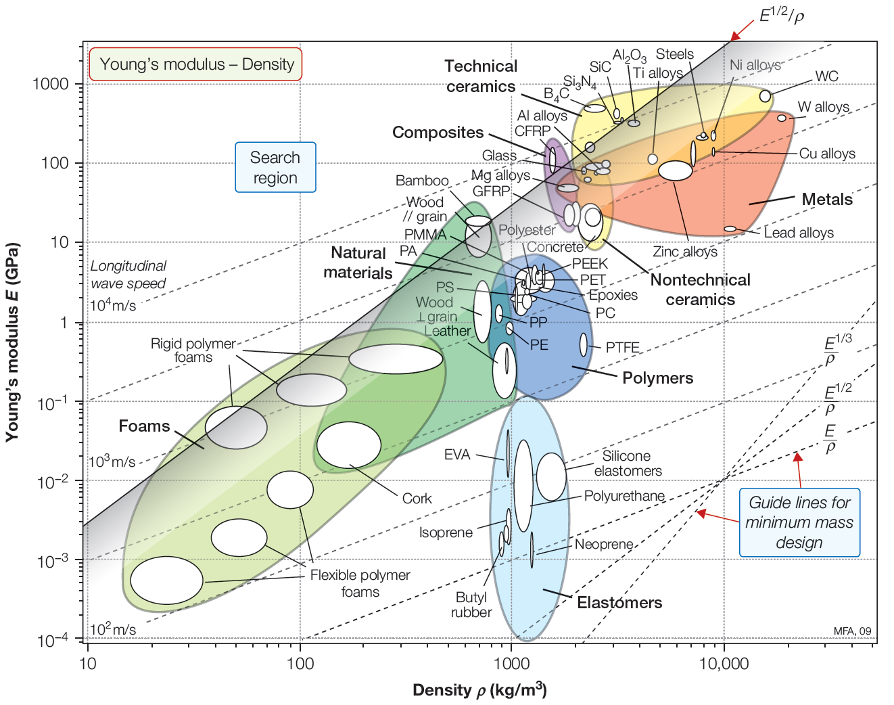
The appropriate selection chart plots Young’s modulus against density. The selection line for the material index has a slope of 2; it is positioned so that a small group of materials is left above it. They are the materials with the largest values of M and represent the best choice, provided they satisfy the other constraints.
Woods, carbon-
reinforced polymers,
and certain ceramics
are the best choices
based on their
location relative to
the selection line
Figure 6.2

Slide 39
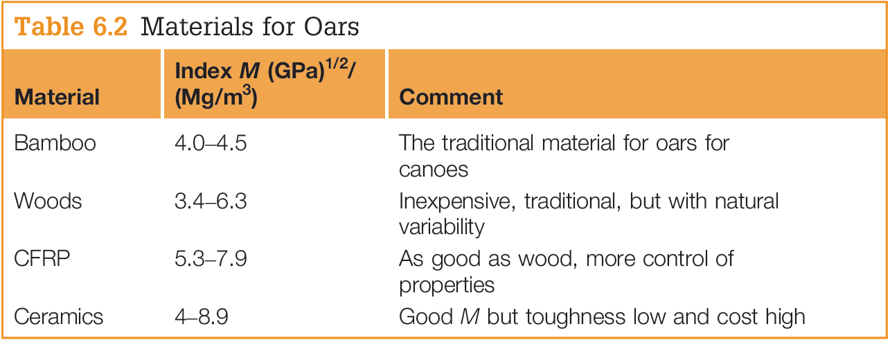
Ceramics are brittle and fail to meet the toughness constraint of the design. Composite blades are lighter than wood for the same stiffness and offer greater control of properties. Until recently a CFRP oar cost more than a wooden one, but the price of carbon fibers has fallen sufficiently that the two cost about the same.

Slide 40

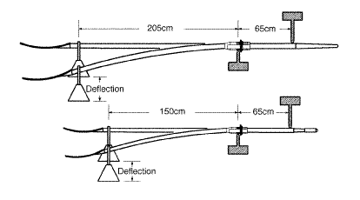

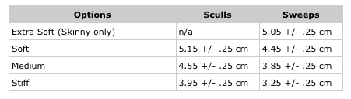
Oars made of fiberglass and carbon fiber are extremely durable, but do not assume they will survive collisions. If oars are involved in a collision, inspect them carefully for signs of damage before continuing to row with them.

