Slide 1
Jeremy Laflin
Lecturer, MANE
Rensselaer Polytechnic Institute
Applications of Basic Machine Elements
Introduction to Engineering Design

Slide 2
Today’s Objectives
Provide some basic analysis concepts to help increase your team project success
Make you think about way to apply basic analysis to your project
Make you aware of some basic mechanical elements that can be used in your project

Slide 3
Today’s Agenda
Basic Mechanical Elements
Application of Mechanics
Fasteners
Structural support
Transfer of rotational motion
Analysis
  Planning motion
    Mechanism design example
  Failure
    Catastrophic
    Performance out of spec.

Slide 4
iClicker Question
Do you intend on building anything for your team project ?
A) Yes
B) No
C) What team project ?
D) What was the question ?

Slide 5



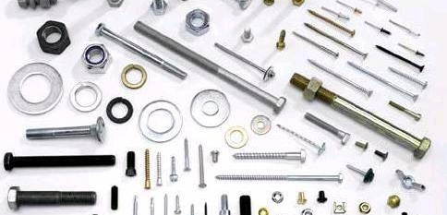
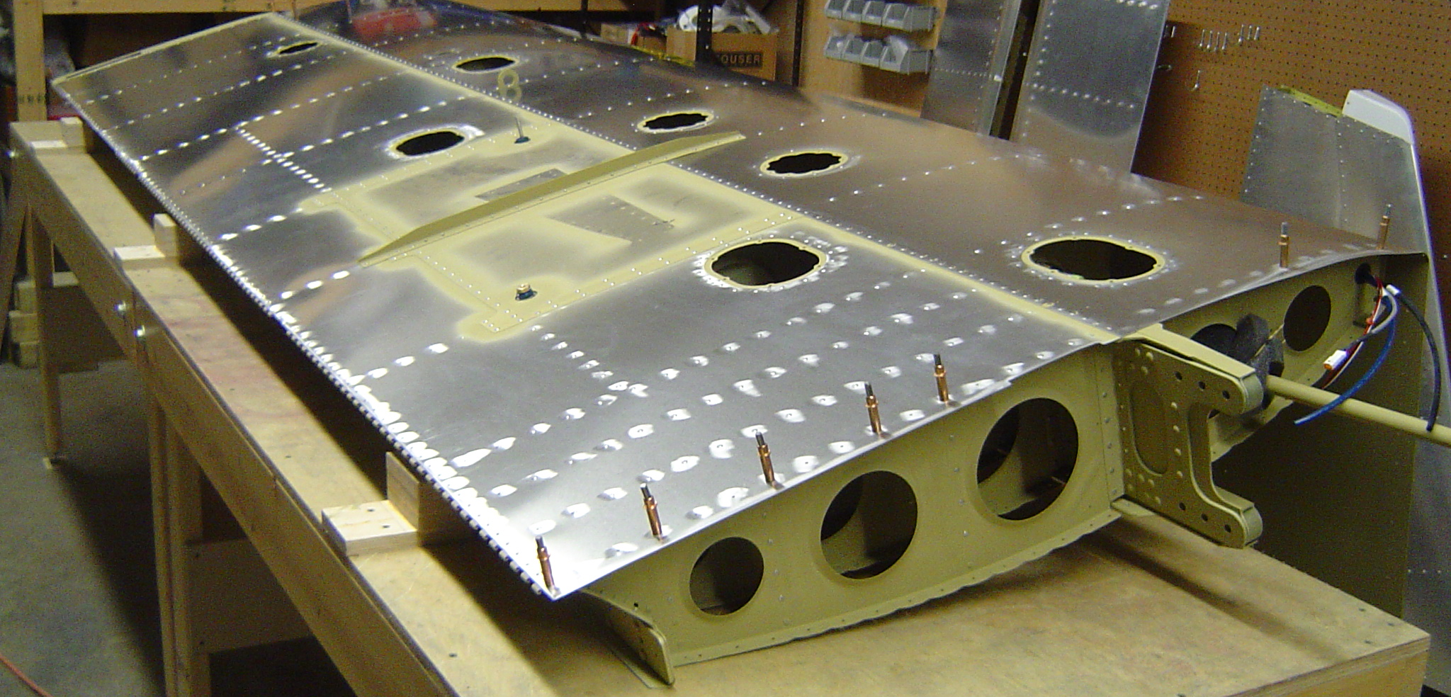
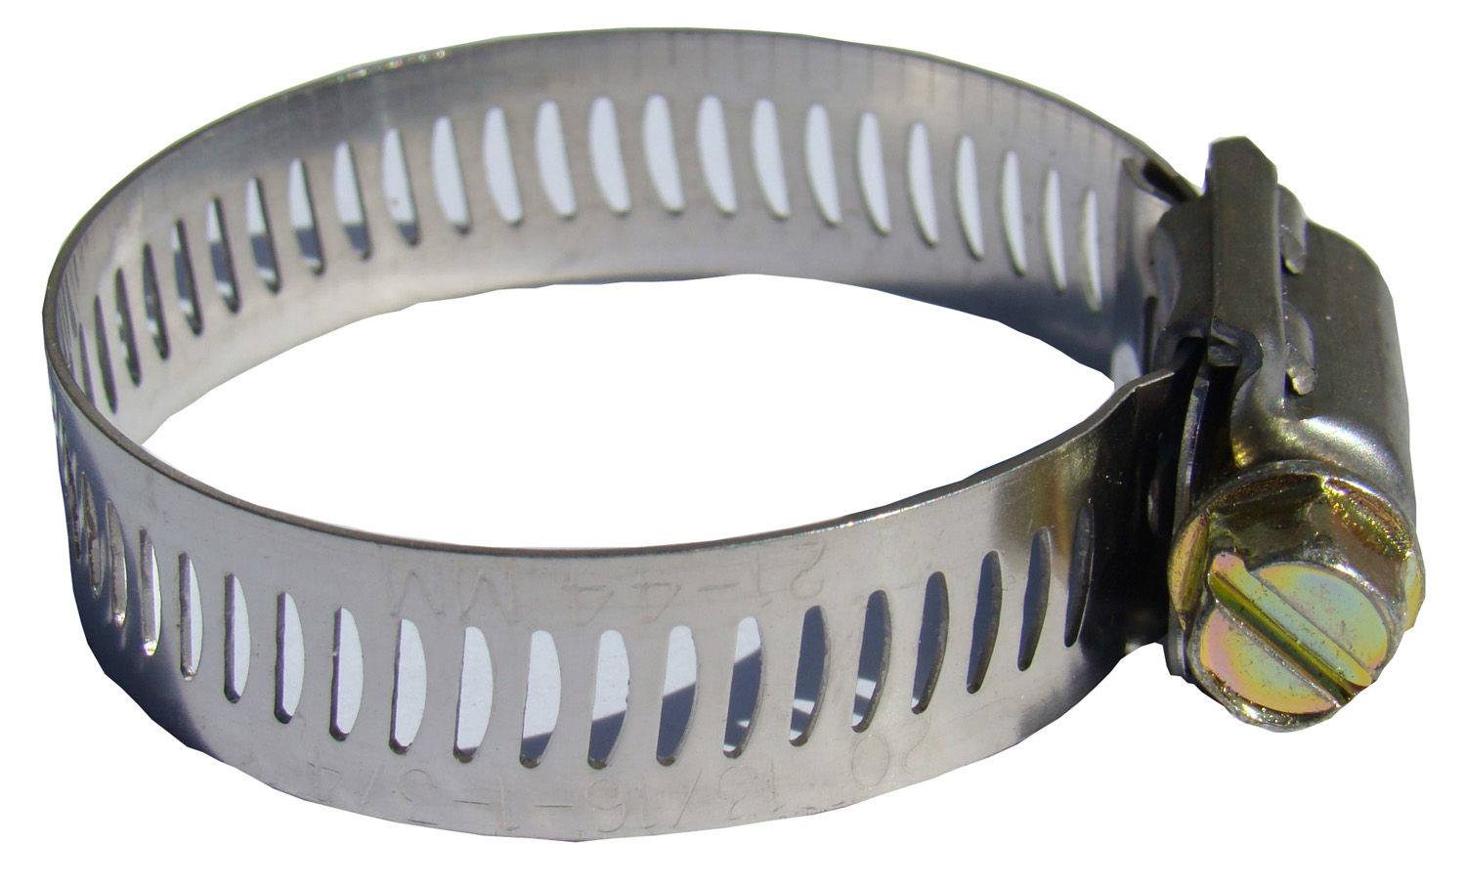
O(10⁵)
Mechanical Elements: Attachment

Slide 6
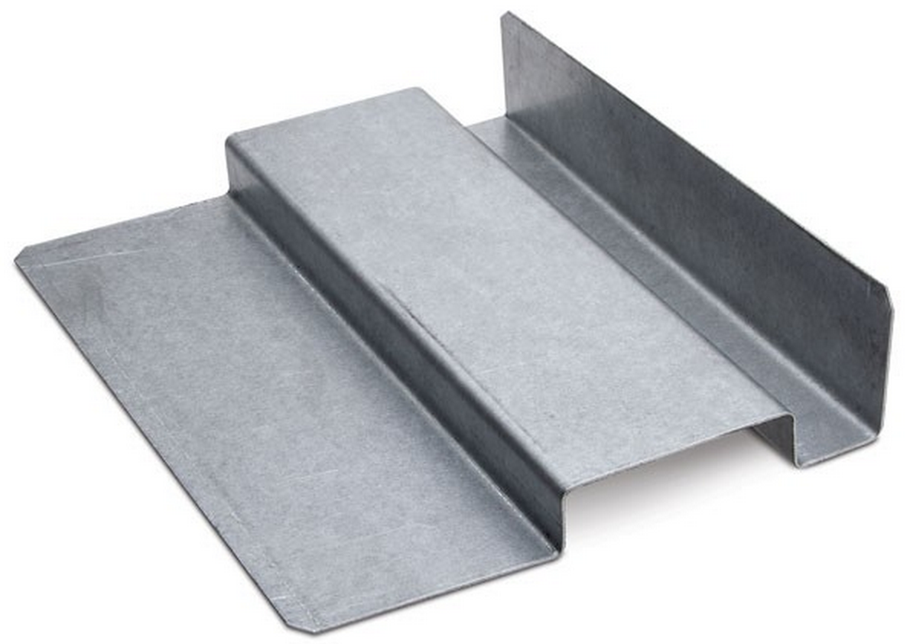
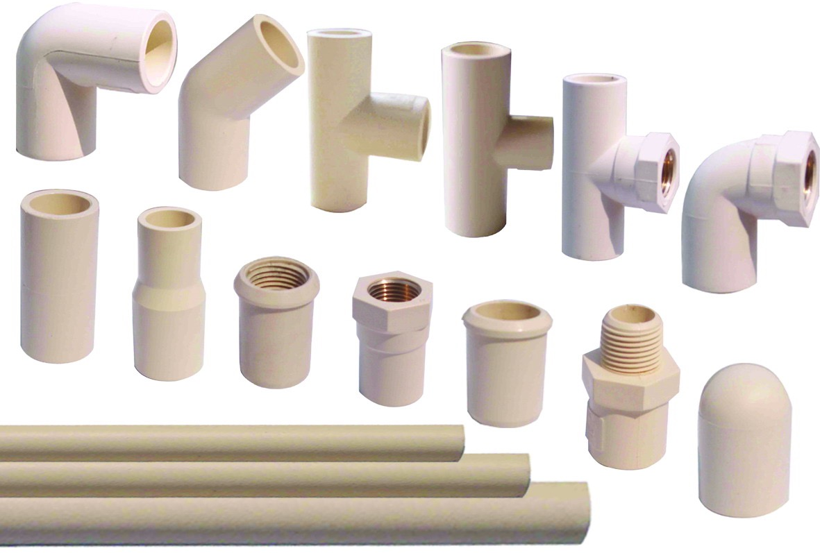
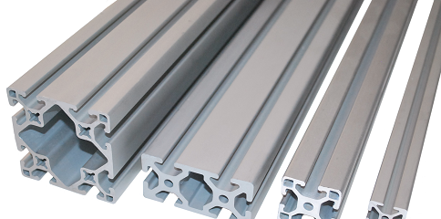
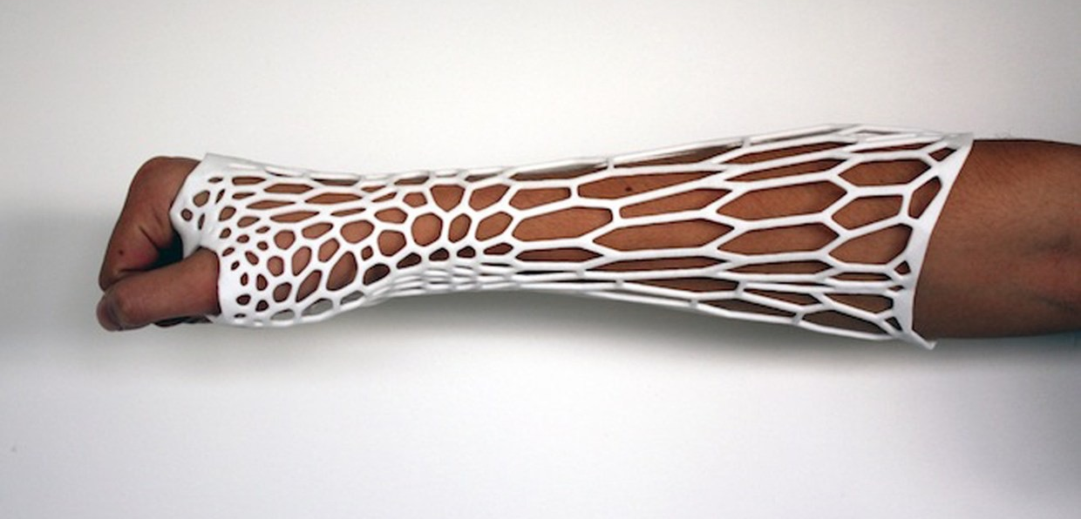
O(10⁵)
Mechanical Elements: Structural Components

Slide 7
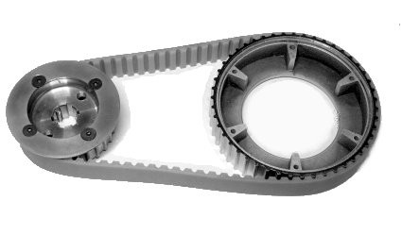
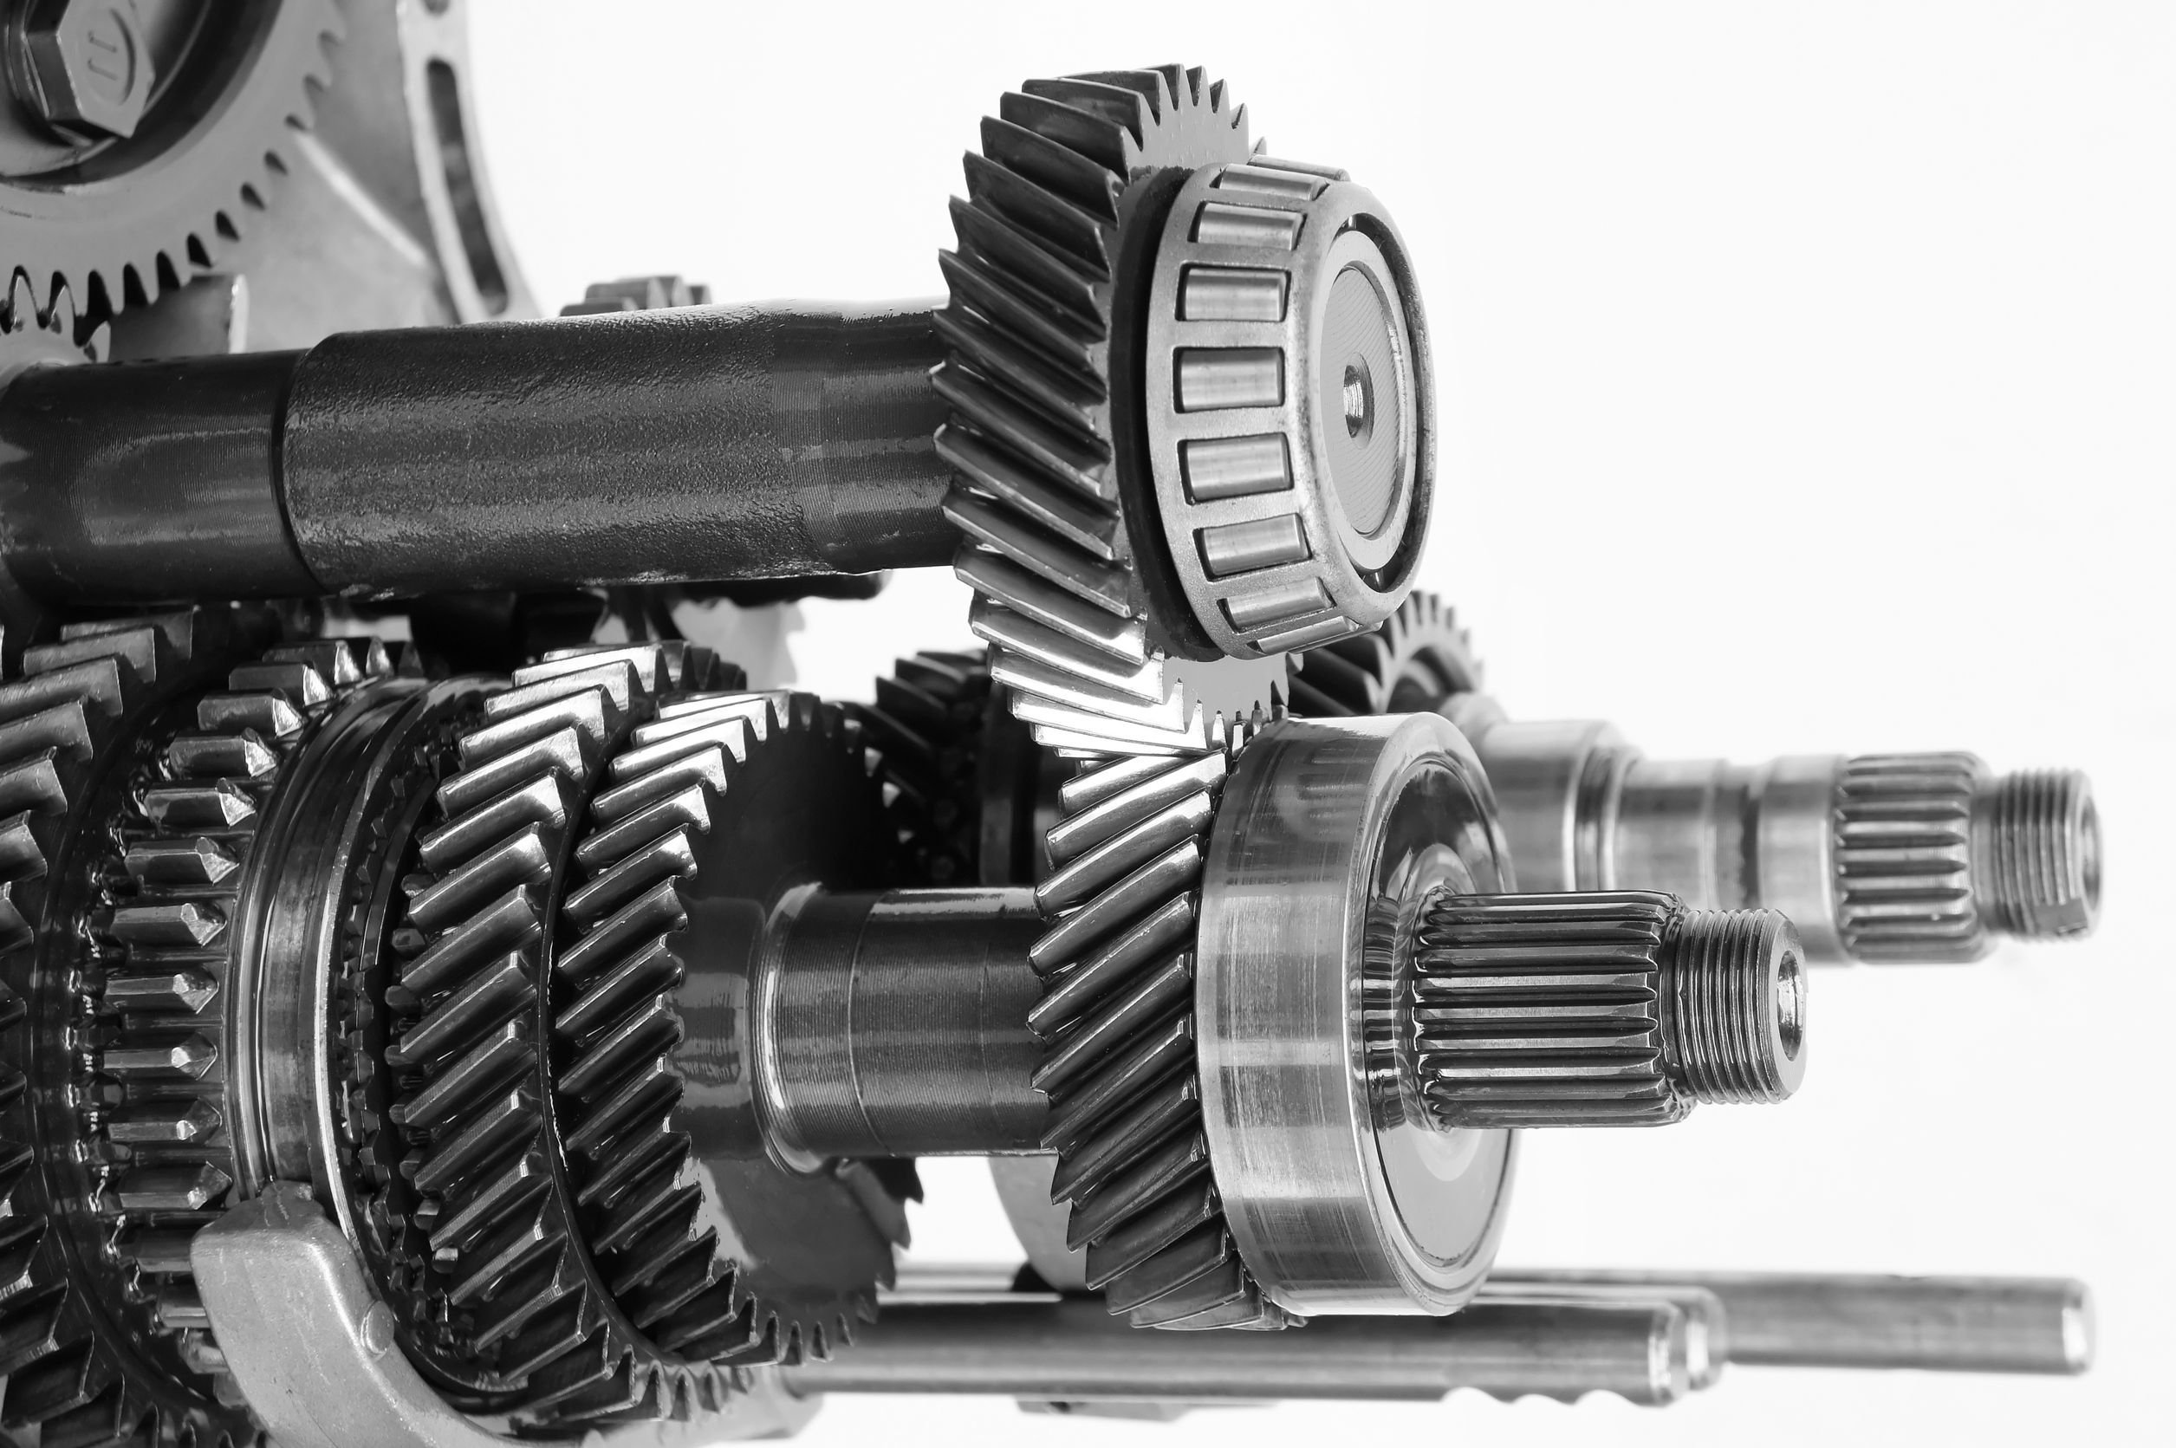
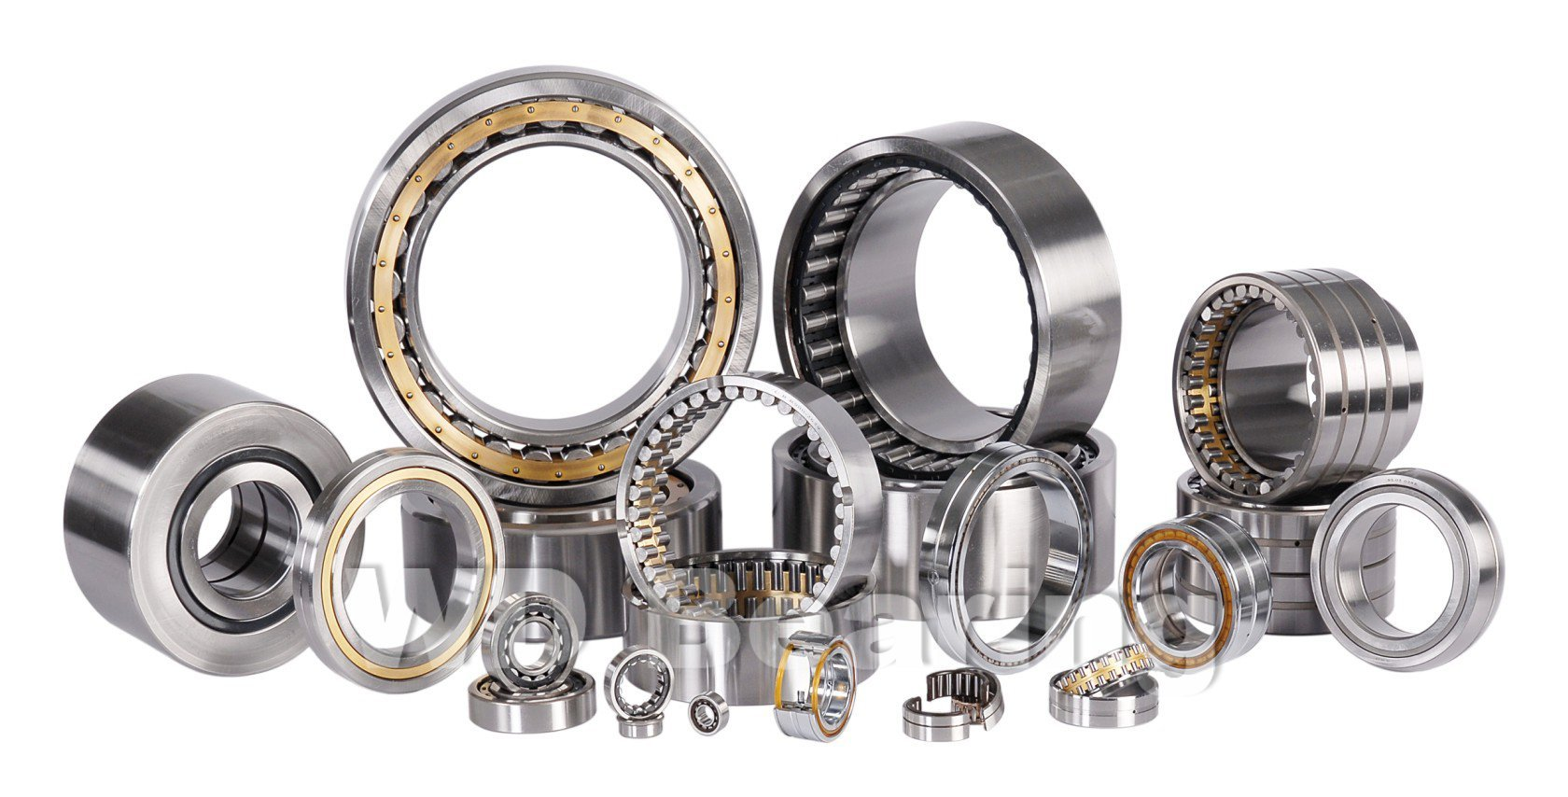
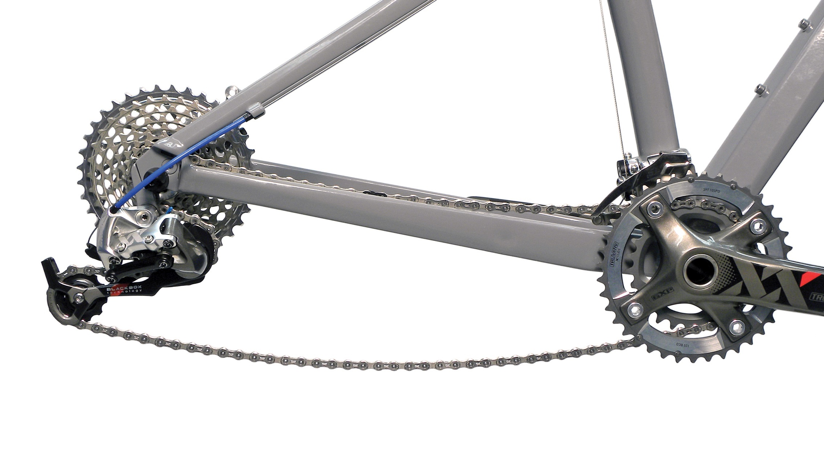
O(10⁵)
Mechanical Elements: Rotational Motion

Slide 8
Mechanical Elements: Where To Get Materials?
http://www.mcmaster.com/
http://www.mscdirect.com/
http://www.globalspec.com/
http://www.mpja.com/
www.smallparts.com
https://www.grainger.com/
Local Options
Harbor Freight (Albany)
Grainger Industrial Supply (Albany)
Pfeil Hardware (Troy)

Slide 9
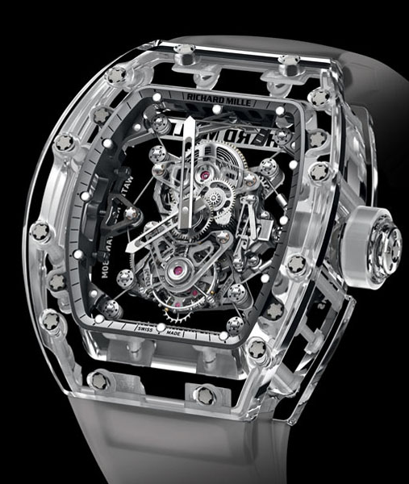
Group Exercise: Design a Mechanism That Takes Rotary Input and Transforms it to …
  Left: Intermittent Rotary Motion
  Middle: Reciprocating Translational Motion
  Right: Continuous Translational Motion
  1) Sketch an example mechanism (2 min)
  2) List important engineering design considerations (1 min)
  3) List prospective uses (1 min)
  4) Come down and discuss (1 min)

Slide 10
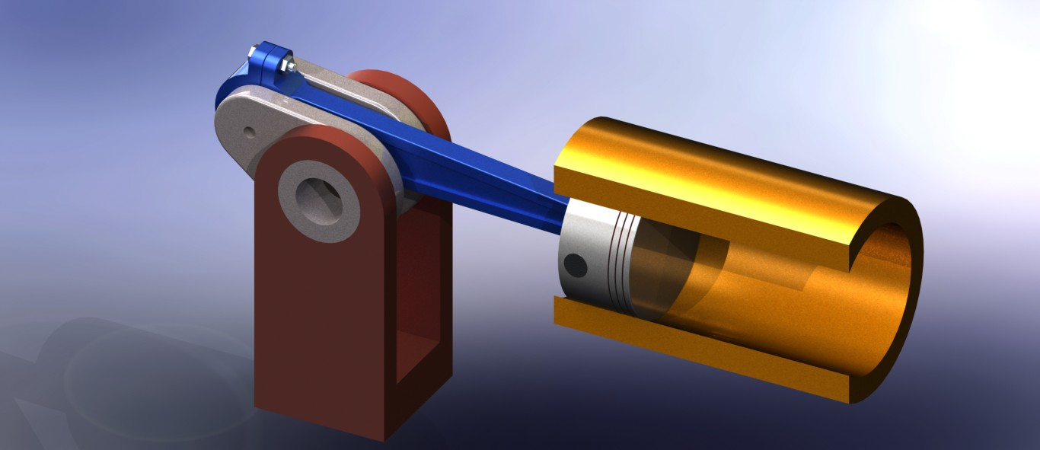
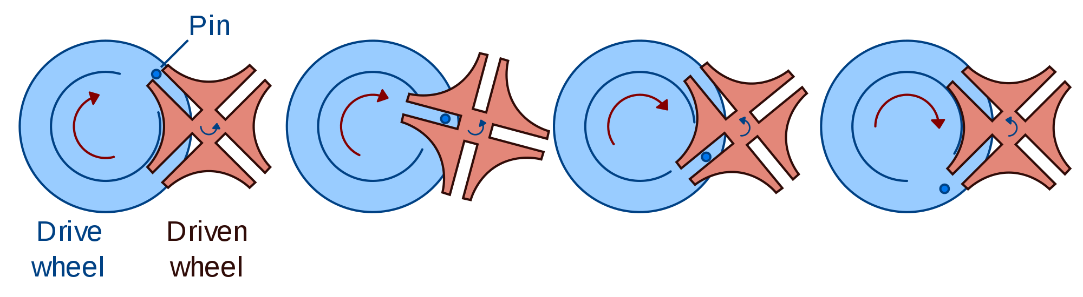
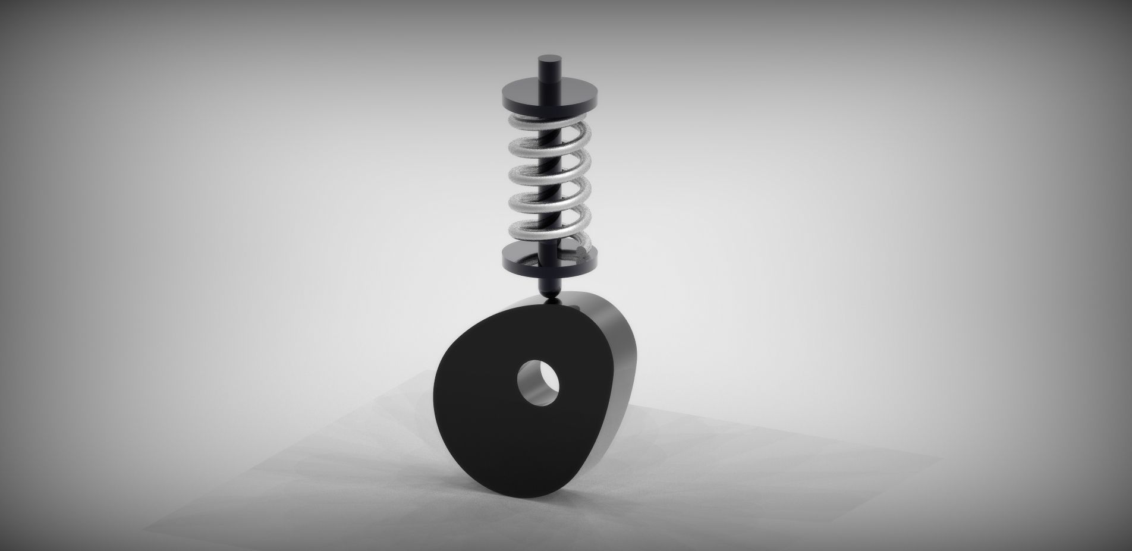
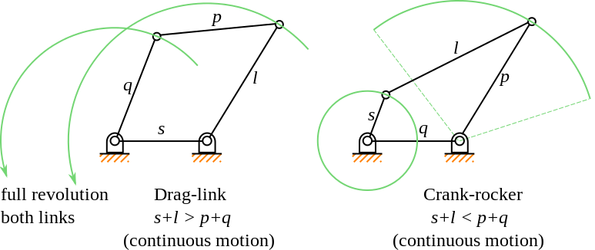
O(10⁵)
Mechanisms: Transforming Motion

Slide 11

Analysis Example: Gravity Powered Walker

Slide 12
Analysis Example: How to Design Mechanism Motion

Slide 13
iClicker Question
How many analysis-based courses have you taken at RPI ?
A) 1
B) 2-3
C) 4-6
D) > 6

Slide 14
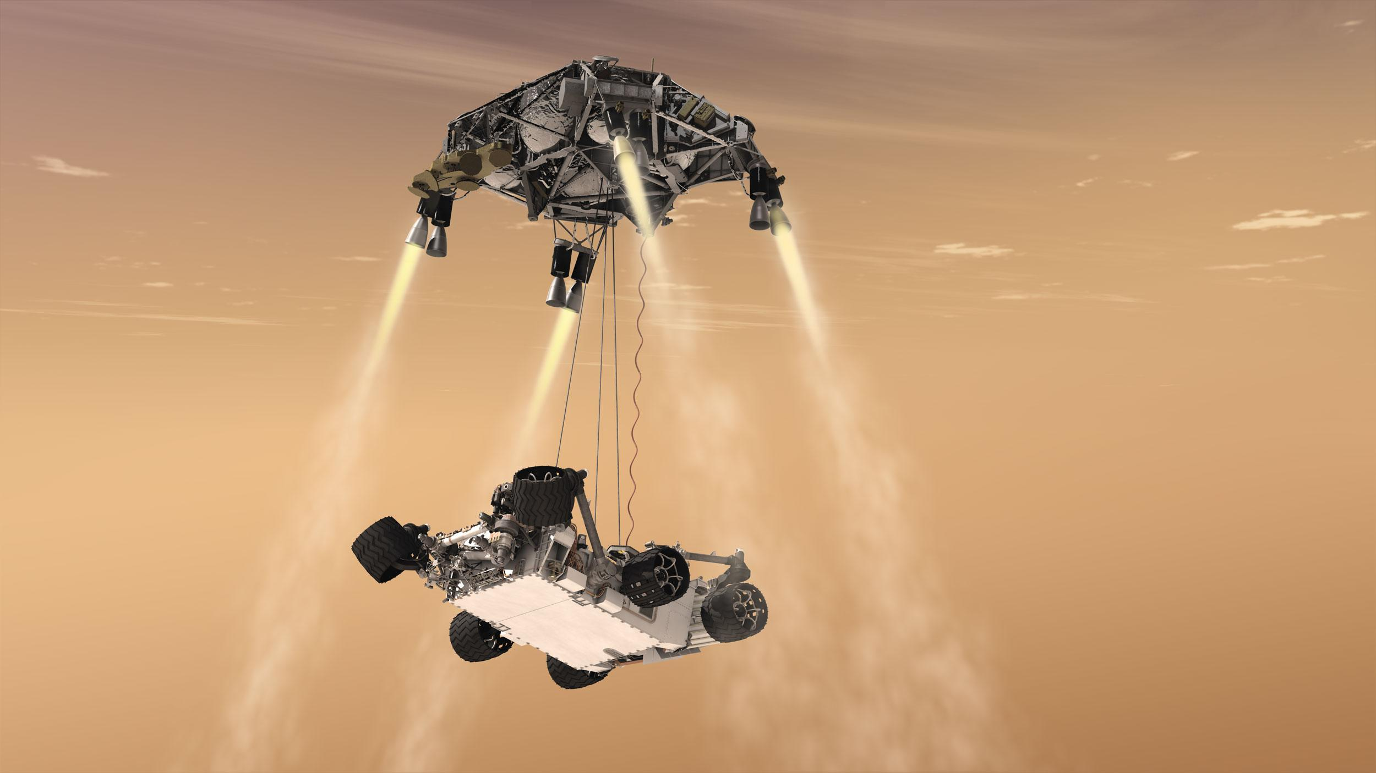
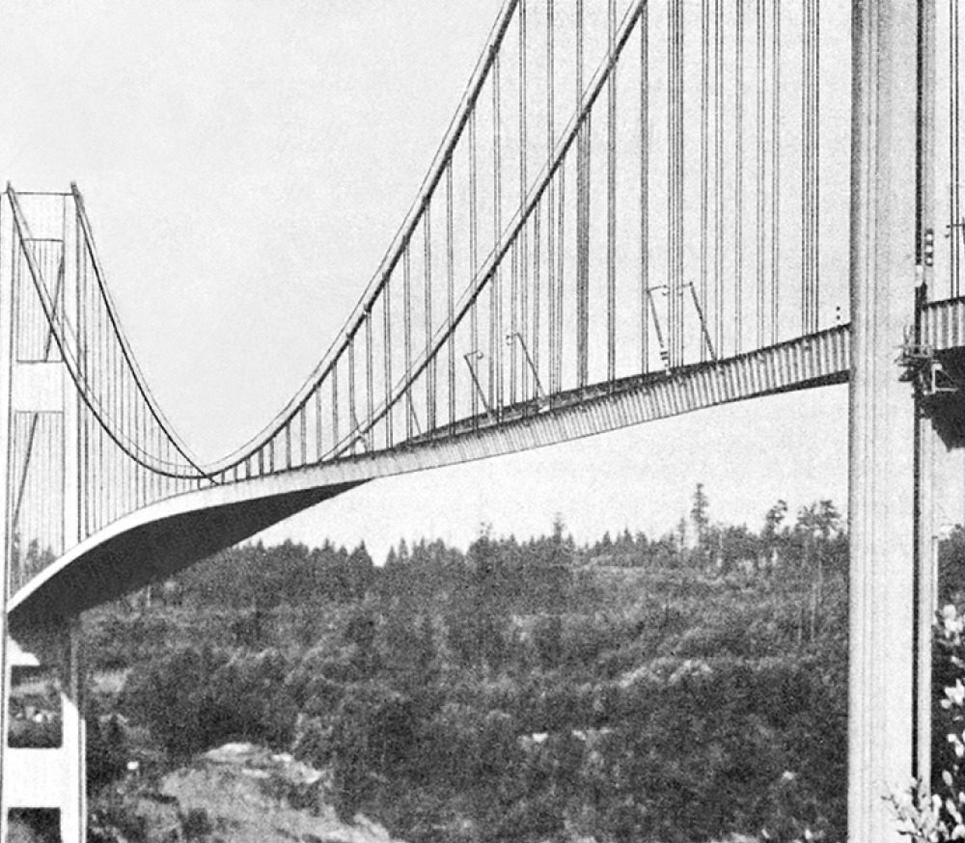
Analysis: Why ?
Sometimes failure has human consequences
Prototyping is expensive
Prototyping is not possible

Slide 15
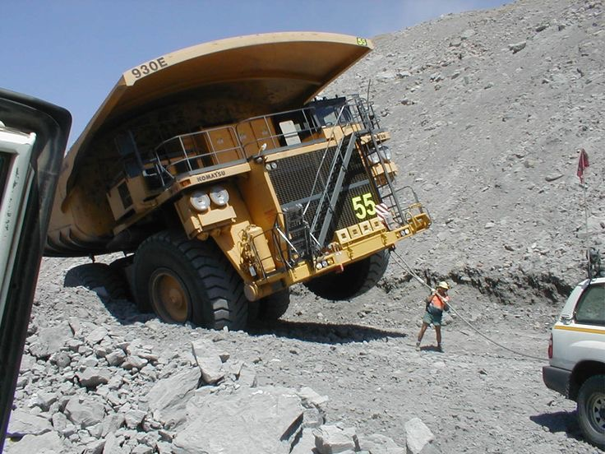
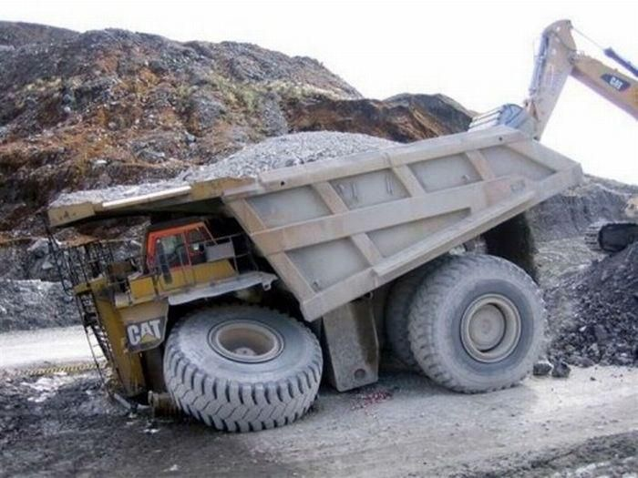
Analysis: Predicting Failure
Defining Failure
  Mechanism no longer performs within design specifications
    Change in material properties
  Catastrophic Failure
    Component(s) break

Slide 16


Analysis: Failure to Perform Task
Environmental considerations
  Temperature (metal, plastic) / Humidity (wood)
    Change in component dimension / material properties
Fatigue
  Cyclic loading
Buckling

Slide 17
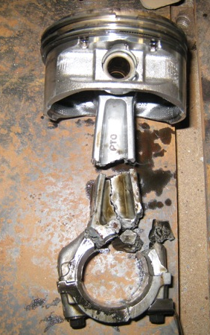
Analysis: Component Failure
Determine external stress (applied forces)
Determine internal loads (thermal, friction)
Free Body Diagram (FBD)
Start with simple reduced model
  Increase complexity as necessary

Slide 18
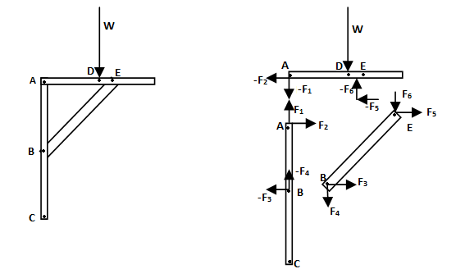
Analysis: Free Body Diagram (FBD)
Not complicated or cluttered (idealized)
Simply display relevant information

Slide 19
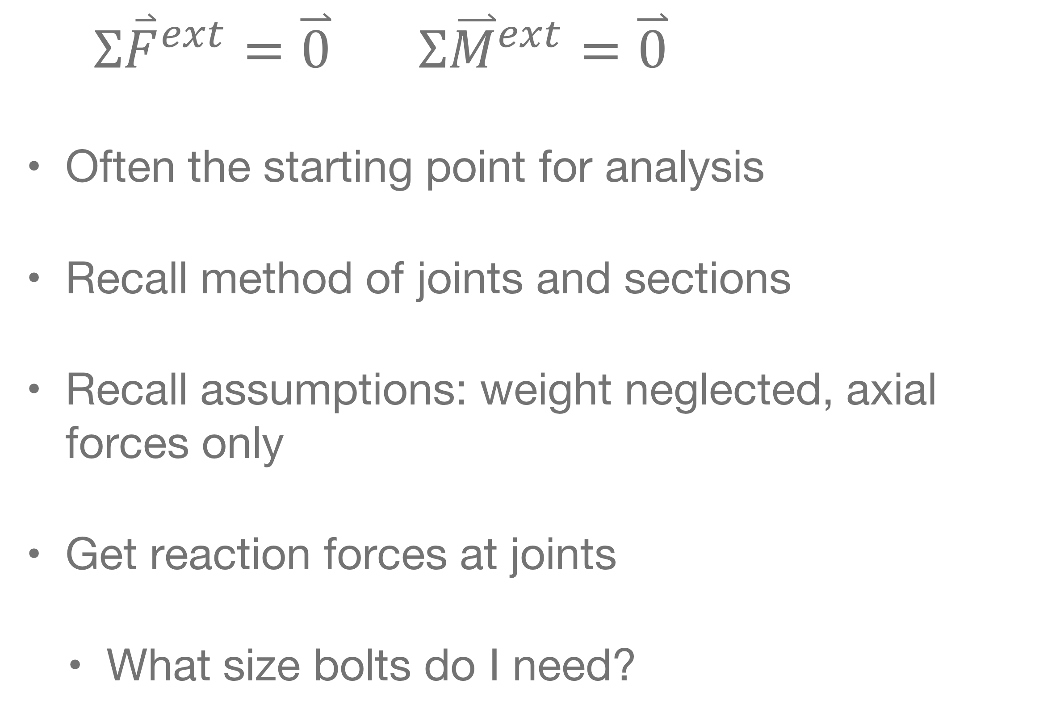
Analysis: Statics
$Σ{\overset{⃑}{F}}^{ext}=\overset{⃑}{0} Σ{\overset{⃑}{M}}^{ext}=\overset{⃑}{0}$
Often the starting point for analysis
Recall method of joints and sections
Recall assumptions: weight neglected, axial forces only
Get reaction forces at joints
  What size bolts do I need?

Slide 20

Analysis: Strength of Materials
  Does it move out of spec ?
$σ=Eε$
$\frac{F}{A}=E\frac{∆L}{L} →∆L=\frac{FL}{AE}$
  Does it break ?
  $\frac{F}{A}≥σ_{y}$

Slide 21
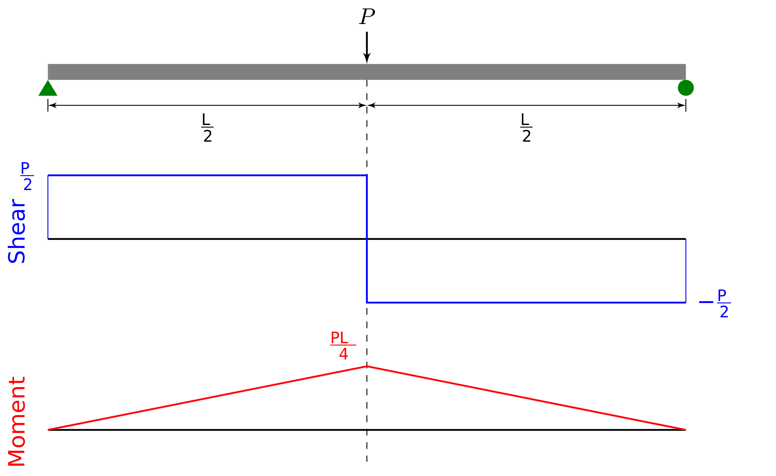
Analysis: Strength of Materials
What about bending ?

Slide 22

Analysis: Strength of Materials
  What about bending ?
  $σ_{b}≥σ_{y}$
  $\frac{My}{I_{x}}≥σ_{y}$
  Compute total stress due to axial loads and bending.

Slide 23
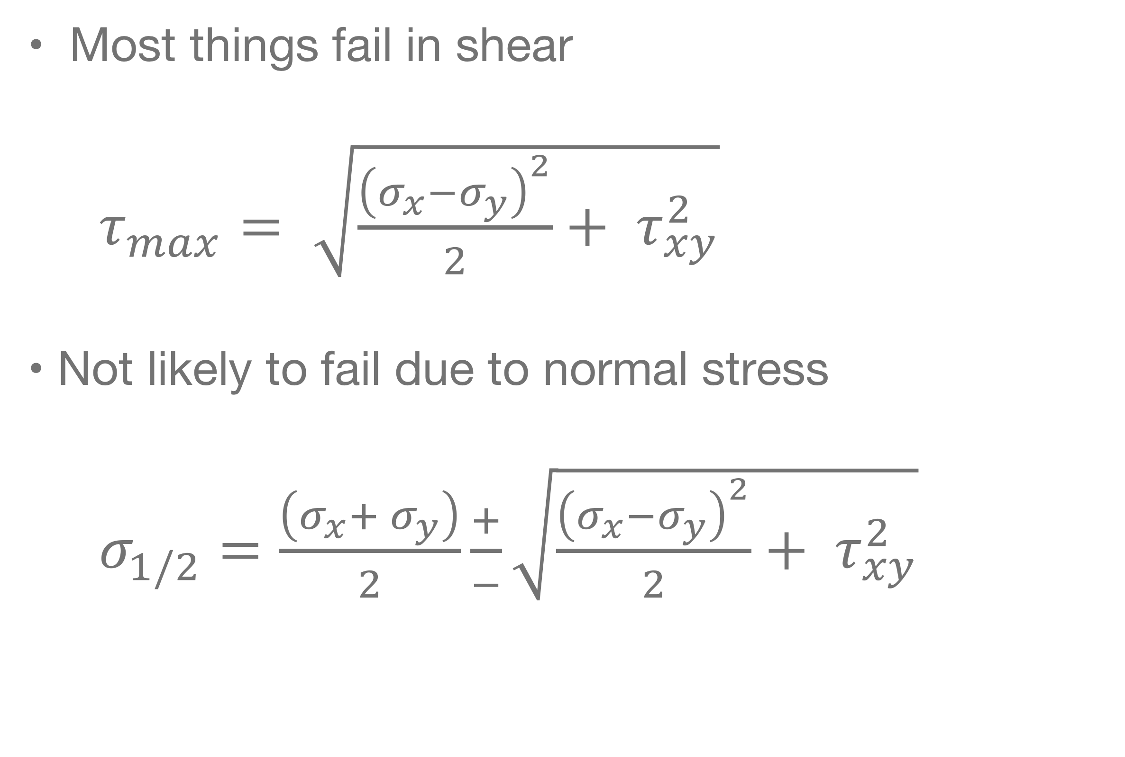
Analysis: Component Failure
Most things fail in shear
$τ_{max}= \sqrt{\frac{{\left(σ_{x}−σ_{y}\right)}^{2}}{2}+ τ_{xy}^{2}}$
Not likely to fail due to normal stress
$σ_{1/2}=\frac{\left(σ_{x}+ σ_{y}\right)}{2}\frac{+}{−}\sqrt{\frac{{\left(σ_{x}−σ_{y}\right)}^{2}}{2}+ τ_{xy}^{2}}$

Slide 24
Analysis: Structural Failure
Consider reaction forces
Consider bending
Determine stress in structural components
Does it break ?
  Yield stress important
Does it buckle ?

Slide 25
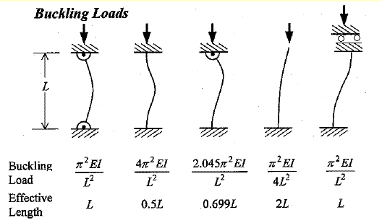
Analysis: Structural Failure
Does it buckle ?

Slide 26
Analysis: Structural Failure
Does it break ?
  What material should I pick ?
Does it buckle ?
  What material should I pick ?

Slide 27
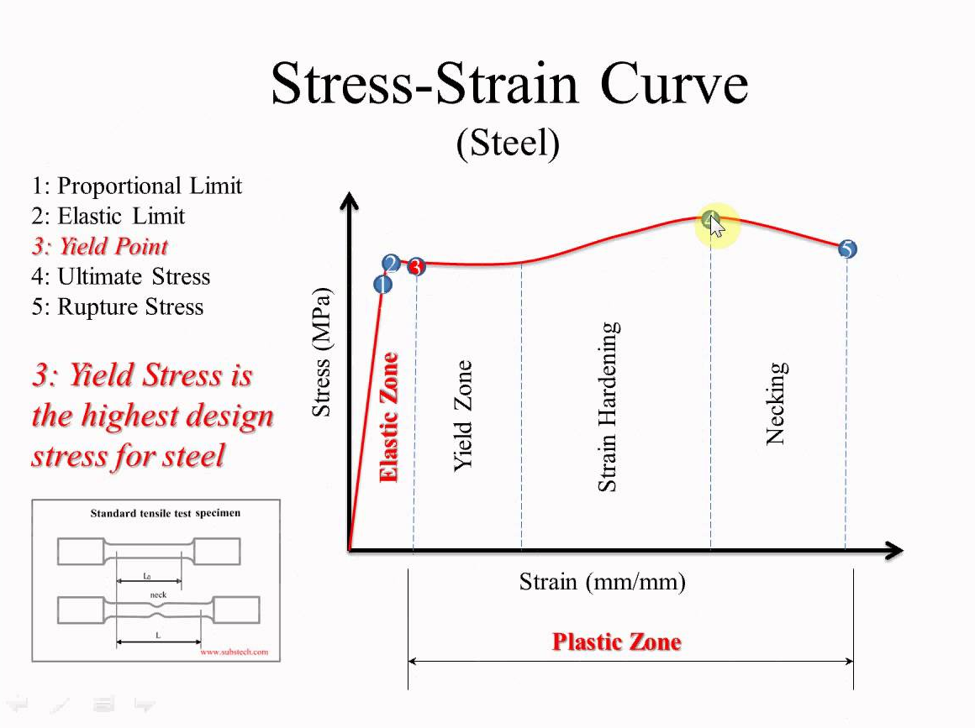
Analysis: Structural Failure

Slide 28
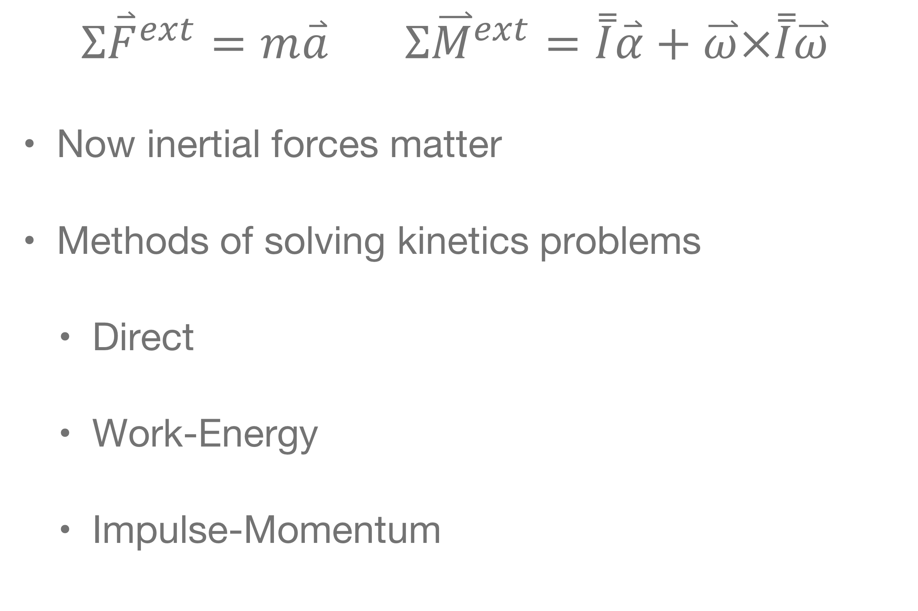
Analysis: Dynamics
$Σ{\overset{⃑}{F}}^{ext}=m\overset{⃑}{a} Σ{\overset{⃑}{M}}^{ext}=\overset{̿}{I}\overset{⃑}{α}+\overset{⃑}{ω}×\overset{̿}{I}\overset{⃑}{ω}$
Now inertial forces matter
Methods of solving kinetics problems
  Direct
  Work-Energy
  Impulse-Momentum

Slide 29
Analysis: Direct Method for Kinetics
Make a FBD
Solve forward problem (determine acceleration) or solve the reverse problem (determine forces) ?

Slide 30

Analysis: Direct Method for Kinetics
How do we compute acceleration ?
$s\left(t\right)=s\left(t_{0}\right)+v\left(t_{0}\right)\left(t−t_{0}\right)+\frac{1}{2}a{\left(t−t_{0}\right)}^{2}$ ?
  What is this equation for ?

Slide 31
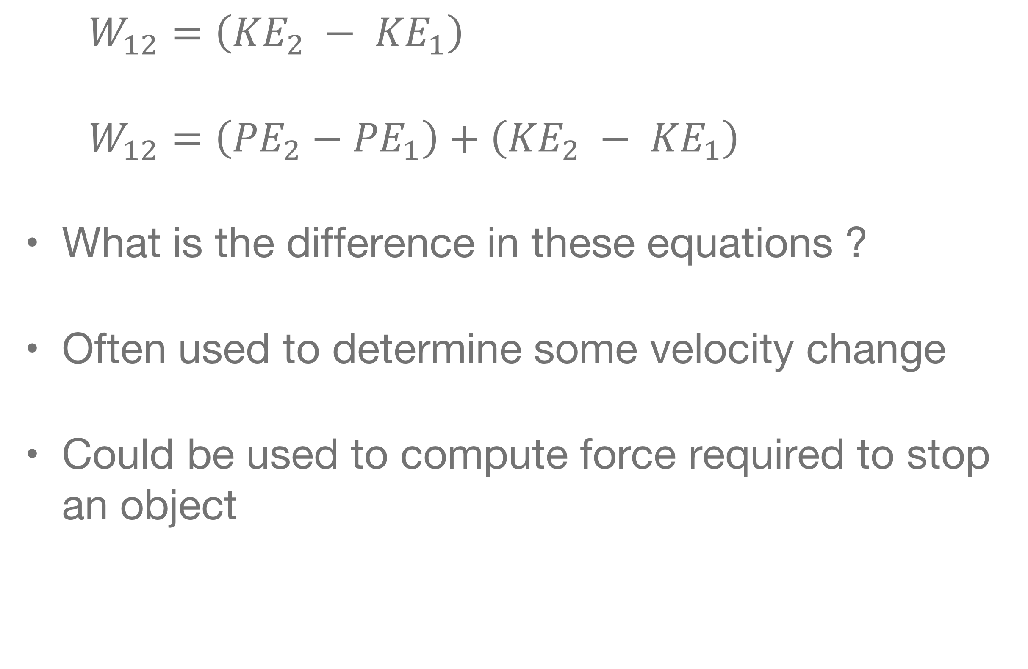
Analysis: Work Energy for Kinetics
$W_{12}=\left({KE}_{2} − {KE}_{1}\right)$
$W_{12}=\left({PE}_{2}−{PE}_{1}\right)+\left({KE}_{2} − {KE}_{1}\right)$
What is the difference in these equations ?
Often used to determine some velocity change
Could be used to compute force required to stop an object

Slide 32
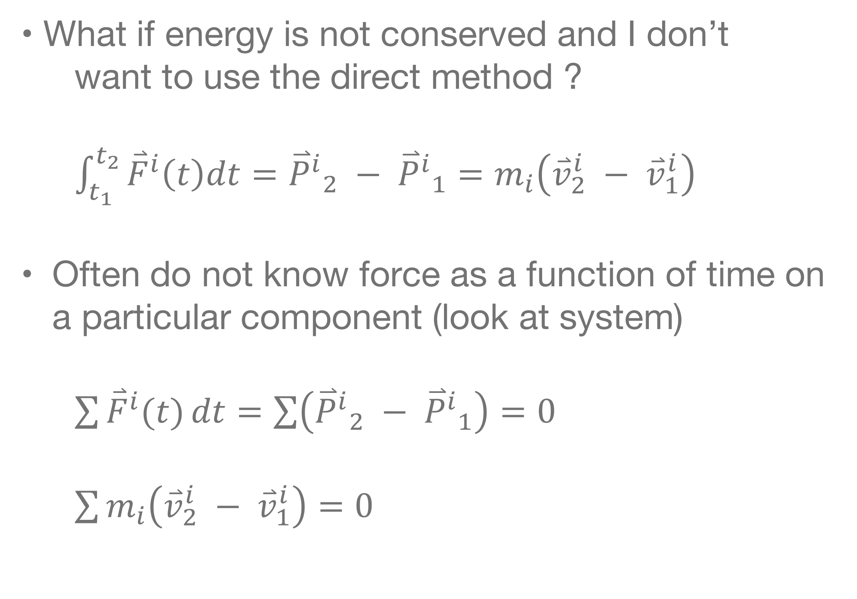
Analysis: Impulse-Momentum
What if energy is not conserved and I don’t want to use the direct method ?
$\int_{t_{1}}^{t_{2}}{{\overset{⃑}{F}}^{i}\left(t\right)dt}={{\overset{⃑}{P}}^{i}}_{2} − {{\overset{⃑}{P}}^{i}}_{1}=m_{i}\left({\overset{⃑}{v}}_{2}^{i} − {\overset{⃑}{v}}_{1}^{i}\right)$
Often do not know force as a function of time on a particular component (look at system)
$\sum{{\overset{⃑}{F}}^{i}(t)}dt=\sum{\left({{\overset{⃑}{P}}^{i}}_{2} − {{\overset{⃑}{P}}^{i}}_{1}\right)}=0$
$\sum{m_{i}\left({\overset{⃑}{v}}_{2}^{i} − {\overset{⃑}{v}}_{1}^{i}\right)}=0$

Slide 33
Analysis: Dynamics
If your project is dynamic by nature
  Consider dynamic stability
  Consider vibrations
  Consider controls

Slide 34
Analysis: Avoiding Failure
Does it move ?
  Should it ?
    Statics or Dynamics Analysis
Does it break ?
Does it buckle ?
Does it stop working ?
  Change in dimension ?

Slide 35
Analysis: Prototype
Probably not subject to actual loads
Your engineering analysis should show that your prototype should not break, or fail
The analysis you deliver should also show that your actual design should not break, or fail

Slide 36
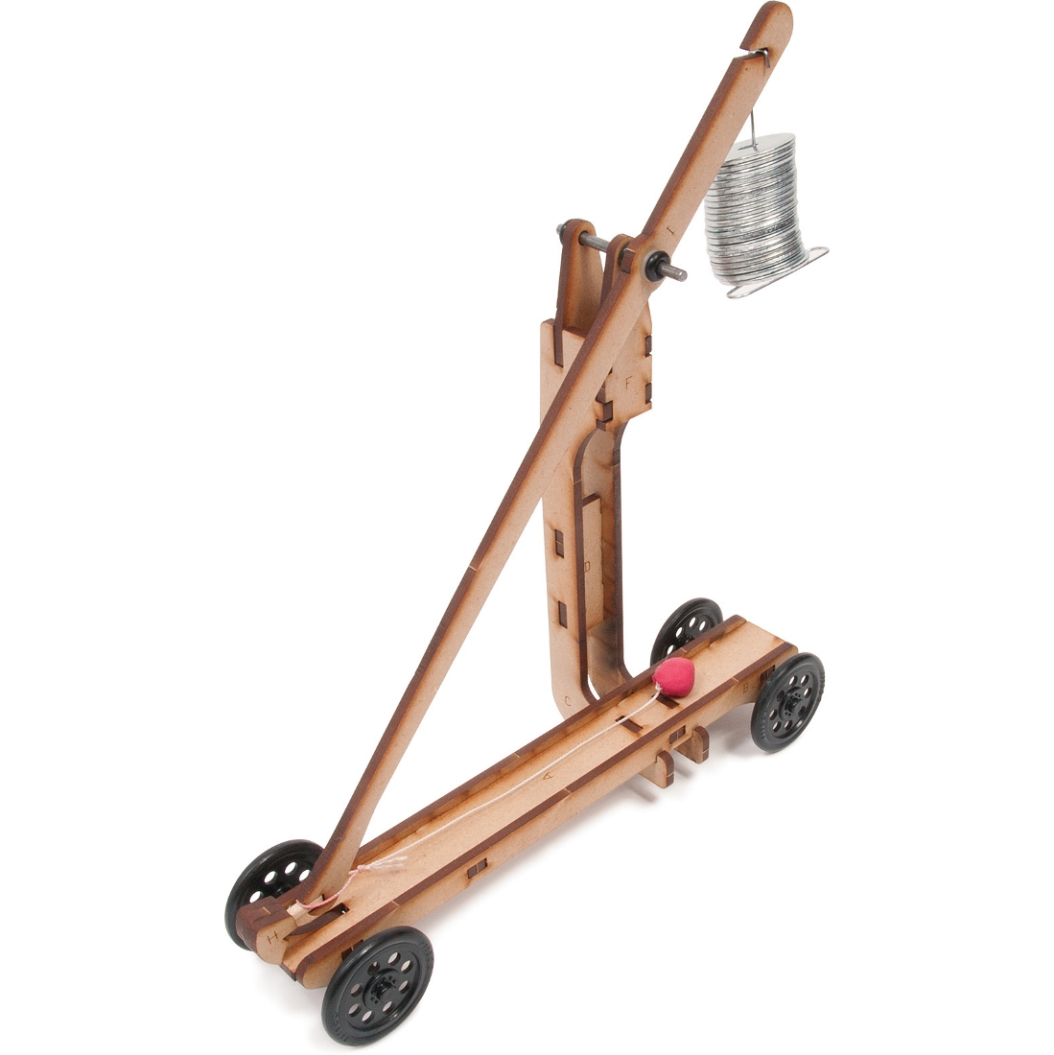
Analysis Example: Performance
Did you make a Trebuchet for the mini-project ?
What is doing work ?
  What happens if the work done on the weight is minimized in the x-dir ?
    How: Eliminate side to side motion of the weight
Result is larger change in kinetic-energy

