Slide 1


Sustainability
For-ev-er
Jeff Morris, Ph.D.
School of Engineering

Slide 2
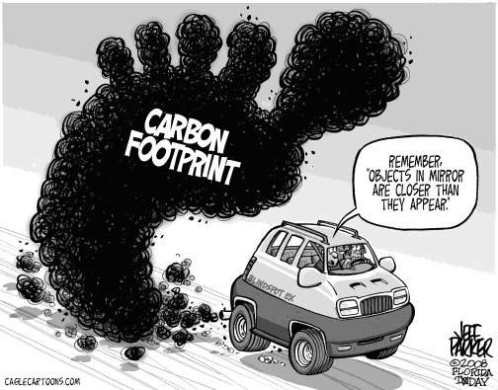
Notes:
http://1st-in-hybrid.com/carbon-footprint/

Slide 3
Legislation
Air Pollution
Clean Air Act (‘70, ‘77, ‘90)
Water Pollution
Clean Water Act (‘72)
Safe Drinking Water Act (‘74)
Land Pollution
Resource Conservation and Recover Act (‘76)
Comprehensive Environmental Response Compensation, and Liability Act (‘80, ‘86)
Material Pollution
Toxic Substance Control Act (‘76)
Hazardous Materials Transportation Act (‘75)

Slide 4
Some Numbers…
July 29th 2011
By 2025, all 13 major automakers agree to have a fleet average fuel economy of 54.5 MPG¹
Paper Consumption
http://calculator.environmentalpaper.org/individual
Newsprint: 12.36 M tons generated 2006 (EPA)
32% Recycled content
Notes:
http://www.whitehouse.gov/the-press-office/2011/07/29/president-obama-announces-historic-545-mpg-fuel-efficiency-standard

Slide 5
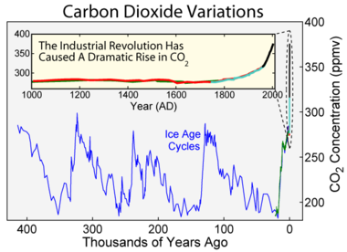
1 M BTU = 7 Gallons of Gasoline
12.36 M tons = 2,500 Gallons of Gas
70,700 lbs CO₂
Notes:
http://en.wikipedia.org/wiki/File:Carbon_Dioxide_400kyr.png

Slide 6
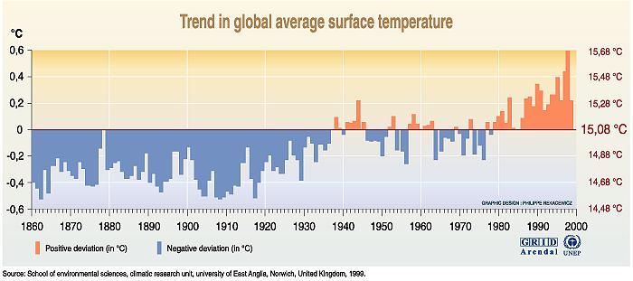
Notes:
http://www.grida.no/publications/vg/climate/page/3070.aspx

Slide 7
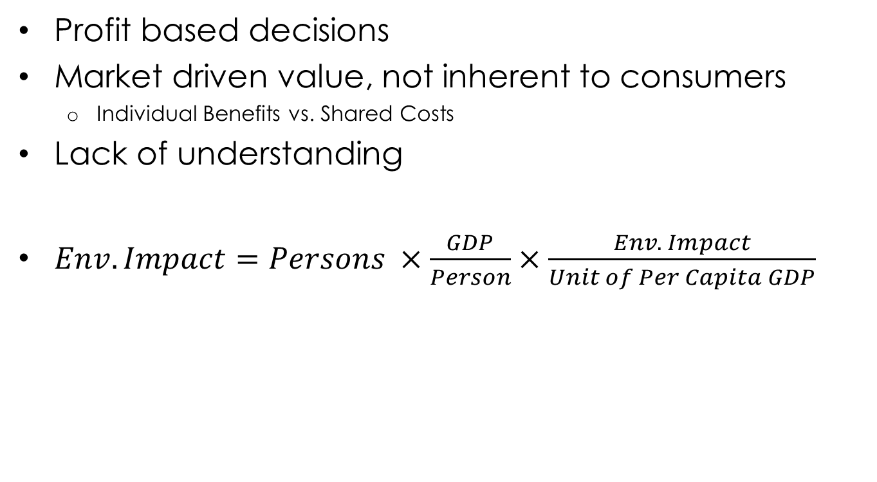
Causes?
Profit based decisions
Market driven value, not inherent to consumers
Individual Benefits vs. Shared Costs
Lack of understanding
$Env. Impact=Persons ×\frac{GDP}{Person}×\frac{Env. Impact}{Unit of Per Capita GDP}$

Slide 8
Population Growth
http://www.census.gov/popclock/

Slide 9
Changing Paradigms
Japan imports 16% less oil than they did in 1973.
Yet, their economy has doubled
Japan accounts for 48% of the world’s solar panel production
USA accounts for 15%

Slide 10
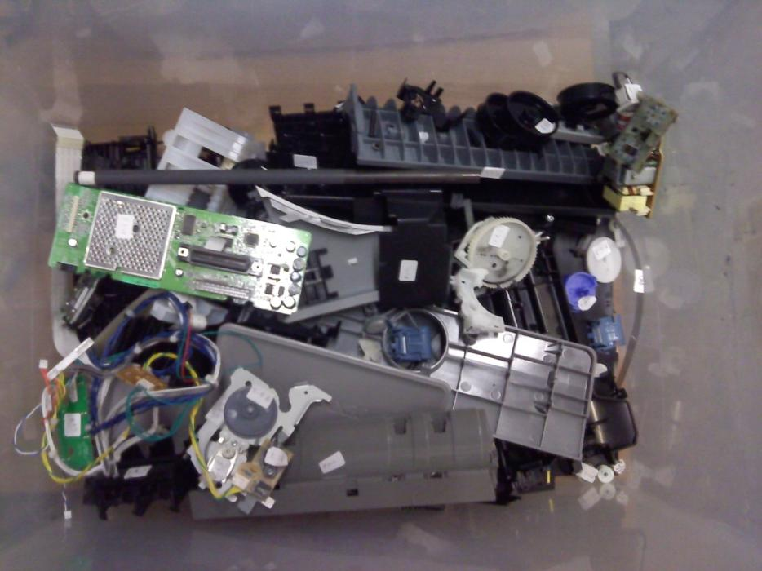
I used to function as:
VCR
Computer
Printer
Smart Car

Slide 11
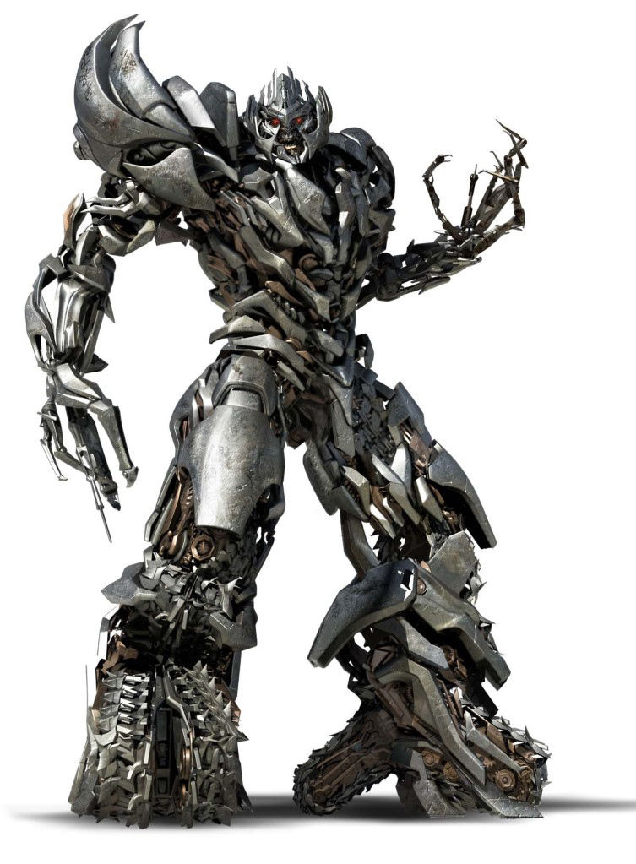

Slide 12
Sustainability is a MULTI-DISCIPLINARY OPPURTUNITY:
Aeronautical
Chemical & Biological
Civil
Computer Systems
Electrical
Mechanical
Material
Industrial Systems
Social

Slide 13
Sustainability is not as much as “what you do” but more importantly the acquisition of knowledge for what to do next to not jeopardize the future

Slide 14
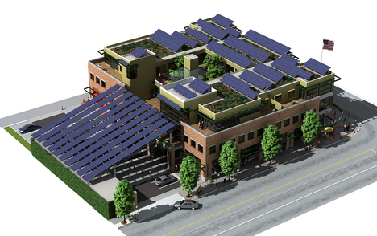
Most Sustainable…
Utility costs 92% less
Notes:
http://www.jetsongreen.com/2008/02/independence-st.html

Slide 15

Sustainability in Design
Responsibility
Life-Cycle View
Impact Assessment
Trade-off Analysis
Planet
People
Profit
Notes:
Image: http://naturallyyoursblog.blogspot.com/2010/09/cfl-bulb-mercury-bombs.html

Slide 16
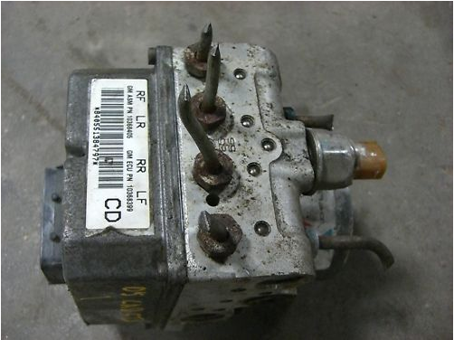
Notes:
2005 Cadillac CTS Module
Casting, Curves, Intricate Geometry. Part Cost = $300

Slide 17
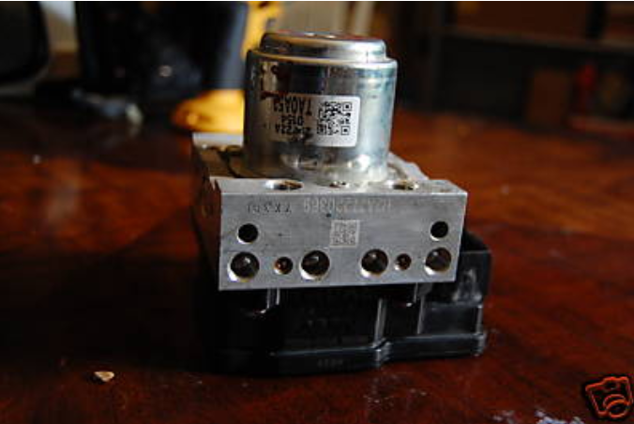
Notes:
2008 2009 Honda Accord ABS Pump 4 Cylinder Automatic
Straight Milled Block with holes. Part cost = $ 80

Slide 18
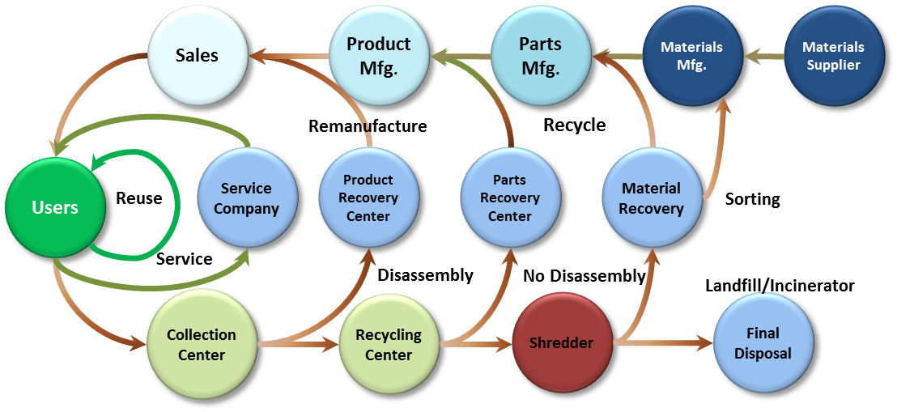

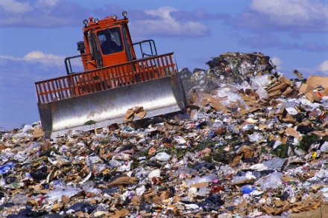
Product Life Cycle
“Ricoh-Comet” Representation
IMPACT INCREASING
Notes:
Low, M.; Williams, D.; Dixon, C. (1998). Manufacturing Products with End-of-Life Considerations: An Economic Assessment to the Routes of Revenue Generation From Mature Products. IEEE Transactions on Components, Packaging, and Manufacturing Technology - Part C., 21, pp. 4-10. IEEE.
Tani, T. (1999). Product Development and Recycle System for Closed Substance Cycle Society. EcoDesign '99: First International Symposium on Environmentally Conscious Design. (pp. 294-299). Tokyo: IEEE Computer Society.
Hierarchy has been initially evaluated with products through environmental impact.
Even this diagram presents an idealized view of the life cycle. There is a more realistic arrow from “USER” to “LANDFILL”. The farther away from the user, the material sees more processing and overhead to have it return to the use phase. Obviously not every product follows each step here, this is more a comprehensive listing of all of the stakeholders involved in resource handling.

Slide 19


Waste = Food
Natural Concept
Viable Business Model
Recellular.com
Terracycle.com

Slide 20
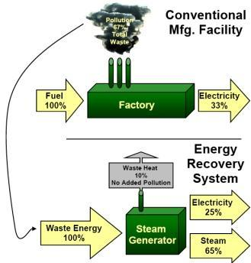

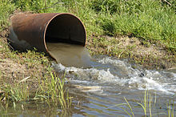
Measures of Sustainability
Carbon [Kg]
Water [L]
Energy [MJ]
Notes:
http://www.hotstocked.com/article/0894/china-energy-recovery-otcbb-cgyv-an-emerging-market-leader.html http://www.concurringopinions.com/archives/2007/08/carbon_offsets.html

Slide 21
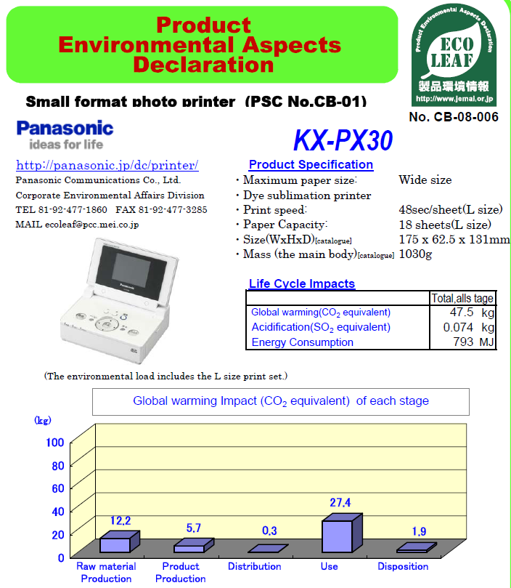

Slide 22
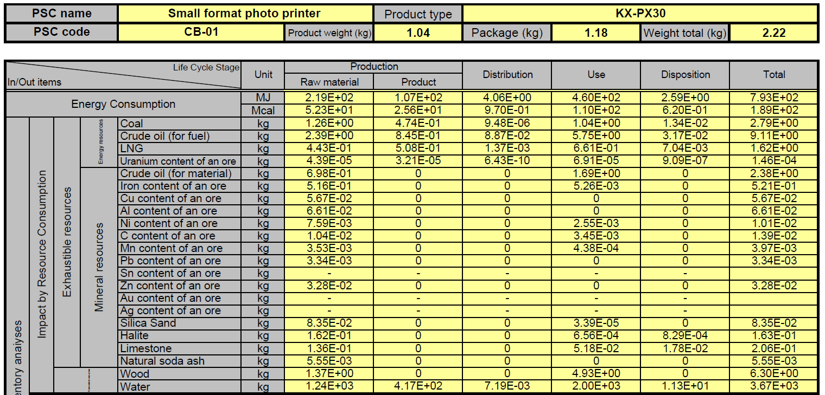
Energy Inventory

Slide 23
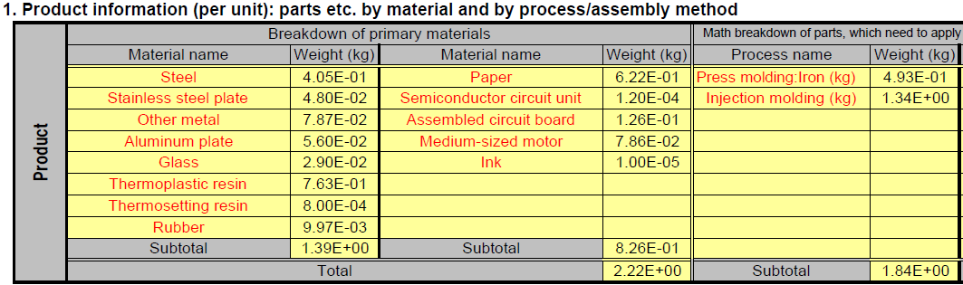
Material Inventory

Slide 24
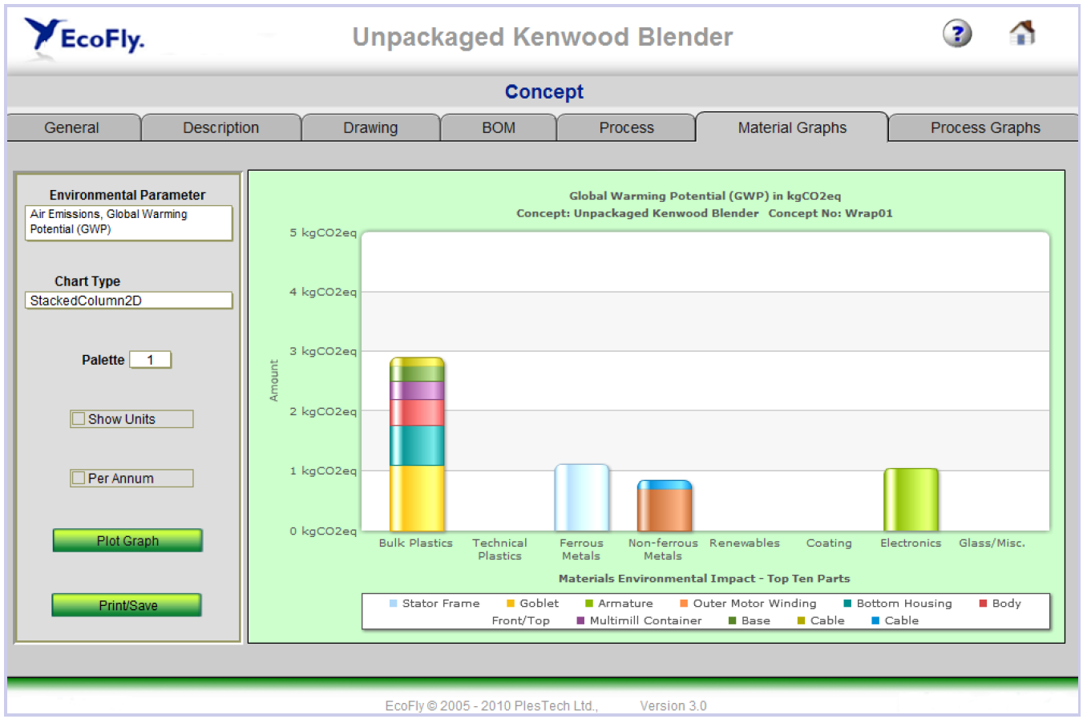

Slide 25
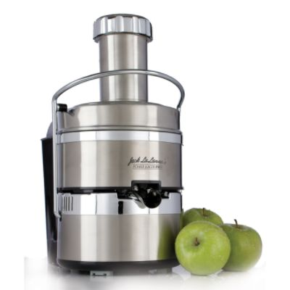
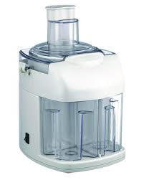
Electric Juicer

Slide 26
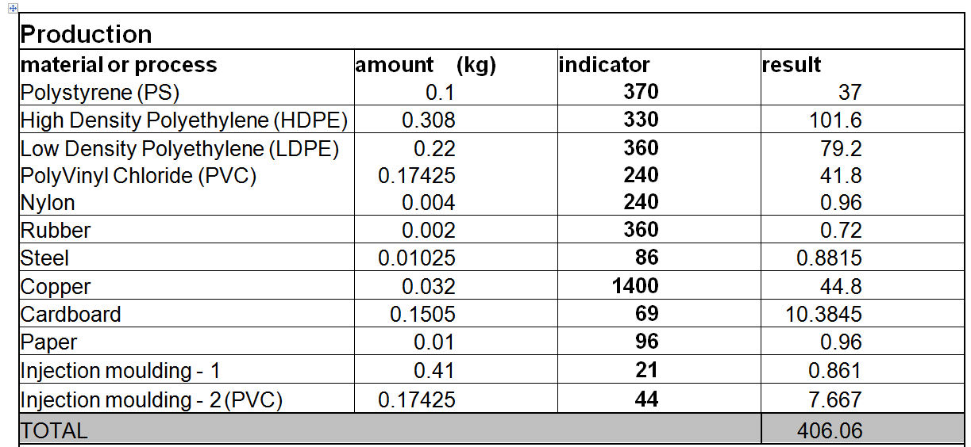
Production

Slide 27
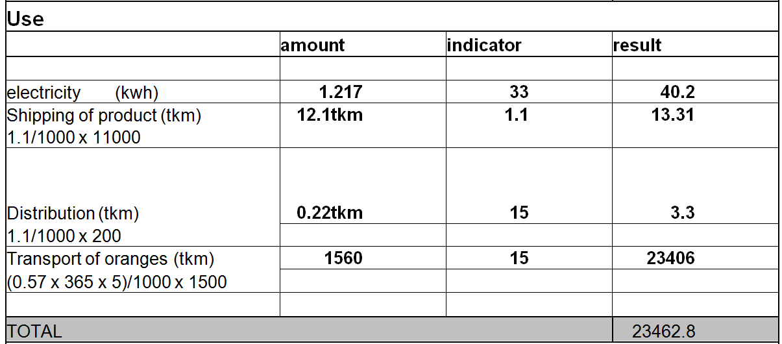
Use
Production: 406.6

Slide 28
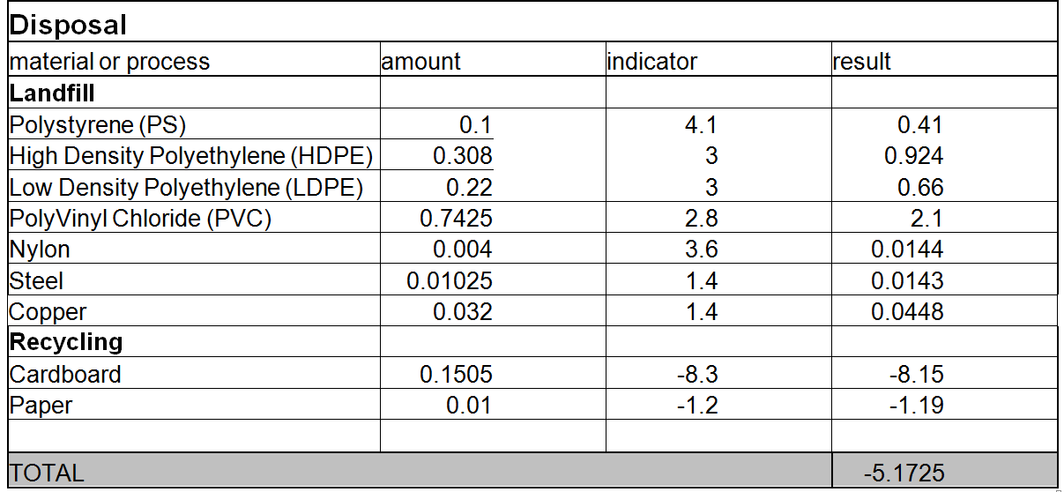
Disposal
Production: 406.6
Use: 23462.8

Slide 29
The US recycled 83 M tons of solid waste in 2008 – which is equivalent to removing:
3 K vehicles from the road
300 K vehicles from the road
3 M vehicles from the road
33 M vehicles from the road
3 B vehicles from the road
(12.9 %)
2008 Total Registered Vehicles: 255.9 M
Notes:
Source:
Epa (2008). Municipal Solid Waste Generation, Recycling, Disposal in the United States: Facts and Figures for 2008.
http://www.epa.gov/epawaste/nonhaz/municipal/pubs/msw2008rpt.pdf
Retrieved April 10, 2010
http://en.wikipedia.org/wiki/Passenger_vehicles_in_the_United_States#Total_number_of_vehicles
Retrieved 9/19/11

Slide 30
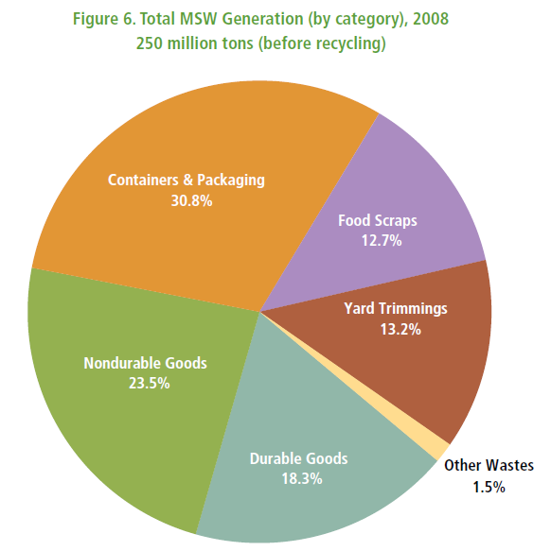
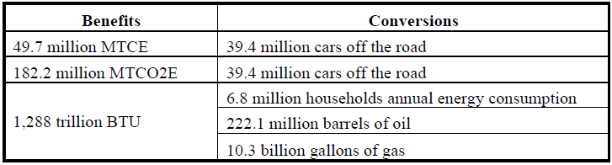
Recycling 32.5% Gives Benefits:
Notes:
Source:
Epa (2008). Municipal Solid Waste Generation, Recycling, Disposal in the United States: Facts and Figures for 2008.
http://www.epa.gov/epawaste/nonhaz/municipal/pubs/msw2008rpt.pdf
Retrieved April 10, 2010

Slide 31
Measures of Sustainability
Time of Disassembly [s]
Force required for Disassembly [N]
Energy required for Disassembly [J]
% Recyclable/Recoverable Materials [-]

Slide 32
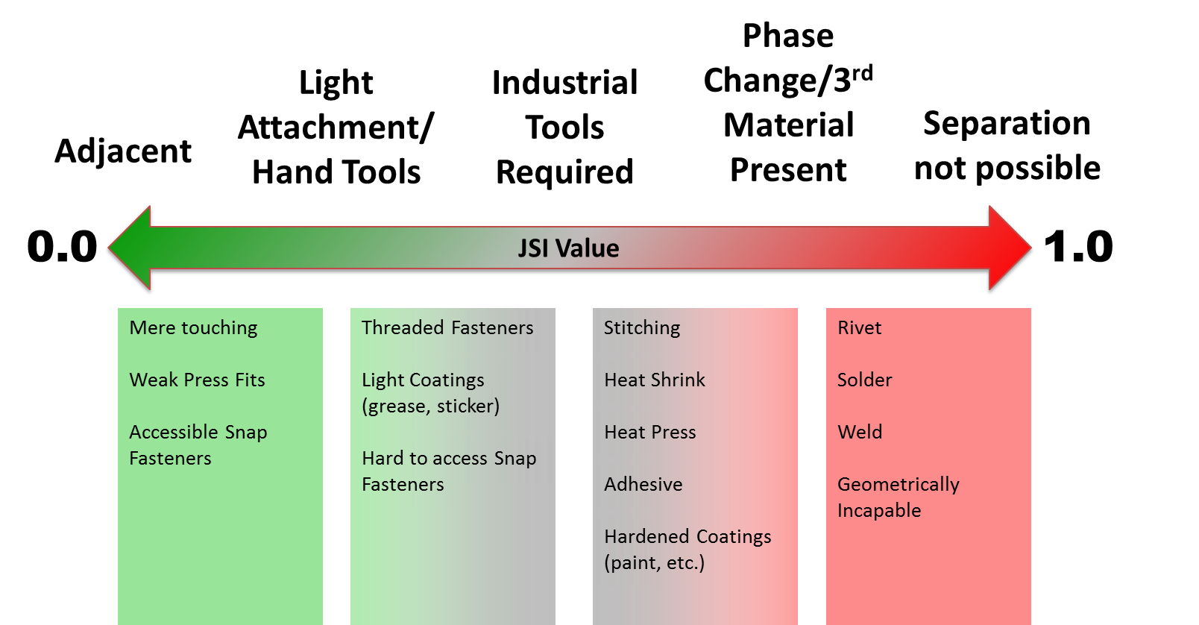
Joint Design

Slide 33
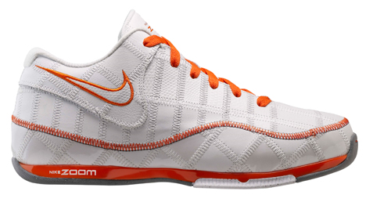
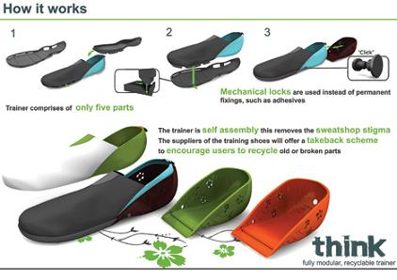
Notes:
Trash talk image: http://www.uncrate.com/men/style/shoes/nike-trash-talk/

Slide 34
Electric Car Infrastructure
Better Place Engineering
http://www.youtube.com/watch?v=spN_7JiInA0
http://www.betterplace.com.au/index.html

Slide 35
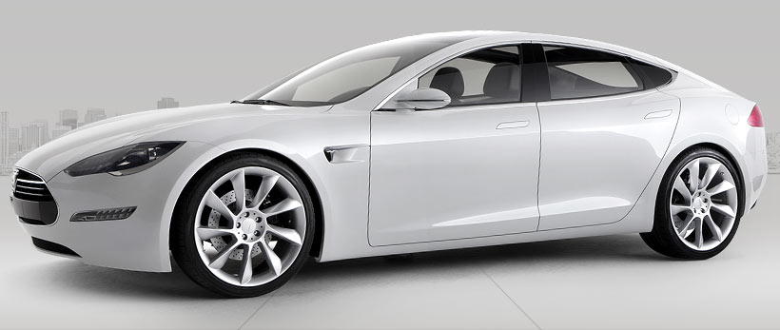
0 – 60 mph: 5.6 seconds
300 Miles/Charge
Zero Emissions
$50,000 USD
Notes:
http://www.teslamotors.com/models

Slide 36
Product Design
Bill of Materials – A Must!
% Material by weight
Material Choice
Is Anything Hazardous?
Design for Part Removal
Compare strength of design joints
Simple Designs Prevail
Count the # of parts in your system

Slide 37
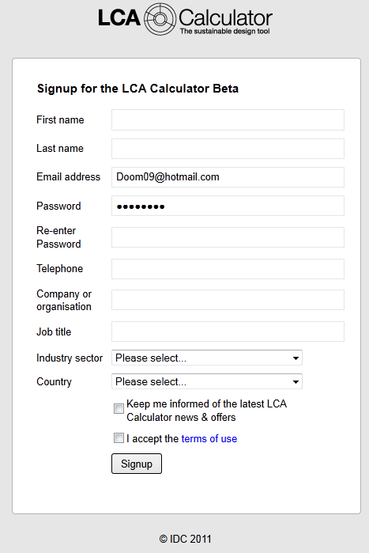
Intro to LCA
http://www.lcacalculator.com/
Select the colorful banner or SIGN UP NOW

Slide 38
Data Entry
Assembly | Part | Material | Process | Mass (lbs) | Qty
Housing | Case | ABS Plastic | Injection Molding | 1.1 | 1
Filaments | Framing | Steel, Virgin | Stamping | 0.22 | 2
Filaments | Heating Elements | Copper, Virgin | Cutting (laser/shear/saw) | 0.02 | 20
Distribution: Truck, Distance = 1000 Miles
Product Lifespan: 5 years
Use: 500 Watts, 5 Minutes Per Day
Percent of Part Recycled: 0%

Slide 39
Additional Slides

