Slide 1

Design for X and Prototyping at RPI
Mark Anderson,
IED Course Coordinator
Sr. Project Engineer, SoE
Aren Paster
Project Engineer, SoE

Slide 2
Learning Objectives
Gain an awareness of prototyping capabilities available to SOE students
Gain an awareness of DfX strategies and outcomes.
Apply basic DfX guidelines to a “simple” problem.

Slide 3
Prototyping at RPI
Fabrication Assistance
Conventional Machining
CNC Plasma Cutting
CNC Abrasive Water-Jet
3D Printing
Electronics
Architecture Wood Shop
Supplies

Slide 4
Prototyping at RPI
Resources
Student Machine Shop – JEC 1010
Mr. John Szczesniak x6551
CNC Plasma Cutting and Turning
Conventional Machine Tools
Welding (steel and plastic)
Laser Cutter
IED Fabrication Area – JEC 2332
Electronic Instrumentation & Basic Components
Conventional Machine Tools & Hand Tools
Open hours posted on door and LMS

Slide 5
Prototyping at RPI
Resources
Douglas Mercer ’77 Laboratory – JEC 6204
Prof. Mona Hella, hellam@ecse.rpi.edu x6314
Soldering/assembly space
Manual pick and place, Printed Circuits Board (PCB) population
4 test benches with various electronic test equipment & specialized equipment
Environmental chamber
Parts room (free electronics parts and a storage area for student projects)
Open hours: weekdays + Saturday afternoon

Slide 6
Prototyping at RPI
3DPrinting and AWJ
3D Printing
E-mail – 3Dprint@rpi.edu
Abrasive Water-Jet Cutting
E-mail - AWJlaser@rpi.edu
Forms
LMS
HUB
http://manufacturing.eng.rpi.edu/
Supplies
Student Machine Shop
R&D Shop – Science Center Basement
Plastic Stock in IED Fabrication Area
See LMS Technical Resources -> Manufacturing resources.pptx

Slide 7
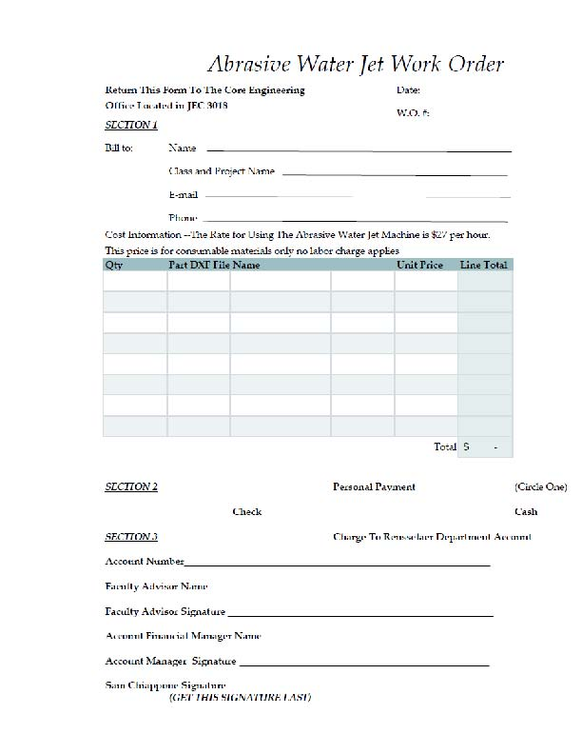
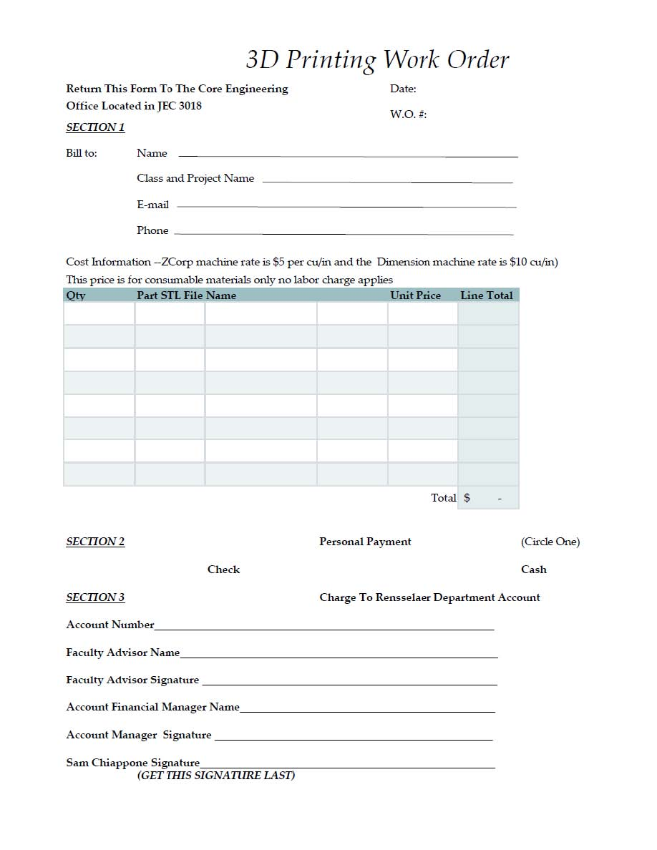
Prototyping at RPI
Forms available on the Manufacturing Network Site

Slide 8
Prototyping at RPI
Manufacturing Network Webpage
http://manufacturing.eng.rpi.edu/
Manufacturing Resources List on LMS
Local & on-line material and parts suppliers, on-campus contacts
Technical Resources ›
Manufacturing_resources.pptx
Manufacturing Services Overview

Slide 9
If you want a Rapid Prototype or Waterjet cut part, just…
A – stop by the machine with an idea, we’d love to show you how to operate the equipment
B – sketch your part and talk to your section instructor
C – email CAD file (.DXF or .STL) to 3Dprint@rpi.edu or AWJlaser@rpi.edu for price quote
D – get form from Sam Chiappone

Slide 10

Design for X
 | This article is incomplete. Please help to improve the article, or discuss the issue on the talk page. (February 2009)
DFX means design for excellence, and also "design for X", where X is a variable with many values
Under the label Design for X, a wide collection of specific design guidelines are summarized. Each design guideline addresses a particular issue that is caused by, or affects the characteristics of a product. […]Thus, it is not granted that a freshman or someone who is outside of the subject area will comprehend this generated explicit knowledge.
Wikipedia, 10/23/13

Slide 11
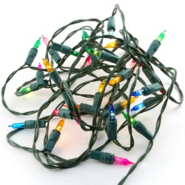


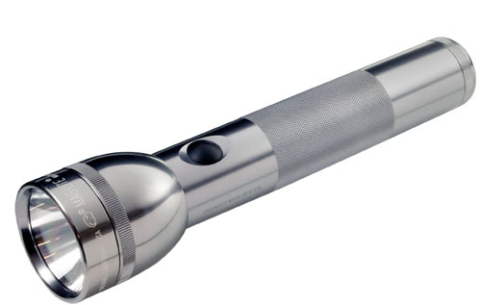
Function : Provide Light
Notes:
Flashlight - http://www.maglite.com/D_Cell_LED.asp
Spot light - http://www.wycokck.org/InternetDept.aspx?id=19960

Slide 12
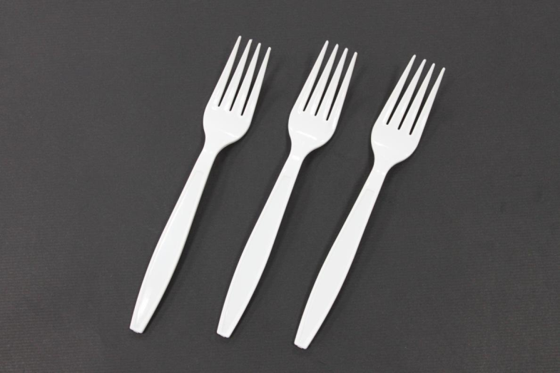
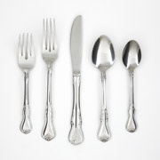
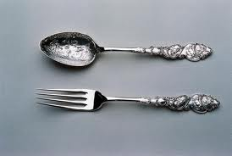
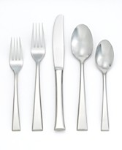
Forks
Plastic – $3.79 for 100 pcs
$0.04/ea
18/0 Stainless Steel - $14.97 for 4 place settings (20 pcs) $0.75/ea
18/8 Stainless Steel - $400 for 12 place settings (65 pcs) $6.15/ea
Antique silver - $440
$220/ea
Notes:
Silver - http://www.leopardantiques.com/object/image/download/9/Antique%20Silver%20Christening%20set%20(Nursery%20rhyme)_Hey%20diddle%20spoon%20and%20fork%20set.Jpg
18/0 – Walmart.com low price stainless
18/8 – Macys.com high price stainless – expensive silver set is $18,300 for 66 pcs -> $277/ea

Slide 13
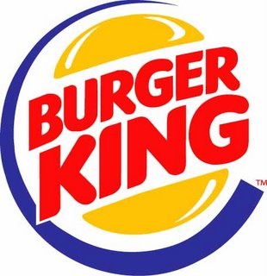





Product Difference?
Hamburgers
Operating
Systems

Slide 14
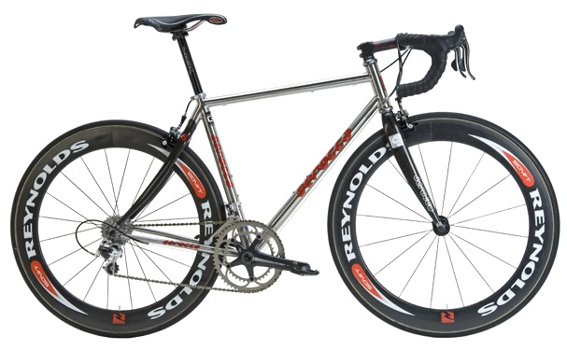
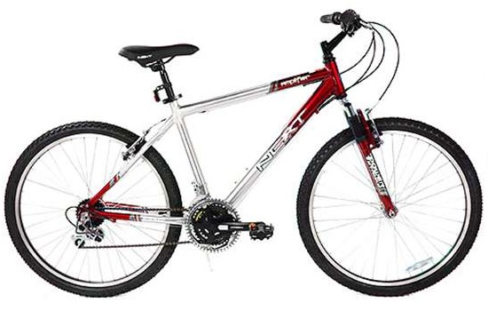
Bicycle Comparison
Serotta Legend
Next Mountain Bike

Slide 15
How many Next Amplifier 26” Men’s bikes does Walmart sell per year in the US?
A – 3,500
B – 50,000
C – 200,000
D – 1,000,000
E – 5,000,000
Notes:
2014 – 4,203 US stores
1/week * 52 weeks * 4203 stores = 218,556

Slide 16
Bicycle Comparison
Price
Features
Weight
Material
Available sizes
Available colors
US stores
International stores
Volume/yr
Serotta
$5000
Carbon fiber rear stays
17 lbs
Titanium & Carbon Fiber
infinite choices - rider customized
32 paints, 6 decals
73
19
2,500-3,500
Next
$100
Front suspension
38 lbs
Steel
3 sizes – 20”, 24”, 26”
One
4,400
5,200
200,000+

Slide 17
Market Comparison 2009 Data National Bike Dealers Association - http://nbda.com/articles/industry-overview-2009-pg34.htm
Manufacturing | US | Import
Volume | 276,000 total all sizes | 14.9 million – total 10.2 million - adult 20”+
Average price | $478
Sales | Specialty Store | Mass Merchandiser
Volume share | 27% | 73%
Dollar share | 68% | 32%
Average price | ~$350 | $78
Notes:
Import – China & Taiwan
US – approx 100 brands
$350 from Larry Ruff

Slide 18
What makes these different? Consumer
$5000 Serotta bike
Material
Titanium
Carbon fiber
Performance components
Performance
Weight
Comfort / response
Rider customization
Appearance
Size
Brand Recognition
$100 Walmart bike
Material
Carbon steel
Commodity components
Delivery
Notes:
Ti tube - $46/ft ($275), CrMo tube - $8/ft ($50)

Slide 19
What makes these different? Production
$5000 Serotta bike
Low volume
Order process
Cycle time
Manual process
Weld
Paint
Manual and CNC machining
Inspection
Fully adjustable tooling
Manufacturing tolerances
Packaging
$100 Walmart bike
High volume
Automated process?
Weld
Paint
CNC machining
Standard jigs and fixtures
Notes:
Serotta aligns to 6 times industry standard
± 0.5mm = 0.020”
Delivery 4-5 weeks from initial order placement

Slide 20
Design for “X”
Performance
Overall features
Reliability
Serviceability
Environmental impact
Conformance to a standard
Manufacturability (chapter 11 in textbook)
Durability
Aesthetics
Perceived quality
Notes:
- Chinese batteries added sand for weight

Slide 21
Design For Manufacturing Defined
Manufacturing cost reduction begins at the design phase of a product.
Design revisions are made in an effort to reduce part count or complexity to eliminate non-value added elements of a component, subassembly, and/or final assembly.
Overall quality is not compromised as a result of the reduced costs.
Reduced costs = higher profit margins

Slide 22
Design for Manufacturing Process Steps
Evaluate Manufacturing and Assembly Processes and Operations
Reduce manufacturing costs
Reduce cost of components (Suppliers)
Reduce the cost of assembly
Reduce the cost of support operations

Slide 23
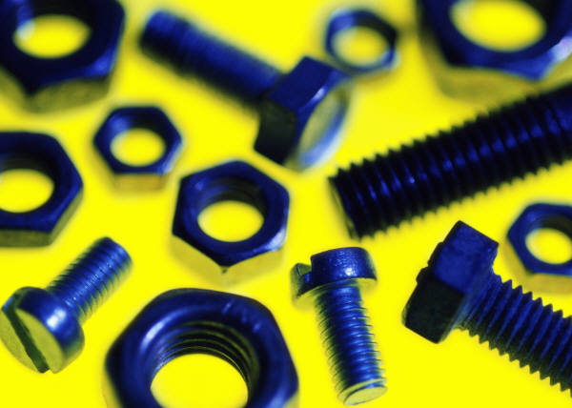
Guidelines for Reducing Manufacturing Costs
Component costs
Make or buy
Make – Design and build from raw material
Costs = Labor, equipment, tooling
In-house vs. supplier
Material selection
Tolerances
Buy – vendor – standard items (nuts, bolts, motors, gears)

Slide 24
Reduce Assembly Costs
Eliminate nonessential parts
Optimized Part Count Benefits Include
Reduced Weight
Reduced Complexity
Reduced Opportunity for Error
Reduced Assembly Time

Slide 25
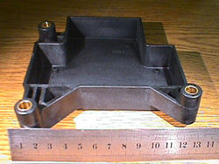
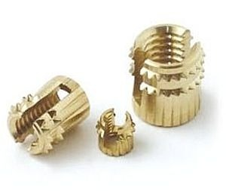
Step 3 – Reduce Assembly Costs
Eliminate nonessential parts
Integrated part - Can the part be combined with another part?
Inset molding a metal bracket in the plastic injection molding process could eliminate a fastener, assembly process, and potential point of failure.
No assembly
Reduced tooling/processing
Assist in quality specifications (orientations are set)
Notes:
Insert - http://img.directindustry.com/images_di/photo-m2/threaded-insert-for-plastic-422065.jpg
Plastic part - http://www.awi-industries.com/image/INJECTION_MOLDING_insert.jpg

Slide 26
Guidelines for Reducing Assembly Costs
Part inserted from top axis (Z) – top down assembly
Self alignment features
Tapers and chamfers
No orientation required
Phillips head screw – aligned with driver bit
One hand assembly
Less time, availability of the other hand to do another task
No tools required for assembly
Reduce the number of snap rings, cotter pins, springs, bolts/nuts
Use Single motion assembly items
Pins and snap-fits
Integrated part - Can the part be combined with another part?
Inset molding a metal bracket in the plastic injection molding process could eliminate a fastener, assembly process, and potential point of failure.
No assembly
Reduced tooling/processing
Assist in quality specifications (orientations are set)
Secure part with single motion
Press fit

Slide 27
The key to Design for Manufacture is:
Low # of materials (Hoover Dam – concrete & rebar)
Reduce skilled labor (Pyramids of Giza)
Loose tolerance requirements (Great Wall of China)
No tools required (Lego automobile)
Reduce component cost (Pig’s straw house)

Slide 28
Perceived Quality
Aspects
Actual quality
Parent brand image & history
Scarcity / exclusivity
“Made in USA”
Troy-Bilt
Cars - % retained value
Lexus vs Altima commercials
Notes:
Chinese batteries added sand for weight
Troy Bilt – bought by MTD in 2001
FIRST Lexus - http://www.youtube.com/watch?v=AktHnnA9QIM
SECOND (response) Nissan - http://www.youtube.com/watch?v=6sr3Rh7Yjnc

Slide 29
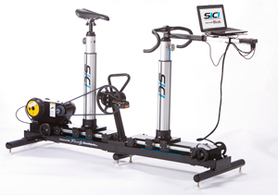
Customization
Fitted Hats
Laptop Skins
Serotta Personal Fit system
Notes:
25 paint colors, 30 decal colors, 7 different decals -> billions of combinations!
Fitted 6-3/4 through 8 in 11 choices. One size fits most 7-1/8 through 7-3/4 or 5 choices

Slide 30
Performance
Aspects
Features
Test results
Material properties / manufacturing process
Tolerance
Upper limits of design application
Alienware Computers

Slide 31
Sustainability
Aspects
Recyclability
Carbon footprint
Renewable material

Slide 32
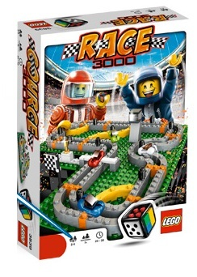
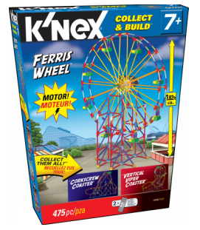
Design for ??
Legos
167 pcs
K’Nex
475 pcs
Notes:
Legos – dozen sets, always EXTRA, but small pieces
K’Nex – 3 boxes, 300-500 pieces, always PERFECT

Slide 33
Did actual # of pieces inside the box match claimed contents?
Lego – Yes. K’Nex – No.
Lego – No. K’Nex – Yes.
Both – No.
Both – Yes.
Inconsistent results, wouldn’t be appropriate to generalize.

Slide 34
Team Exercise
Work in your project teams (15 mins)
Develop a conceptual design for a vehicle based on Design for “X”
Standard features
Option packages
Six specifications and target values
Sustainability(left), Performance (center), Perceived Quality (right)

